Slide 1
Polling station staff training session
Police [Fire] and Crime Commissioner and local government elections in England
Notes:
Aim
This PowerPoint presentation has been designed to assist with the briefing of polling station staff working at Police and Crime Commissioner election combined with local government election in England.
For PAROs in Cumbria, Essex, North Yorkshire, Northamptonshire and Staffordshire ONLY, the candidate elected to the role of PCC also holds the fire and rescue authority function known as a “Police, Fire and Crime Commissioner”
Key points are covered in the slides, but the presenter will need to ensure that more detail fleshing out the key points is provided during the training session. The notes in this document can be used as talking points for this purpose.
This presentation refers to the polling station handbook and polling station quick guide produced by the Electoral Commission to support this election.
Additional materials
A copy of the Polling station handbook and Polling station quick guide (copies are available on the EC website).
Equipment
PowerPoint, flip chart, sundries box, notices, ballot papers, ballot box, sample paperwork.

Slide 2
Introduction
Local Returning Officer
Electoral Services Manager
Notes:
Introduce yourself and anyone else involved in the briefing session.
If you have any key staff who deal specifically with polling stations and/or staff issues introduce them and/or give key contact details (this may encourage people to call with questions or problems when they know exactly who it is they need to contact).

Slide 3
Which elections are being held?
  [Include all those that are applicable]
    - Police [Fire] and Crime commissioner
-district, borough, county, county borough and unitary council elections
-parish and community council elections
-combined authority mayoral elections
-mayoral elections
-mayoral referendums
Notes:
Notes for the trainer
For PAROs in Cumbria, Essex, North Yorkshire, Northamptonshire and Staffordshire ONLY, the candidate elected to the role of PCC also holds the fire and rescue authority function.
Explain the context of the poll(s).
Display a large copy of an example of what the ballot paper will look like (explaining that the actual ballot papers can’t be finalised until the nominations are closed).
Note that the PCC elections are now being run under first-past-the-post (FPTP), the voting system used at other local elections, rather than Supplementary Vote (SV) that has been used previously.

Slide 4
Your role working in a polling station
Your role is vital in ensuring voters, political parties, candidates and agents have confidence in the election process.
It is essential that you:
act impartially at all times
comply with any instructions issued by the Returning Officer
ensure the secrecy and security of the ballot
ensure voters are able to cast their vote safely and privately
call the elections office without delay in event of problems
Notes:
Notes for the trainer
Outline the session:
At this session we will:
outline what we expect you to do on polling day
discuss the voting procedures
think about health and safety issues
highlight a number of administrative arrangements
Start with highlighting the importance of polling station staff being prepared for and confident about their duties.
Explain:
The role is vital in ensuring:
that voters have confidence in the election process
that all voters have a good experience, with any person who is entitled to vote being able to do so
That all voters are able to vote in private, unless they are disabled/unable to read and they have requested assistance by either a companion or the PO
Highlight the key aims at the election:
that the poll is professionally delivered
that we produce accurate results in which all stakeholders are confident
that the process is transparent
that the poll is consistently administered

Slide 5
Staff in the polling station
Presiding Officers
Poll Clerks
Polling station inspectors
All should:
be polite and professional
understand the process for issuing ballot papers
dress appropriately
Notes:
Aim of this slide is to highlight what the main duties of Presiding Officers, Poll Clerks and polling station inspectors are and what is expected of staff working in the polling station.
Trainer - Broadly explain the main duties of staff working at the station – refer to the polling station handbook and in particular the added information regarding arrangements to help ensure the safety for all in the polling station. Emphasise that the RO has introduced additional measures which are there to protect both voters and staff during the pandemic and these will be covered in this presentation and in the polling station handbook.
Presiding Officers will:
Be in charge of proceedings
Instruct and supervise the work of the Poll Clerks
Account for all the ballot papers, ballot boxes and paperwork
Ahead of the poll, POs should:
Visit the polling place and check out contact and access arrangements
Make contact with the key holder on at least two occasions: one early on and one near to the day.
Getting the keys, alarm codes, access, facilities, furniture.
Make sure any problems with contact are highlighted to elections team immediately.
Check out arrangements for ballot box collection and check contents as soon as possible. If ballot papers are collected in advance of polling day by Presiding Officers, these should be checked in advance to ensure the ballot papers are numbered in sequence and match those pre-printed on the CNL(s) and are stored securely. Check the register and absent voting lists are the correct ones for the polling station and that the register contains the expected number of electors for your polling station.
Contact other members of the team – in particular, you should be making contact with Poll Clerks on at least two occasions. Staff problems such as possible sickness should always be referred to the elections team to manage.
Poll Clerks will:
Assist with the layout of the polling station and prepare for the opening of the poll
Check that electors are eligible to vote at that polling station
Act as a greeter if necessary
Thinking points for poll clerks –
Make sure you know where the polling station is and where you can park if you are driving
Make sure PO contact details are available – contact in case of emergency
Polling station inspectors will:
Check things are set up correctly and running smoothly
Collect any returned postal votes
Trainer - Explain what is expected of all staff working in the station
Be polite and professional in dealing with the voters
Fully understand the process for issuing ballot papers
Dress appropriately – ensure clothing reflects professionalism and impartiality but is also comfortable and warm.
Trainer - Emphasise that both Presiding Officers and Poll Clerks must work together to understand their respective roles and, where required, carry out each other’s duties.

Slide 6
Specific duties of the Presiding Officer
Certain duties must only be carried out by the Presiding Officer when certain scenarios arise. These are:
Instructing a police officer to remove someone from the polling station (but they must be allowed to vote)
Asking the prescribed questions
Limiting the number of accredited observers present at any one time
deciding to refuse to issue a ballot paper to an elector:
  if their photographic ID raises reasonable doubt as to whether the voter is the elector they claim to be or if it is reasonably suspected to be a forgery
  who has not answered the prescribed questions satisfactorily
Notes:
Trainer - List the specific duties below which must be carried out by the Presiding Officer, as defined by law. The full list can be found in the Polling Station Handbook.

Slide 7
Staying safe
All staff throughout the day should:
never put the safety of anyone inside the polling station at risk
be aware of any potential risks to safety
inspect the premises regularly
if hazards are discovered – find a remedy
if an accident occurs – follow procedures
be careful when lifting heavy objects
Notes:
The aim of this slide is to highlight the importance of health and safety for those working in the polling station.
Use common sense.
Call elections office if you find something you aren’t happy about.
Make use of polling station inspectors throughout the day

Slide 8
What happens if…
Can’t make contact with key-holder
Can’t gain access to the polling station
Staff failing to turn up or being late
A member of staff becomes ill
Problems displaying notices
Wrong registers allocated to the station
The ballot paper numbers do not match those pre-printed on the CNL
Notes:
What are the risks?
This is an interactive slice – click on the slide and the scenario will appear
Ask trainees – what they would do in each of these situations?
Q - Can’t make contact with key-holder - If you can’t make contact don’t leave it, contact the election office.
Q - Can’t gain access to the polling station – PO to contact the key-holder and / or elections office
Q – Staff failing to turn up or being late – contact the elections office
Q – Staff become ill – Staff should contact the elections office immediately for further instruction
Q – Problems displaying notices – check polling station handbook and contact the elections office
Q – Wrong register allocated to the station – contact the elections office
Q – The ballot paper numbers do not match those pre-printed on the CNL – contact the elections office
Discussion – discuss how the risks on the slide could be mitigated (emphasise that PO’s job starts before polling day). Could use flipchart.
Key learning point - Most issues can be avoided or resolved more quickly by making early contact with the elections office – MAKE CONTACT .

Slide 9
The polling station
Setting up, layout and who can enter the polling station

Slide 10
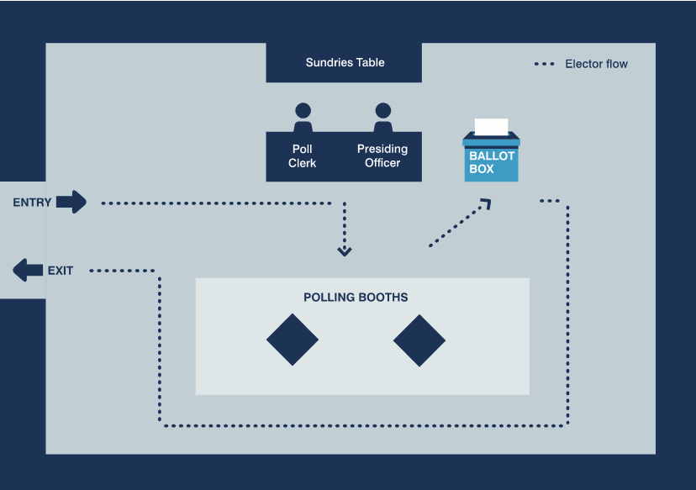
Polling station layouts
Notes:
The next 3 slides show different layouts of the polling station depending on the configuration of your venue and whether you are a single or a double polling station.
The example layouts on the slides also appear in the polling station handbook
As far as is possible the layout should support the flow of electors through the polling station and prevent bottle-necks or areas where voters can congregate, particularly around polling booths, to help maintain the secrecy of the ballot.
RO should amend to reflect local arrangements / circumstances.
Trainer - refer to the polling station set-up list in Appendix 11 of polling station handbook
When setting up the station – remember that the layout must work for the voter.
Walk route voter expected to follow – ensure route is fully accessible to all voters
Consider needs of those with mobility and visual impairments
Provide seats for electors who may need to rest
Ballot box position – accessible but safe, the PO must be able to see it clearly at all times and voters must pass by it on the route from booths to door
Privacy screen/ area- conveniently located, but positioned to allow privacy for the users
Think of the areas of the polling station where polling agents (including candidates and election agents) and observers can be positioned so that they can oversee proceedings but not get too close to put voters off.
At the discretion of the Presiding Officer, tellers can be within the building / area that has been hired but should not get too close to others and not be able to see or hear what is going on in the polling station. They cannot demand information from electors. Think where they could be, perhaps arrange chairs to encourage the tellers to keep their distance. Be aware of tellers guidance.
Other supporters and any people who may be campaigning must remain in public places such as the public street. They must not impede the electors or cause undue influence. Contact the elections office if there are any issues.

Slide 11
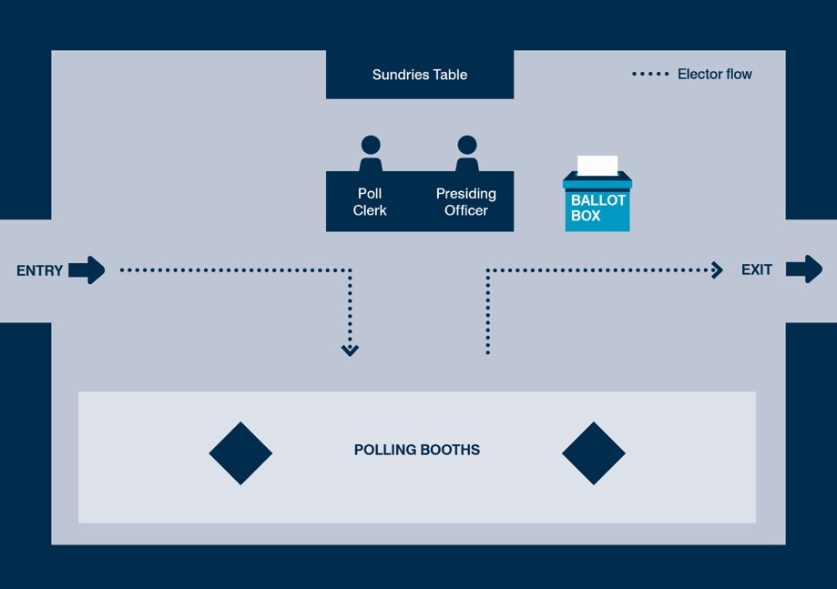
Polling station layouts (cont’d)

Slide 12
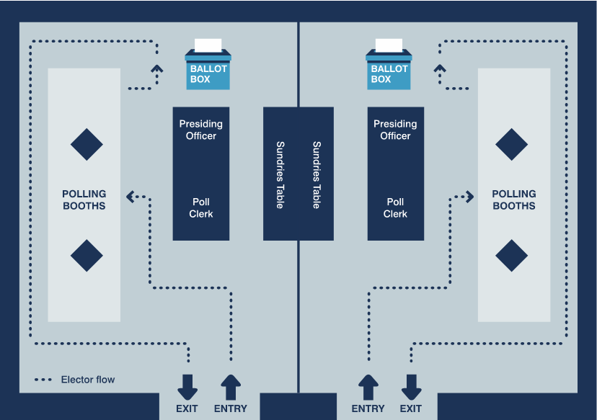
Polling station layouts (cont’d)

Slide 13
Getting ready to open the polling station
Before polls open….
check layout of the station
prepare and check the stationery
arrange the ballot papers in numerical order
prepare register, corresponding number list and ballot paper refusal list (BPRL)
Complete the polling station cehcklist
any problems - contact the elections office
Just before 7am….
show box is empty
seal just before 7am
don’t allow candidates / agents to add seal at this time
be ready to greet voters
Notes:
This slide aims to provide key points to consider on setting up before polls open.
Trainer – refer to the polling station set-up list in Appendix 11 of polling station handbook
Check layout - clear pathway – accessible to all
Check all notices up
Check privacy screens in place [if applicable]
If pencils are used, that they are ready and sharp
Check all notices up and in a place where voters can see them. Also, the graphical ‘Information for Voters’ notice in each polling booth; the notice entitled ‘Guidance for Voters’ and the notice listing the accepted photographic IDs inside the polling station.
Equipment – enlarged ballot paper, magnifier, pencil grip, tactile voting device, any other equipment provided to assist with accessibility –available for use at any time.
Trainer - have available examples of the polling station equipment and different types of notices at the briefing so that people can see it, ask how anything is used or what things are for.
Trainer – run through final tasks to carry out just before polls open.

Slide 14
Who can enter the polling station?
  Voters
  Returning Officer and staff
  Candidates and election agents
  Sub-agents at the PCC election (only in place of the election agent)
  Polling agents
  Police officers and community support officers on duty
  Representatives of the Electoral Commission
  Accredited observers
  Under 18s accompanying voters
  Companions of voters with disabilities
  Individuals aged 18 or over handing in postal votes
Notes:
Trainer - Ask trainees the question: ‘who can enter the polling station?’
Interactive slide – a click will make answers appear
Other discussion points
Can tellers wear rosettes with party names / candidates?
[Tellers should wear coloured rosettes of a reasonable size, as this assists electors by making it clear that they are activists and not electoral officials. The rosette may display the name of a candidate and/or an emblem or description]
Can the media enter the polling station to film a candidate/campaigner voting?
Representatives of the media have no right to enter a polling station except as voters or accredited observers. They must not be allowed to film or interview voters in the polling station.
NB -At the Police and Crime Commissioner election, an election agent may appoint sub-agents to attend the polling station on their behalf.

Slide 15
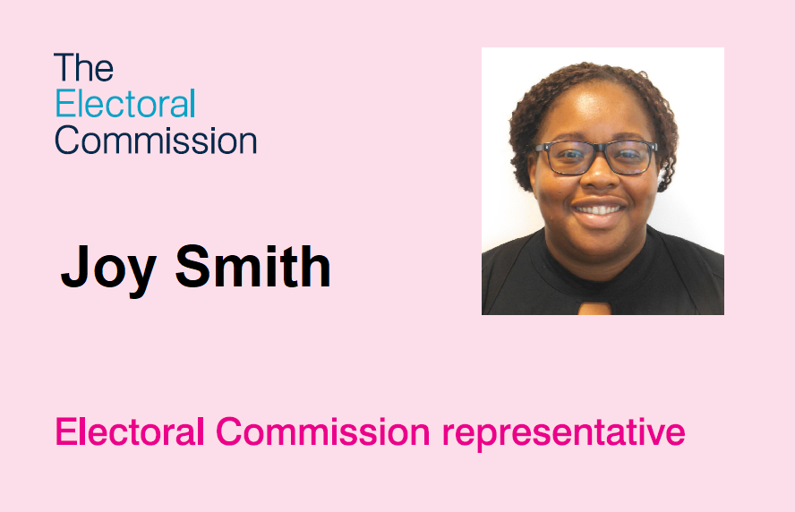
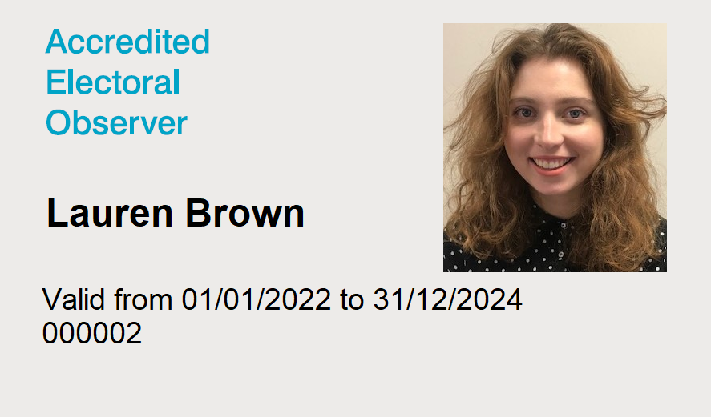
Accredited observers and Commission representatives
Notes:
The aim of this slide is to highlight what polling station staff should expect if observers and Electoral Commission Representatives visit the station.
Trainer – Explain that observation is an important part of the election process and should not be obstructed it in any way. All those who attend a polling station for the purposes of observing proceedings should follow the public health measures in place throughout.
Accredited observers and Electoral Commission representative will have photographic ID issued by the Electoral Commission
Accredited observers & Commission representatives do not need to give advanced warning of their visit, however they may have contacted the RO in advance to advise that they will be observing in your area.
Accredited observers and Commission representatives DO need to provide you with ID when they come into the station.
Silver badges (ie those issued to accredited observers) will have a start and expiry date, as well as a reference number above the picture.
To ensure the safe and effective conduct of the poll, Presiding Officers are entitled to limit the number of accredited observers (but not Commission representatives) present inside a polling station for a specified time – such as for 30 or 60 minutes. If, due to the number of electors waiting to vote or the number of observers already present, there is a risk to the safe and effective conduct of proceedings you may need to temporarily limit the number of observers and/or the amount of time observers that can stay in the polling station, to ensure that there is sufficient room to minimize close contact between people and that the poll can proceed effectively. However you cannot bar all observers from the entire process, only to limit the number of observers present at any one time. When such action is taken, this should be recorded in a polling station log.
Trainer - Refer POs to EC’ Guidance for observers: https://www.electoralcommission.org.uk/voting-and-elections/observing-elections-and-referendums/guidance-and-feedback-observing-elections and the Commission’s Polling station handbook.

Slide 16
Customer care
Be professional
Show a personal interest
Put the voter first
Be helpful and approachable
Always use English in the first instance
Allow them to put their point across before responding
Don’t say ‘No’, tell them what you can do for them and what they can do
But the election rules must be followed at all times, no matter how insistent, upset or angry they are
If in doubt, contact the elections office
Notes:
The aim of this slide is to highlight the importance of customer care, particularly if faced with a difficult situation.
Trainer - reinforce that voters who feel comfortable with the voting experience are more likely to participate regularly. All voters should receive a consistent level service.
Being positive and empathetic can often help to diffuse difficult situations.
Make sure that you do not lead voters to vote in a specific way when offering assistance.
The language used to assist or give instructions to voters in the polling station should be English. The Returning Officer may have provided instructions or guidance in alternative languages or formats depending on requirements within the community.
The Presiding Officer should be familiar with what resources are available and provide these as and when appropriate. In some exceptional cases the translated notices may not be sufficient or appropriate. For example, a voter may have low levels of literacy or may have a question that falls outside of what is covered by the notices. In those circumstances, if polling station staff are able to provide information in a language spoken by the voter, assistance in a language other than English may then be provided.
Where assistance is given in another language, you should explain to other staff and any polling agents or observers present what question has been asked and the response given.
The electoral rules must always be followed – refer to the polling station handbook and if in doubt, call the elections office.
Be aware of the security of voters personal details on the electoral register and poll cards. Ensure any poll cards left by voters at the station are destroyed in line with your document retention policy.
Discussion points
What types scenarios could occur in the polling station which may be challenging? For example, someone not on the register, someone in the wrong polling station, someone refusing to show photographic ID etc.
What strategies could be used to meet those challenges? – Talk about customer services here – active listening, remaining calm etc

Slide 17
Ensuring access for all voters – Being aware of the barriers faced by disabled voters
not all disabilities are visible or obvious
some voters may have more than one impairment
communication with electors is important
electors may use alternative methods of communication
equipment provided can help overcome certain barriers
electors may bring their own form of additional assistance
Notes:
The aim of the following 3 slides is to highlight the importance of ensuring all voters receive the same level of service and to explain the tools available to polling station staff to ensure that any barriers faced by disabled voters can be overcome or reduced.
Given the Elections Act requirement to meet accessibility standards, you may wish to have separate, specific training to cover this in more detail working in conjunction with your Equality, Diversity and Inclusion (EDI) officer or HR department.
Refer to our Guidance for Returning Officers – Assistance with voting for disabled voters
Polling station staff should have an awareness that:
not all disabilities are visible or obvious- polling station staff should not make assumptions about what equipment voters might need the importance of considering the needs of the person, not a specific disability
some voters may have more than one impairment – for example, a visual impairment and dementia. This may require a combination of different methods to enable an elector to vote
communication with electors is important- emphasise the importance of clear communication about the voting process and of clearly communicating that assistance and equipment is available if required
electors may use alternative methods of communication- cover alternative methods of communication that voters may use for example verbal, written, Makaton, and British Sign Language (BSL)
equipment provided can help overcome certain barriers- show how the equipment provided at the polling station can enable or make easier the process of voting in the polling station for disabled voters, particularly where polling station staff may be less familiar with some types of equipment, for example hearing loops
electors may bring their own form additional assistance
a voter may bring a companion to assist them in voting- more information on next slide
they may also need to have an assistance animal present- assistance animals should not be prevented from entering the polling station
voters with sight loss may use apps on their mobile phones or carry pocket-sized assistive equipment, such as video magnifiers, to help them read documents in the polling booth or in conjunction with a tactile voting device- the use of text to speech apps are acceptable for use in polling stations
TRAINER: Cover any specific equipment/support that has been provided, particularly if it has been done following a request from an elector, and any relevant public awareness campaign messages that you have been using locally

Slide 18
Ensuring access for all voters – what you can do
Clear access to the building and in the station
Speak directly to a disabled voter, even if they have a companion with them
Think about what help people with a disability and their supporters need. You could:
  ask if someone needs help
  offer to show someone the set-up in the polling station and the process of casting their vote
  explain they can vote with the assistance of the PO or a companion
Notes:
Trainer – refer to Appendix 1 in the polling station handbook
Equality issues – while physical access is important, this is not the only consideration in ensuring equality
Ensure clear access to the building and within the polling station with ramps where necessary, temporary alerters/doorbells for doors that are required to remain shut, appropriate lighting inside and out, and a reserved parking space for disabled voters if parking is available.
Ensure that any large print ballot papers, tactile voting template, magnifying glasses, easy-read/alternative format literature, easy grip pencils, chairs/seating, the wheelchair accessible booth, are all visible and available when people enter the station.
Providing assistance
Disabled voters or those who cannot read or write may ask for assistance to mark the ballot paper – Presiding Officer can do this or a companion.
Companions of voters with disabilities must be 18 years or over [companions of voters must complete a declaration (SHOW COPY)].
Companion can assist no more than 2 voters – more information in the PSH.
Secrecy of the ballot must be ensured.
Enlarged copies of the ballot paper should be available to be taken into the polling booth with a voter to assist them marking the actual ballot paper. They can also be fixed to the wall/notice board for voters to look at before they enter the booth. Your RO may provide laminated copies of the enlarged ballot papers which can be cleaned after each use, or a stock of single-use copies which can be disposed of after use.
A person who is registered as an elector or entered on the list of proxies cannot be refused a ballot paper, or in other words be excluded from voting, on the grounds of mental incapacity.

Slide 19
Ensuring access for all voters – supporting people with sight loss
voting – by making a cross in a specific location on a piece of paper – is principally a visual exercise
make sure the large-print version of the ballot paper is displayed in a well-lit area
make sure the enlarged sample ballot paper, tactile voting device and magnifier are available to voters
offer partially sighted or blind voters the enlarged sample ballot paper as a guide
make sure you know how to use the tactile voting device
the experience of someone with sight loss when they vote in a polling station – RNIB video
Notes:
Ensure that any large print ballot papers, tactile voting template, magnifying glasses and easy-read/alternative format literature are all visible and available when people enter the station.
Also make sure that you know how to use the TVD.
A blind or partially sighted elector may use an app on their mobile phone or carry pocket-sized assistive equipment, such as a video magnifier to help them read documents. These could be used in conjunction with the template.
Providing assistance
Disabled voters or those who cannot read or write may ask for assistance to mark the ballot paper – Presiding Officer can do this or a companion.
Companions of voters with disabilities must be 18 years [companions of voters must complete a declaration (SHOW COPY)]. Companion can assist no more than 2 voters – more information in the PSH.
Secrecy of the ballot must be ensured.
Enlarged copies of the ballot paper should be available to be taken into the polling booth with a voter to assist them marking the actual ballot paper. They can also be fixed to the wall/notice board for voters to look at before they enter the booth.
A person who is registered as an elector or entered on the list of proxies cannot be refused a ballot paper, or in other words be excluded from voting, on the grounds of mental incapacity.
Trainer - provide a practical demonstration of how to use the tactile voting device. Where polls are combined and different voting systems are in use, different tactile voting devices may be required for the different ballot papers.
The PO should:
Remove the sticky tape at the back of the template and affix it to the ballot paper – reiterate the adhesive backing needs to be removed so the device firmly adheres to the ballot paper
Explain to the voter how to they should use the tactile voting device and ensure the voter is confident about using it
Explain the order of the candidates on the ballot paper

Slide 20
The experience of someone with a learning disability when they vote in a polling station
Charlotte – polling station https://www.youtube.com/watch?v=xmA_ZtYqGaE
Harry – polling station https://www.youtube.com/watch?v=-KjeqUkqj5Y
Notes:
These are videos of two people from Mencap about their experiences of voting in a polling station and what they think can be done to help someone with a learning disability.

Slide 21
Who can and cannot vote?
Using the electoral register and corresponding number list

Slide 22
Who is eligible to vote at the polling station in the PCC election and local government election?
Electors with no letters or dates before their name
Electors who are 18 years of age or over on the day of the election – date on or before polling day before their name
Electors with a ‘G’ or ‘L’ before their name
[only include if relevant] Electors who have registered anonymously - will have an ‘N’ instead of a name
Notes:
This slide outlines who can vote at PCC and local government elections.
Trainer – talk through each category of elector and how the register will be marked.
G = Citizen of European Union who is only entitled to vote at PCC elections, local government elections and in devolved elections
L = Peer who is entitled to vote at PCC elections, local government elections and in devolved elections
The following electors must not be given a ballot paper in the polling station:
Electors who will not be 18 years of age until after polling day
Electors with an ‘A’ before their name (postal voters)
Electors with an ‘E’ before their name (overseas peers)
Electors with an ‘F’ before their name (overseas electors)
Electors without an accepted form of ID

Slide 23
Voter ID Checks
all electors are required to show an accepted form of photographic ID in order to receive a ballot
the image on the photographic ID must have a good likeness of the elector and be genuine
electors may present an accepted form of photographic ID, on which the name varies from the name of the elector on the register of electors
some electors may request for their ID to be checked in private
expired documents can be accepted as long as the photo still has a good likeness of the elector
Notes:
This slide outlines the purposes and processes connected to Voter ID
Use the Voter ID list to show examples of the accepted voter ID and list specific examples that you expect to be used frequently in your area. Full list is in the Polling Station Handbook
Highlight the point that a poll clerk can check an elector's ID, but if they are not satisfied that it is genuine or that it resembles the elector, the Presiding Officer must make the final decision as to allow a ballot paper or not.
If you have greeters then you should highlight that greeters should not check a voter’s photographic ID, this must be done inside the polling station as part of the ballot paper issuing process.
Cover any arrangements or practical solutions you have in place for the provision of private ID checks, such as using a privacy screen or a separate room in certain polling stations and the provision of mirrors. If you have a contingency plan in place for any stations without a female member of staff, such as having female polling station inspectors available, explain this procedure.
No other people are entitled to be present in the polling station can observe a private ID check.
The purpose of the photographic ID check is to ensure the elector is the person in front of you. Therefore, the key information on the ID is the photo.
Name variations can be accepted if they are reasonable. You should not reject a form of ID because of a minor discrepancy with the name on the ID and the register, eg a double-barrelled name or shortened form of their official name, as long as you are satisfied that the person is the elector they claim to be.
If the name is sufficiently different to that on the electoral register, the poll clerk should refer the matter to the presiding officer to make further enquires or ask for additional evidence to explain the differences. The PO can then determine if the explanations/ evidence given are satisfactory and make a decision to issue or refuse to issue the elector a ballot paper.
Further information on the process is in the Polling station handbook
Separate ID type for anonymous electors will be covered in anonymous elector slides.

Slide 24
Accepted
ID
a passport issued by the UK, any of the Channel Islands, the Isle of Man, a British Overseas Territory, an EEA state, or a Commonwealth country (including an Irish Passport Card)
a driving licence issued by the UK, any of the Channel Islands, the Isle of Man, or an EEA state
a biometric immigration document
an identity card bearing the Proof of Age Standards Scheme hologram (a PASS card)
a Ministry of Defence Form 90 (Defence Identity Card)
a Blue Badge
a national identity card issued by an EEA state
an Older Person’s Bus Pass funded by the UK government
a Disabled Person’s Bus Pass funded by the UK government
an Oyster 60+ Card funded by the UK government
a Freedom Pass
a Scottish National Entitlement Card for the purpose of concessionary travel
a 60 and Over Welsh Concessionary Travel Card
a Disabled Person’s Welsh Concessionary Travel Card
a Senior SmartPass issued in Northern Ireland
a Registered Blind SmartPass or Blind Person’s SmartPass issued in Northern Ireland
a War Disablement SmartPass issued in Northern Ireland
a 60+ SmartPass issued in Northern Ireland
a Half Fare SmartPass issued in Northern Ireland
an Electoral Identity Card issued in Northern Ireland
a Voter Authority Certificate
an Elector’s Document issued to an anonymous elector
Notes:
Expired documents can still be used as accepted photographic ID at the polling station as long as the photograph is still a good likeness of the elector.
Electors with anonymous entries on the register must produce their Elector’s Document as their form of photographic ID in order to vote.
What should you look for when checking an elector’s photographic ID?
You should check that the photographic ID is included on the list of accepted photographic ID shown above.
You should check that the photographic ID includes a photo that has a good likeness of the elector:
Does the person have any distinguishing features e.g. moles, scars etc?
Compare the shape of the face and look at the position of the main features (e.g. eyes, ears, nose, mouth) in relation to the rest of the person’s face
You should check that the photographic ID appears to be genuine/not forged:
Does the ID resemble the sample image shown on the placemat provided?
Is the photographic ID an original, not a scan, photo or copy of the document?
Is there any damage or signs of tampering, especially in areas where the photo or name are shown (except where cancelled passports have been returned with cut corners to indicate that they can no longer be used as an official travel document)?
You should not refer to any other markers on the photographic ID (for example address details or nationality, age or gender markers).

Slide 25
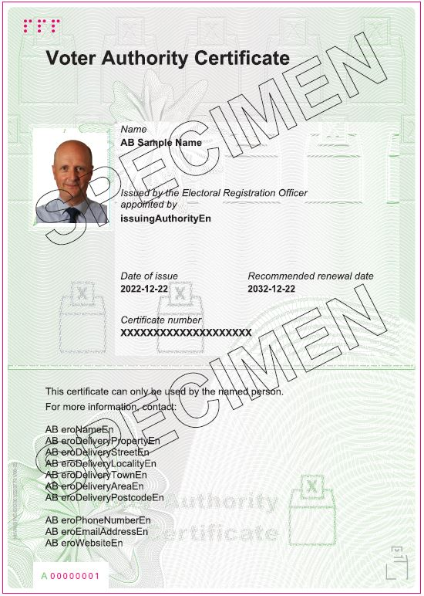
Voter Authority Certificate (VAC)
Notes:
An example of the Voter Authority Card (VAC)- you may have an idea of the total number of these issued so far.
The Voter Authority Certificate must include:
the applicant’s full name
the applicant’s photograph
the date of issue
the appropriate identifier- is made up of 20 numbers or letters generated by the EROP
the words 'issued by the Electoral Registration Officer appointed by [insert the name of the Local Authority]'
the recommended renewal date
one or more security features recommended by the Home Secretary
VACs issued by other ERO’s in different Local Authorities are still valid if the elector has since moved. These could be bilingual if issued in Wales.
Explain that there may also be temporary VACs issued- example on next slide

Slide 26
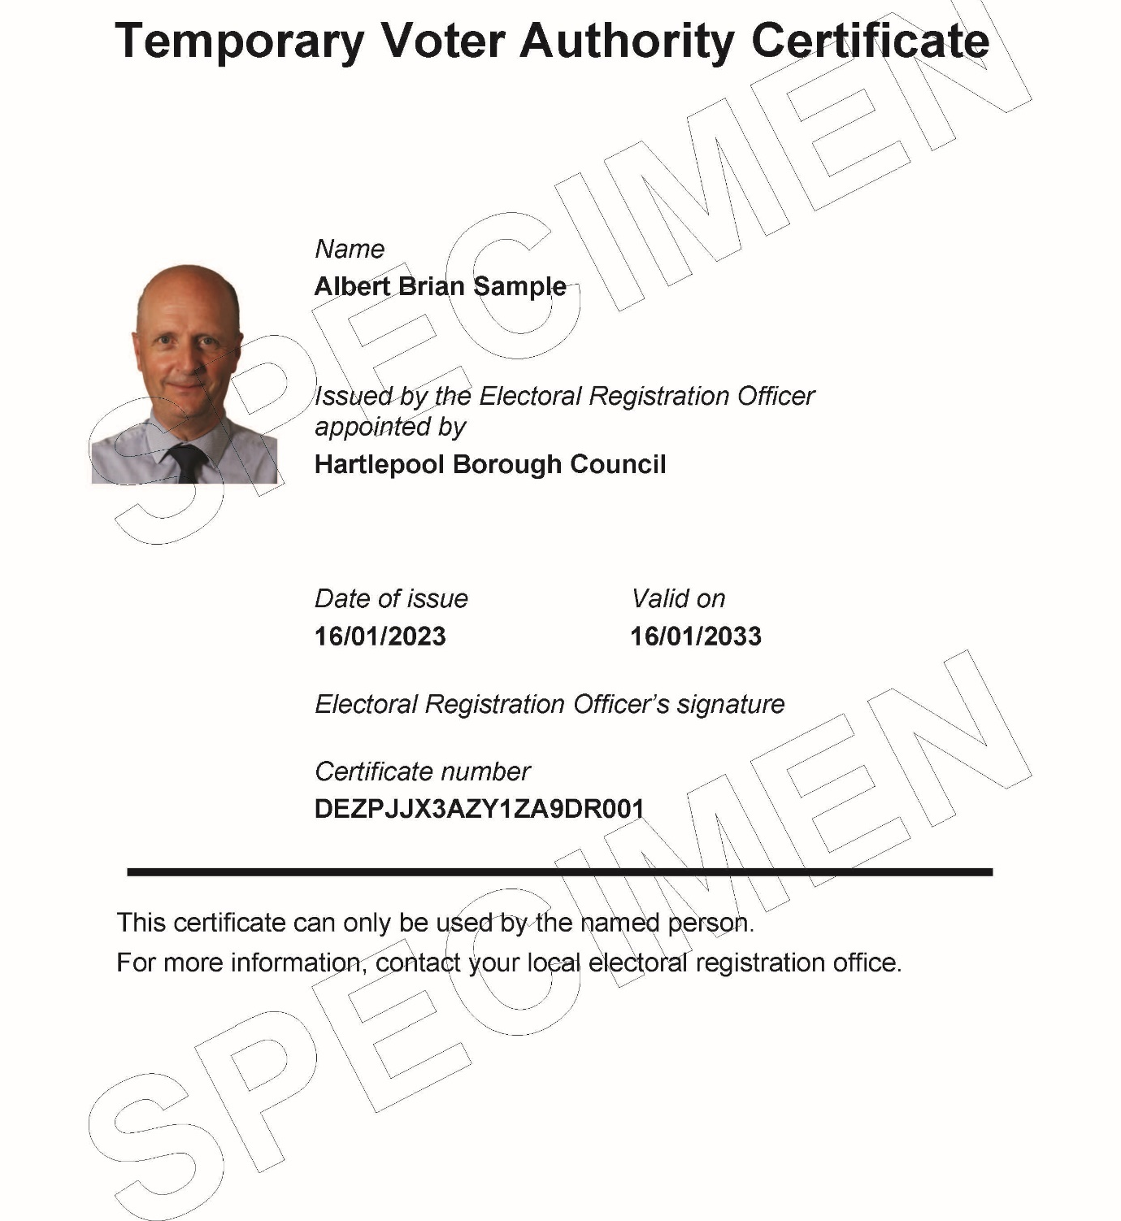
Temporary Voter Authority Certificate (VAC)
Notes:
Example of a Temporary Voter Authority Certificate
A temporary Voter Authority Certificate is valid only on the relevant date of a specific election or for the remaining period of a petition.
A temporary Voter Authority Certificate must include:
the elector’s full name
the date of issue
the name of the local authority by which the ERO was appointed
an appropriate identifier-made up of 20 numbers or letters generated by the EROP
the date for which the temporary Voter Authority Certificate is valid
the applicant’s photograph
the ERO’s signature
The ERO’s signature can be provided by a deputy and should be a wet ink signature, or it may be an electronic signature or stamp.
You should explain any additional local security measures used to identify the documents as authentic.

Slide 27
Marking the register and completing the Voter ID paperwork
Marking the register, the Corresponding Numbers List (CNL) and the Ballot Paper Refusal List (BPRL)
  Ask the elector to confirm their name and address
  Ask the elector for their photographic ID
  Mark against their elector number in the register
  Update the BPRL and [include if applicable] the VIDEF notes sheet if necessary
  Enter the elector number on the CNL
  Do NOT write the elector number on the ballot paper!
Notes:
The aim of this slide is to summarise the marking of the register and how to complete the voter ID paperwork, explain corresponding number lists, and the BPRL
Explain that exceptions are dealt with separately and are covered in more detail in the Commission’s polling station handbook.
Marking of the register- example in next slide
Ballot Paper Refusal list- example in later slide
This provides an audit trail of the Presiding Officer’s decisions whenever they refuse to issue a ballot. The Presiding Officer is required to record on the BPRL throughout the day the details of the total number of electors (or proxies) who are refused a ballot paper on the following grounds:
the photograph was not a good likeness
the Presiding Officer believed the photographic ID was a forgery
the elector failed to answer the prescribed questions satisfactorily
The BPRL will also be updated if an elector returns later with accepted photographic ID, that is a good likeness and is issued with a ballot paper.
Voter Identification Evaluation Form
If the VIDEF is being used, the VIDEF notes sheet will be completed to collect data which will be used to produce a record of specific issues relating to the checking of photographic ID. This will help with the evaluation of how the ID requirements are working in practice.
Corresponding number list – show example in later slide
There is a separate sheet of paper for the elector number to be written on - The elector number is written beside the number of the ballot paper to be issued.
NOTHING must be written on the ballot paper.

Slide 28
Marking the register
Queen’s Walk |  |  | BC
 |  |  | JP12 7AS
411 G |  | Vella, Eva | 1
412 F |  | Vella, Tolek | 1
413 |  | Vella, Christina | 1
414 |  | Brown, Robert | 3
415 |  | Evans, Gareth | 5
416 |  | Hall, Peter | 7
417 |  | Myers, Martin | 7
418 A |  | Bishop, Stephanie | 13
418/1 | 4 May 2016 | Smith, Ben | 13
Notes:
The aim of this slide it to provide a demonstration of how to mark the register – consistently and accurately.
An example of a register marked for elector numbers 414 and 416.
Use a ruler to draw the line
Mistakes can be made as a result of poor quality/wobbly marks.
Be especially careful to accurately mark the register where there are family members with the same surname.
Always ask for full name and address – unless you are dealing with an anonymous elector - even if the elector has presented you their poll card.
Discussion points – Trainer to ask questions
Can 415 vote? Yes. No marker against their name.
Can 412 vote? No. They are an overseas voter and cannot vote in the PCC election.
Can 418 vote? No. They are a postal voter so you cannot give them an ordinary ballot paper.
Can 418/1 vote? Yes. They will be 18 on poling day.
Can 411 vote? Yes. They are a citizen of an EU member state and are entitled to vote at local and PCC elections.
Poll cards are not needed to vote (except for anonymous electors), and even where they are presented the elector’s name and address should still be asked for.

Slide 29
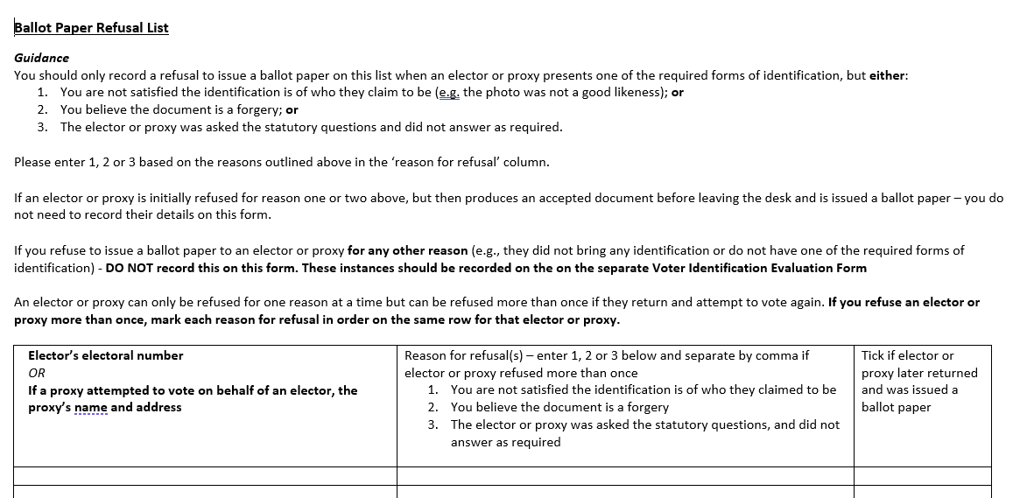
Ballot Paper Refusal List (BPRL)
Notes:
The Ballot Paper Refusal List (BPRL)-
You should only record a refusal to issue a ballot paper on this list when an elector or proxy presents one of the required forms of identification, but either:
You are not satisfied the identification is of who they claim to be (e.g. the photo was not a good likeness); or
You believe the document is a forgery; or
The elector or proxy was asked the statutory questions and did not answer as required.
If an elector or proxy is initially refused for one of the above reasons, but then produces an accepted document before leaving the desk and is issued a ballot paper – you do not need to record their details on this form.
If you refuse to issue a ballot paper to an elector or proxy for any other reason (e.g., they did not bring any identification or do not have one of the required forms of identification) - DO NOT record this on this form.
An elector or proxy can only be refused for one reason at a time but can be refused more than once if they return and attempt to vote again. If you refuse an elector or proxy more than once, mark each reason for refusal in order on the same row for that elector or proxy.

Slide 30
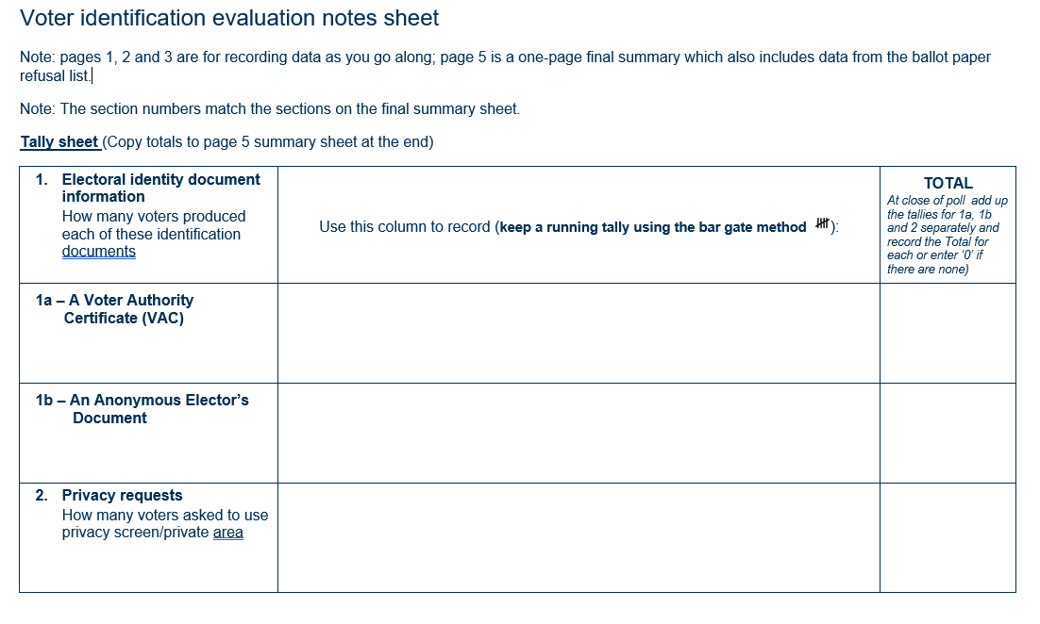
Voter ID Evaluation Form notes sheet
[slide to be used only if relevant]
Notes:
[To be included if applicable] This is an example of the Voter ID Evaluation notes sheet which will be updated throughout the day.
You should use it to tally the number of electors that have:
Produced a Voters Authority Certificate
Produced an Anonymous Electors Document
Requested a private area for the voter ID check
You should also use it to record the details of any electors who were turned away without being issued a ballot paper because:
They produced an unaccepted form of ID
They were unable to produce any form of ID
And also record whether they later returned and were issued with a ballot paper.
At the close of poll the information used on this sheet will be used to complete the Voter ID Evaluation Form (VIDEF) example on late slide in Close of Poll section.

Slide 31

Example Corresponding Number List (CNL)
BC 27/1
Notes:
31
Ballot paper numbers will be pre-printed on the list so all you need to write on is the elector number next to the relevant ballot paper number. Do not write the elector number on the ballot paper.

Slide 32
Issuing the ballot papers
Ballot papers
  fold then open up fully so the whole paper is visible before handing to the elector
  official mark
  ballot paper number
  Unique Identifying Mark (UIM)
Notes:
Make clear NOTHING must be written on the ballot paper.
For combination: Always give all the ballot papers the voter is entitled to receive, don’t ask which ones they want. Only if the voter tells you that they only want some of the ballot papers (before you have issued any to that voter) do you then only issue the ones that the voter has asked for. Only if the voter tells you that they only want some of the ballot papers (before you have issued any to that voter) do you then only issue the ones that the voter has asked for. You should place the ballot paper down on the table in front of you for the voter to pick up.
The official mark will be [explain your official mark]. Refer to slide with example. Explain about watermark/barcode. Explain how to improvise an official mark – perforate the paper – in the absence of a watermark/barcode
Ballot papers must be issued in strict numerical order commencing with the lowest number in the batch. Otherwise, problems will be experienced at the close of poll when completing the ballot paper account
The UIM will be [explain your UIM]. The UIM is another security device and is useful for a court if an election is challenged

Slide 33
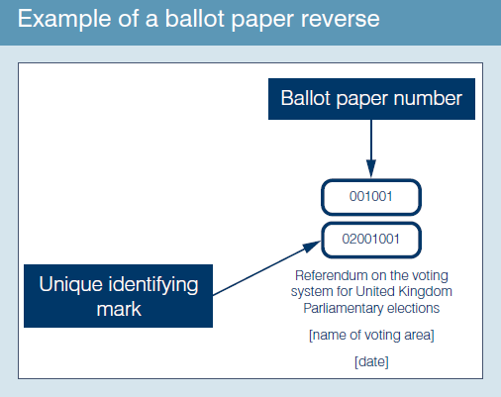
Example reverse of ballot paper
Notes:
Check that the ballot papers bear the unique identifying mark on the back (see example).

Slide 34
Providing information on the number of ballot papers issued
An election agent or polling agent might ask you for information on the number of ballot papers issued.
You can obtain the current total number of ballot papers that have been issued as follows:
the ballot paper number of the next ballot paper to be issued
minus
the ballot paper number of the first ballot paper issued
minus
the total number of spoilt ballot papers in the envelope for spoilt ballot papers (if any)
Notes:
*You should only include this slide if you have decided to allow the provision of this information
This request may come under the guise of ‘how busy have you been’ or ‘what is the rolling turnout figure’ etc?
You should only deal with requests where to do so would not negatively impact on any voters who are in a queue at the polling station and are waiting to be issued with a ballot paper. If this is not possible, you should advise the agent making the request to return later.
You can find the number of the next ballot paper to be issued by looking at:
the back of the next ballot paper to be issued; or
the corresponding number list (i.e. the list pre-printed with ballot paper numbers against which you record the elector’s number when you issue a ballot paper)
You can find the number of the first ballot paper issued by looking at:
the first ballot paper number on the corresponding number list
You must place spoilt ballot papers in the envelope provided, count them at the close of poll and enter the total figure on the ballot paper account. You should keep a running tally of spoilt ballot papers to avoid having to count them each time a request is made.

Slide 35
Anonymous electors [slide to be used only if relevant]
Anonymous electors
  Must have poll card
  Marked ‘N’ on register
  Name and address must not be called out
  Mark the register by their poll number as usual
Notes:
Only use this slide if you have anonymous electors
Explain anonymous elector voting procedure – refer to polling station handbook
Poll card should be returned to the elector to protect privacy
Anonymous electors can only use the Elector’s Document as their accepted form of ID
Show example on next slide if relevant

Slide 36
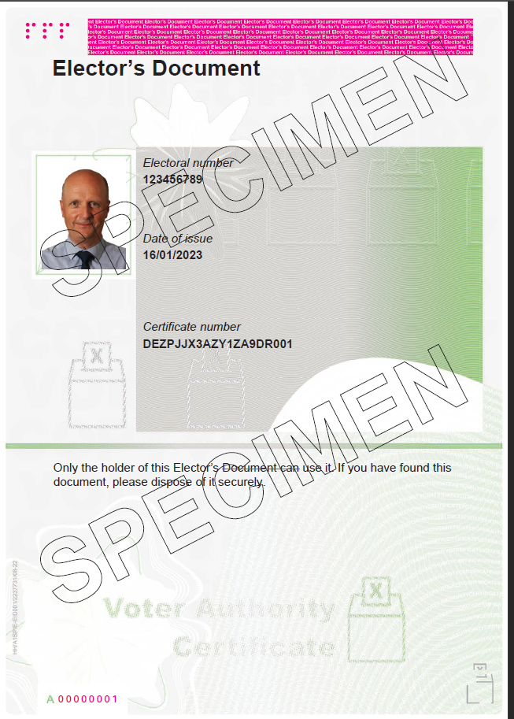
Example of Elector’s Document
(AED)
[slide to be used only if relevant]
Notes:
Anonymous electors must show an AED in order to receive a ballot paper. They cannot use any other accepted ID.
These are printed on specialist paper containing a serial number
An Elector’s Document must include:
the date of issue
the applicant’s photograph
the applicant’s electoral number
the appropriate identifier- made up of 20 numbers or letters generated by the EROP.
The electors name will not be on the AED

Slide 37
Secrecy of the vote
Make sure voters go to polling booths individually so that their right to a secret vote is protected.
No other person is allowed to accompany a voter to a polling booth unless a voter who is disabled or unable to read has requested assistance to vote.

Slide 38
Secrecy of the vote - power to order removal
if you observe someone attempting to accompany a voter in the voting booth who is not their appointed companion, then you must approach them and ask them not to do so
if they fail to comply with this request the presiding officer can order them not to do so
if someone fails to comply with this order the presiding officer has the power to order their removal from the polling station
Notes:
*More information on keeping order in the polling station can be found in the appendix in the polling station handbook.
If an elector is accompanied by their child, under the age of 18, then they are entitled to accompany them.

Slide 39
Marking the ballot paper for the local government election
Some electors may need to have the voting process explained to them:
Voters at local government elections may be able to vote for more than one candidate depending on how many candidates are to be elected, and should place an ‘X’ in the box to the right of the name of the candidate(s) for whom they wish to vote.
Notes:
Modify as required.
Show ballot papers for the elections.
Explain that the top of the ballot paper gives the instructions on how to complete the ballot papers. Some voters may still find the instructions unclear. They may ask, for example, to have their favoured candidate or party pointed out to them, or ask where they should make their mark on the ballot papers. In these circumstances, the Presiding Officer should read out the instructions printed at the top of each ballot paper and the list of candidates in the order that they appear on the ballot papers.
Explain that voters can only vote for the maximum number of candidates allowed on the ballot paper (according to the instructions) - usually at local government elections, voters have between one and three votes (but at parish elections there may be more).

Slide 40
Marking the Police and Crime Commissioner election ballot paper
The Police and Crime Commissioner is elected under the first-past-the-post electoral system, whereby the candidate with the most votes is elected.
voters put an ‘X’ in the box next to the candidate of their choice
Notes:
The Police and Crime Commissioner will be elected under the first-past- the-post electoral system. Voters will be asked to place an ‘X’ in the box next to the candidate of their choice on the ballot paper.

Slide 41
If voter ask you how to vote…..
If a voter asks you how to vote, read out the instructions at the top of each ballot paper
If voters make a mistake, simply follow the spoilt procedure
Don’t get into conversations about the election, the police, the council or anything other than how to vote
More information in the Polling Station Handbook
Notes:
Highlight importance of staff being professional and impartial when talking to voters.
If asked by a voter, how to vote/what to do – staff can explain:
The top of the ballot paper gives the instructions on how to complete the ballot paper.
Some voters may still find the instructions unclear. They may ask, for example, to have their favoured candidate or party pointed out to them, or ask where they should make their mark on the ballot paper. In these circumstances, the Presiding Officer should read out the instructions printed at the top of the ballot paper and the list of parties and / or candidates in the order that they appear on the ballot paper.
In these circumstances, the Presiding Officer should read out the instructions printed at the top of the ballot paper and the list of candidates in the order that they appear on the ballot paper.
Even if you know about the topic the voter has a complaint about, or even work for the council, explain that you can’t talk about that today and direct them to contact the council if they wish after they have voted. On polling day you are working for the Returning Officer, not the council.

Slide 42
What happens if…?
you are handed a certificate of employment
a voter spoils a ballot paper
a voter has nominated a proxy but the voter arrives before the proxy
a person arrives to vote but the register indicates the person has already voted
a person arrives to vote but the register indicates the person is a postal voter
a person arrives wanting to vote as an emergency proxy
a person believes they should be on the register but they are not listed
there is a disturbance at the polling station
Notes:
Interactive slide –
Either work in groups or ask for answers from the trainees.
Use this slide to explain special voting procedures.
Explain what a certificate of employment looks like and what information the staff need from that form. Even with a certificate of employment the elector will need to follow the normal issuing process including providing an accepted photographic ID.
If the voter spoils their ballot paper they must be issued a replacement and the PO must account for any spoilt papers on the ballot paper account.
If the voter arrives before the nominated proxy then the proxy cannot vote and must be told the situation.
This is a situation where the PO must put the prescribed questions to the voter before issuing a tendered ballot paper.
Questions about a person’s registration should be directed to the electoral registration office.
Electors or proxies marked as having been issued with a postal vote cannot be given an ordinary ballot paper in the polling station. However, an elector or proxy who claims never to have applied for a postal vote but is listed as a postal voter, is entitled to receive a tendered ballot paper at the polling station at any time. Alternatively, up until 5pm on polling day, they may be issued with a replacement postal ballot pack but only by the Returning Officer at the elections office. The Presiding Officer should refer the elector or proxy to the Returning Officer for advice on this procedure.
An elector may appoint an emergency proxy to vote on their behalf at the polling station in certain circumstances:
in the case of a disability (whether a medical condition, illness or otherwise) arising after the deadline for ordinary proxy applications (i.e. after 5pm on the sixth working day before the poll)
if they are a mental health patient detained under civil powers (i.e., who are not also detained offenders)
if their occupation, service or employment means they cannot go to the polling station in person, provided that they only become aware of this fact after the deadline for ordinary proxy applications (i.e. 5pm on the sixth working day before the poll)
if they meet any of the conditions relating to emergency proxies on the grounds of voter identification after the deadline to apply for a Voter Authority Certificate or Anonymous Elector’s Document (i.e. 5pm on the sixth working day before the poll), i.e. where their photographic ID lost, stolen, destroyed or so damaged that it is no longer useable, or have sent away or applied for ID that has not been returned or received in time for polling day
Emergency proxies can be granted up until 5pm on polling day. Explain how any updates would be notified on polling day.
If the voter has arrived at the correct polling station then contact electoral services as there may have been a clerical error when compiling the register – outline the process to be followed.
Emphasise that the poll is never to be adjourned on the PO’s own initiative.
For further detail on the above please see the Commission’s polling station handbook.
[The Commission has developed a polling station scenarios role play which can be to support this slide].

Slide 43
What happens if….?
(Voter ID)
  a voter produces a photographic ID that is not on the accepted ID list
  a voter refuses to provide photographic ID and demands a ballot paper
  a voter does not have an accepted voter ID
  a voter is known to the polling staff
  the photographic ID provided does not resemble the voter
  the voter’s name on the register is different from the name on the photographic ID
  a voter is wearing a face covering and refuses to remove it to verify their identity
  a voter’s photographic ID appears to be a forgery
Notes:
A voter produces a photographic ID that is not on the accepted ID list
The PC will explain what forms of photographic ID can be accepted and ask the voter to return with an accepted form of ID.
A registered voter refuses to provide photographic ID and demands a ballot paper
The PC will explain to the voter that voters are required by law to show photographic ID before being issued with a ballot paper at certain elections, including Police and Crime Commissioner elections. They will ask the voter to return with an accepted form of ID, they can then issue the voter with a ballot paper.
A registered voter does not have an accepted voter ID
If the elector does not have an accepted form of photographic ID they cannot be given a ballot.
They may be entitled to an emergency proxy, if it is before 5pm and they do not have their ID because:
the elector or proxy’s photographic ID is lost, stolen, destroyed or so damaged that it is no longer useable, or they have sent away or applied for ID that has not been returned or received in time for polling day
an anonymous elector has not been issued with the necessary Elector’s Document
A voter is known to the polling staff
Even if the polling staff personally know the elector, they must still show an accepted form of photographic ID
The photographic ID provided does not have a good likeness of the voter
The PC will refer the matter to the PO. The PO will check the ID and if they have reasonable doubt that the voter is the elector they claim to be they will:
explain to the elector that they do not think the image on the photographic ID has a good likeness of the elector
they will ask the elector to return with an accepted form of ID that does bear a current likeness of the elector
the PO will check the BPRL to see if the elector has an existing entry, if they do, the PO will record they have been turned away again. If they haven’t, the PO will make a new entry including the voter’s elector number and write number ‘1’ in the Reason for refusal column.
The voter’s name on the register is different from the name on the photographic ID
The PC must refer the matter to the PO. The PO can request additional evidence to make a connection between the photographic ID and the name on the register, such as a marriage certificate, divorce papers or deed poll. If the elector is unable to provide additional evidence and the PO still has reasonable doubt that the ID is the elector’s, the PO will:
ask the elector to return with another accepted form of ID that does contain their name as it appears on the register
the PO will check the BPRL to see if the elector has an existing entry, if they do, the PO will record they have been turned away again. If they haven’t, the PO will make a new entry including the voter’s elector number and write number 1 in the Reason for refusal column.
A voter is wearing a face covering and refuses to remove it to verify their identity
The PC will explain that it is mandatory to provide photographic ID, and that the law does not allow them to issue a ballot paper unless they can verify the ID by comparing the picture with the elector’s face. The PC should also explain that there is an area where this can be done in private with a member of polling station staff.
A voter’s photographic ID appears to be a forgery
The PC must pass the photographic ID to the PO for a decision. In this scenario the PO agrees there is reasonable doubt that the photographic ID is a forgery. The PO will:
hand the ID back to the elector and explain that they think the photographic ID is a forgery and advise the elector to return with an alternative form of accepted photographic ID
the PO should then check the BPRL for any previous entries for the elector to see if they have been turned away previously. They should then update the BPRL accordingly and write the number ‘2’ in the Reason for Refusal column
this should also be recorded in the polling station log book so that the RO can be made aware of suspected forged photographic ID.
[The Commission has developed a polling station scenarios roll play which can be used to support this slide].

Slide 44
The prescribed questions
No enquiry or questioning of electors is allowed other than asking the prescribed questions
The prescribed questions must be asked:
  when a candidate, an election agent or polling agent requests them
  before issuing a tendered ballot paper
The prescribed questions should be asked:
  when you suspect personation
  when a registered elector is clearly under age
  when an elector states their name is not as shown in the register of electors
Notes:
Refer to Appendix 5a of the polling station handbook.
Make clear that only the prescribed questions are able to be asked if there is concern about the eligibility of a person who applies for a ballot paper. If there is concern then ask the prescribed questions and record the event in the polling station log.
Make clear the point that they must not ask any other questions about the qualification to vote other than the prescribed questions.
The Presiding Officer may only issue an ordinary or tendered ballot paper, as appropriate, to anyone who has answered the questions correctly and has shown an accepted form of photographic ID.
The prescribed questions cannot be used to override reasonable doubt that the elector is who they claim to be (either because of a name variation or the photo does not resemble the elector) or where it appears that the photographic ID is a forged document.
Refer to: Personation advice for Presiding Officers and Log to record details of postal voters who claim not to have applied for a postal vote available on the Commission’s website.

Slide 45
Postal votes being handed in at the polling station
voters can hand in their postal votes at any polling station within the voting area
a postal vote return form must be completed to enable the polling station staff to determine if the postal votes are to be accepted or rejected
if the form is not completed in full, the polling station staff must reject the postal vote(s)
returned postal ballot packs must be stored, sealed and labelled as instructed
postal votes may be collected during the day. Any not collected will be returned with the ballot box at close of poll
Notes:
TRAINER: refer to appendix 3a of the Polling Station Handbook
The procedure for receiving postal votes handed in at the polling station is covered in slide 45 and 46
[insert any local instructions]

Slide 46
Who can hand in postal votes at the polling station
an individual can hand in:
  their own postal vote
  as well as postal votes for up to five other people
political campaigners can only hand in:
  their own postal vote
  and up to five others who are either a close relative or someone for whom they provide regular care
Anyone handing in postal votes must complete a postal vote return form
Notes:
If there are multiple polls taking place and postal votes for these polls have been issued separately, the postal votes handed in must still only belong to a total of 5 other electors – but there may be multiple postal votes per elector.
If an individual is not sure if they are a political campaigner, a definition is provided on the back of the postal vote return form which polling station staff should encourage them to read. This will help them determine if they can hand in the postal vote(s).
an individual can hand in:
their own postal vote
as well as postal votes for up to five other people
political campaigners can only hand in:
their own postal vote
and up to five others who are either a close relative or someone for whom they provide regular care
Polling station staff should not determine if someone is a campaigner (although if they have reasonable cause to suspect that an individual is a campaigner, they can reject – but extreme care should be taken on this point).
A Political campaigner is (as set out on reverse of postal return form):
a candidate at the election;
an election agent of a candidate at the election;
a sub-agent of an election agent at the election;
employed or engaged by a person who is a candidate at the election for the purposes of that person’s activities as a candidate;
a member of a registered political party who carries out an activity designed to promote a particular outcome at the election;
employed or engaged by a registered political party in connection with the party’s political activities;
employed or engaged by a person listed in (a) to (f) above, to carry out an activity designed to promote a particular outcome at the election;
employed or engaged by a person within paragraph (g) to carry out an activity designed to promote a particular outcome at the election
Anyone handing in postal votes must complete a postal vote return form when doing so otherwise the postal votes must be rejected. This form must be completed in the polling station and cannot be supplied and completed in advance.

Slide 47
Procedure for receiving postal votes handed in at the polling station
- Completion of the postal vote return form
confirm that the postal vote(s) can be returned to your polling station and inform the individual that they will need to provide some details to return the postal votes
polling station staff should assist the individual with completing section 1 of the form
the individual to check the information provided in section 1 is correct and to complete section 2
if satisfied that the form has been completed correctly with the required information, accept the postal votes and complete section 3A of the form
Notes:
Refer to appendix 3a of the Polling Station Handbook.
Explain the procedure for receiving postal votes handed in at the polling station. Both Presiding Officers and Poll Clerks may complete the postal vote return form, including determining whether to accept or reject the postal votes being handed in.
If you are using greeters then you should ensure that they do not accept postal votes without the postal vote return form being completed.
Stage 1
Polling station staff should explain to the individual that the postal vote return form must be completed correctly otherwise the postal votes will be rejected.
Stage 2
Polling station staff should assist the individual with completing the postal vote return form, particularly on the completion of section 1.
Section 1 of the form requires the following information:
If the individual is handing in their own postal vote
If the individual is handing in postal votes for any other people, and if so, how many (a maximum of 5)
If the individual is a political campaigner
and if the individual:
Is handing in no more than the permitted number of postal votes
has confirmed that they are not a political campaigner or
that they are a political campaigner but are handing in postal votes for close relatives or people for whom they provide regular care
Although not defined in law, we believe that it will be beneficial for polling station staff to follow this approach because it will:
be the most efficient process for staff to follow
ensure a consistent approach for all individuals who want to hand in postal votes
reduce the risk of postal votes being rejected as mistakes on the form will be picked up with the individual handing them in
reduce the risk of individuals refusing to fill in the form and just leaving postal votes on the desk
reduce the risk of post-election complaints about incorrect completion of the form leading to postal votes being rejected
Stage 3
Section 2 requires the individual to provide their name and address, and if they are handing in postal votes for other people, the reason why.
The individual must also read and complete a declaration confirming that:
they have not handed in more than the permitted number of postal votes
they are not a political campaigner, or
they are a political campaigner and have only handed in their own postal vote and/or that of a close relative, or someone for whom they provide regular care
The individual must them sign and date the form.
Stage 4
In order to accept the postal votes, polling station staff must be satisfied that:
the postal vote return form has been completed correctly with the required information
the individual has only handed in as many postal votes as they are entitled to, and
the individual is not a political campaigner, or is a political campaigner who has only submitted their own postal vote and/or postal votes of close relatives or people for whom they provide regular care

Slide 48
Procedure for receiving postal votes handed in at the polling station
- Storage of handed in postal votes
Once you are satisfied the form has been completed fully, thank the individual and inform them the postal votes will be forwarded to the Returning Officer
Put the postal votes in the packet for accepted postal votes
Put the completed postal vote return form in the appropriate packet
More detail on the process is contained in the Polling Station Handbook.
Notes:
Refer to appendix 3a of the Polling Station Handbook.
Polling station staff should place the accepted postal vote(s) unopened, in the packet provided.
The packet must be kept secure at all times. You should inform staff of any local arrangements for the collection of postal votes handed in at polling stations or delivered to the count centre at the close of poll.
Staff should ensure that completed postal vote return forms are kept separately from the packet contain the accepted postal votes. You should confirm the local arrangements for returning the packets to you at the close of poll.
[The Commission has developed a polling station scenarios roll play which can be used to support these slides].

Slide 49
Rejecting postal votes handed in at the polling station
There are 4 situations when you must reject postal vote(s) that are handed in. These are where the individual:
did not fully complete the postal vote return form
handed in more postal votes on behalf of other electors than permitted
is a campaigner not permitted to handle the postal votes
did not complete the postal vote return form
In all of these cases you must complete section 3B of the postal vote return form.
More detail on the process is contained in the Polling Station Handbook.
Notes:
Refer to appendix 3a of the Polling Station Handbook.
You should explain the process for rejecting postal votes and discuss the different situations.
Polling station staff should explain to the individual that the postal vote return form must be completed by law and the postal votes cannot be handed in without it. Any postal votes that are left behind at the polling station without the form being completed will be rejected.
Individuals are only allowed to hand in their own postal vote and postal votes for up to 5 other people.
If an individual tries to submit more postal votes than permitted, the individual should determine which postal votes they wish to submit. They may leave the polling station to make the decision.
The individual can hand in the permitted number of postal votes and leave the polling station with the remaining postal votes.
If the individual insists on handing in postal votes for more than 5 other people, all the postal votes for the other people must be rejected. Polling station staff can only accept the individual’s own postal vote.
More information on completing the postal vote return form in this scenario is provided in the Polling Station Handbook.
You should talk through with polling station staff what to do in the scenario where a campaigner insists on handing in postal votes that are not from close relatives or someone for whom they provide care. They should advise the individual that:
It is an offence for political campaigners to handle postal votes which are not their own, those of close relatives or those of someone for whom they provide care
any postal votes that are handed in which belong to other people except those set out above will be rejected.
the Returning Officer will notify the police where they suspect an offence has been committed.
In all of these situations the details of the rejected postal votes must be recorded in section 3 of the postal vote return form and attached to the rejected postal votes.
[Local instructions on how to bundle rejected postal votes]
[The Commission has developed a polling station scenarios roll play which can be used to support this slide].

Slide 50
Postal votes
A’ markers cannot be given ordinary ballot papers at the polling station:
  direct to Returning Officer for replacement
    if a person has spoilt, lost or not received their postal ballot paper, it can be replaced until 5pm
  tendered ballot paper procedure
Notes:
Explain the procedure for directing people for a replacement ballot pack and explain tendered ballot paper procedure.

Slide 51
Close of poll
The procedures to be followed

Slide 52
Managing a queue
  Just before 10pm:
  make sure those waiting can cast their vote
  check that anyone waiting to vote is at the correct polling station for their address
At 10pm:
  bring all the waiting electors into the room/building and close the door, OR
  if the room/building is not big enough, a member of the team should stand at the end of the queue to mark it, OR
  Hand out tokens to identify electors in the queue
  continue to issue ballot papers until everyone who was in the queue by 10pm has voted
Anyone who was not in the queue at 10pm must NOT be issued with a ballot paper
Notes:
Explain that it is rare for there to be queues to vote at 10pm but there could be a queue even with only a few people. If someone arrived at the polling station in time, it is their right to cast their vote.
If there are lengthy queues at any point in the day, particularly in the last couple of hours before the close of poll, polling station staff should contact the election office to discuss the situation and agree how to deal with it.
Electors must be in the queue for the polling station they have been allocated to. If they are in the queue for a different polling station in the same polling place or at the wrong polling place altogether, unless they get to the right one and are in the queue there by 10pm, they will be unable to vote.
Staff should manage a queue at the close of poll by either bringing all the electors into the room or building and closing the door so no-one else can join the queue after 10pm, or if the room or building isn’t large enough, a member of the polling station team should stand (socially distanced) at the end of the queue to mark it and explain to anyone arriving that the polls closed at 10pm and, by law, they cannot vote.

Slide 53
Close of poll
Once the last voter has voted, seal the ballot box(es)
Candidates/agents are also entitled to affix seals to the ballot box(es) at this point
Notes:
The PO should seal the ballot box and begin to complete paperwork and pack up the polling station with the Poll Clerk(s).

Slide 54
Absolutely essential that the ballot paper accounts are completed accurately
The ballot paper accounts – must be kept with the ballot box(es)
[to be included if relevant] The VIDEF will need to be completed using the data recorded during the day on the VIDEF notes sheet and BPRL
Ensure all documents placed in correct packets and signed as appropriate
Poll clerks to assist packing up station to allow Presiding Officer to do these important tasks
After close of poll
Notes:
Trainer - You could run a mock exercise in how to fill in the ballot paper account. The Commission has developed such an exercise as part of its suite of support materials.
Take time to complete the ballot paper accounts and make sure this is done accurately - otherwise it will cause problems at the count.
Take time to ensure that all documents are placed in the correct packets and are signed as appropriate.
Explain any other local arrangements with regard to equipment and left over sundries and stationery.
An example of the VIDEF is on the following slide [if using].
Data protection – poll cards need to be disposed of securely and in line with both data protection legislation and your authority’s data retention policy.
Give any specific instructions regarding the transportation of ballot boxes and polling station materials to the verification and count centre, including any instructions for the safe delivery of materials.

Slide 55
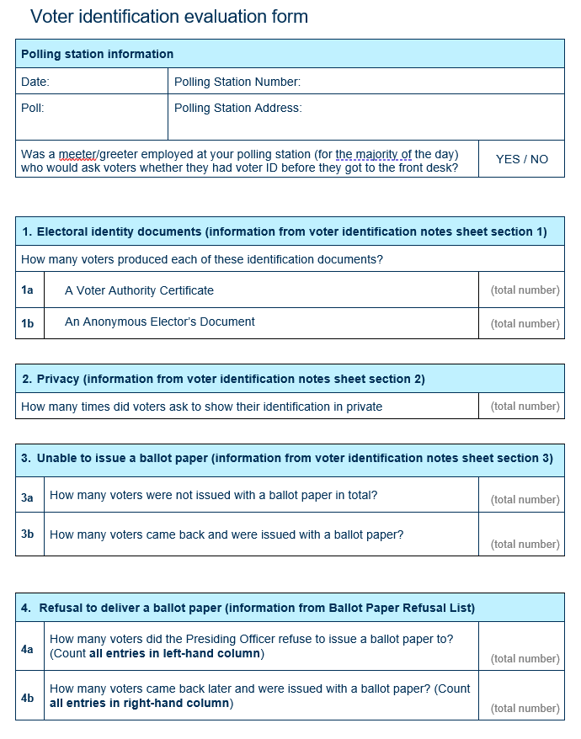
Voter ID Evaluation Form
(VIDEF)
[to be included if relevant]
Notes:
The VIDEF will need to be completed using the information recorded on the VIDEF notes sheet and BPRL during the day.

Slide 56
Any questions?
Notes:
You may want to test if all the polling station staff have understood and feel fully confident about their role on the day. [The Commission has developed a multi-choice quiz which can be used for this purpose as part of its suite of support materials].

Slide 57
Additional Information
Election team contacts
Electoral Commission website
  www.electoralcommission.org.uk
Feedback sheets
Notes:
Personalise this slide as appropriate.

