Slide 1
Polling station staff training session
Local government elections in Wales
Notes:
Notes for trainer:
Aim of the presentation
This PowerPoint presentation has been designed to assist with the briefing of polling station staff for local government elections in Wales.
Key points are covered in the slides, but the presenter will need to ensure that more detail fleshing out the key points is provided during the training session. The notes in this document can be used as talking points for this purpose.
This presentation refers to the polling station handbook and polling station quick guide produced by the Electoral Commission to support this election.
Additional materials required
A copy of the Polling station handbook and Polling station quick guide. (copies are available on EC website)
Equipment
PowerPoint, flip chart, sundries box, notices, ballot papers, ballot box, sample paperwork.

Slide 2
Introduction
Returning Officer
Electoral Services Manager
Notes:
Notes for the trainer
Introduce yourself and anyone else involved in the briefing session.
If you have any key staff who deal specifically with polling stations and/or staff issues introduce them and/or give key contact details (this may encourage people to call with questions or problems when they know exactly who it is they need to contact).

Slide 3
Which elections are being held?
[Include all those that are applicable]
county and county borough elections
community council elections
Notes:
Notes for the trainer
Explain the context of the poll(s).
Display a large copy of an example of what the ballot paper will look like (explaining that the actual ballot papers can’t be finalised until the nominations are closed).
Explain that more information on the voting system and the instructions to be given to voters in each case can be found in the polling station handbook.
Some areas may have principal area wards with more than three members to be elected. Explain that while the polling station handbook may talk about voters having between one and three votes, in those circumstances, voters will still have as many votes as there are candidates to be elected.

Slide 4
Your role working in a polling station
Your role is vital in ensuring voters, political parties, candidates and agents have confidence in the election process.
It is essential that you:
act impartially at all times
comply with any instructions issued by the Returning Officer
ensure the secrecy and security of the ballot
ensure voters are able to cast their vote safely by making sure that that any measures put in place by the RO in light of the coronavirus pandemic are observed throughout the day
call the elections office without delay in event of any problems
Notes:
Notes for the trainer
Outline the session:
At this session we will:
outline what we expect you to do on polling day
discuss the voting procedures
think about health and safety issues, including measures to mitigate the spread of coronavirus
highlight a number of administrative arrangements
Start with highlighting the importance of polling station staff being prepared for and confident about their duties.
Explain:
The role is vital in ensuring:
that voters have confidence in the election process
that all voters have a good experience, with any person who is entitled to vote being able to do so
Highlight the key aims at the election:
that the poll is professionally delivered
that we produce accurate results in which all stakeholders are confident
that the process is transparent
that the poll is consistently administered

Slide 5
Staff in the polling station
Presiding Officers
Poll Clerks
Polling station inspectors
All should:
be polite and professional
understand the process for issuing ballot papers
  dress appropriately
  follow any public health guidelines in place
Notes:
Aim of this slide is to highlight what the main duties of Presiding Officers, Poll Clerks and polling station inspectors are and what is expected of staff working in the polling station.
Trainer - Broadly explain the main duties of staff working at the station – refer to the polling station handbook, and in particular the added information regarding arrangements to help ensure the safety for all in the polling station. Emphasise (if relevant) that the RO has introduced additional measures which are there to protect both voters and staff during the pandemic and these will be covered in this presentation and in the polling station handbook
Presiding Officers will:
Be in charge of proceedings
Instruct and supervise the work of the Poll Clerks
Account for all the ballot papers, ballot boxes and paperwork
Ahead of the poll, POs should:
Visit the polling place and check out contact and access arrangements
Make contact with the key holder on at least two occasions: one early on and one near to the day.
Getting the keys, alarm codes, access, facilities, furniture.
Make sure any problems with contact are highlighted to elections team immediately.
Check out arrangements for ballot box collection and check contents as soon as possible. If ballot papers are collected in advance of polling day by Presiding Officers, these should be checked in advance to ensure the ballot papers are numbered in sequence and match those pre-printed on the CNL(s) and are stored securely. Check the register and absent voting lists are the correct ones for the polling station and that the register contains the expected number of electors for your polling station.
Contact other members of the team – in particular, you should be making contact with Poll Clerks on at least two occasions. Staff problems such as possible sickness (including coronavirus and its associated symptoms, or the need to self-isolate) should always be referred to the elections team to manage.
Poll Clerks will:
Assist with the layout of the polling station and prepare for the opening of the poll
Check that electors are eligible to vote at that polling station
Thinking points for poll clerks –
Make sure you know where the polling station is and where you can park if you are driving
Make sure PO contact details are available – contact in case of emergency
Polling station inspectors will:
Check things are set up correctly and running smoothly
Collect any returned postal votes
Trainer - Explain what is expected of all staff working in the station
Be polite and professional in dealing with the voters
Fully understand the process for issuing ballot papers
Dress appropriately – ensure clothing reflects professionalism and impartiality but is also comfortable and warm, especially given the need to ensure adequate ventilation in polling stations for public health reasons, which may mean that windows and doors remain open.
Trainer - Emphasise that both Presiding Officers and Poll Clerks must work together to understand their respective roles and, where required, carry out each other’s duties.

Slide 6
Staff in the polling station – coronavirus considerations
[Slide to only be used if relevant]
Welcoming voters and alerting them to information notices relating to public health requirements such as keeping your distance where possible and face coverings
Encouraging voters to clean their hands on entry and exit
Providing information to voters about how they should navigate through the polling station
Managing the flow of voters into and out of the station
Notes:
Aim of this slide is to highlight some of the additional duties required owing to coronavirus. Please adapt as relevant to your local arrangements and to the restrictions or regulations in place at the time.
Trainer - There are a number of additional duties for this set of polls that staff will need to undertake
[Add your own messaging about who will be responsible for what here, for example you may have employed ‘Greeters’ or marshalls to carry out these duties, or they may be the responsibility of poll clerks]
The type of additional help that may need to be provided to voters so that they can cast their vote safely includes:
Welcoming voters and ensuring they have read information notices relating to public health requirements, such as only entering if well and free of coronavirus symptoms, the need to wear face coverings and keep their distance where possible throughout the polling station
Providing information to voters about how they should navigate through the polling station to cast their vote and exit safely, including any measures in place to facilitate this, and any information regarding the use of own/provided pencils and pens
Encouraging voters to clean their hands on entry to and exit from the polling station, and offering face coverings to voters who do not have one.
Managing the flow of voters into and out of the station, as well as any queues that may form outside, to ensure that people keep their distance where possible.

Slide 7
Specific duties of the Presiding Officer
Certain duties must only be carried out by the Presiding Officer when certain scenarios arise. These are:
Instructing a police officer to remove someone from the polling station (but they must be allowed to vote)
Limiting the number of accredited observers present at any one time
Notes:
Trainer - List the specific duties below which must be carried out by the Presiding Officer

Slide 8
Staying safe
All staff throughout the day should:
never put the safety of anyone inside the polling station at risk
be aware of any potential risks to safety
inspect the premises regularly
if hazards are discovered – find a remedy
if an accident occurs – follow procedures
be careful when lifting heavy objects
[follow coronavirus public health advice]
Notes:
The aim of this slide is to highlight the importance of health and safety for those working in the polling station.
The specific coronavirus requirements are included on the next slide in detail
Use common sense.
Call elections office if you find something you aren’t happy about.
Make use of polling station inspectors throughout the day

Slide 9
Staying safe – Covid considerations
[Slide to only be used if relevant]
Public health principles that everyone should follow when in the polling station:
keep your distance where possible
clean hands regularly (including on entry and exit)
avoid touching your face
wear a face covering, where necessary
no-one should attend the polling station if they are unwell, symptomatic with COVID-19, a confirmed case or are legally required to self-isolate
Notes:
The aim of this slide is to highlight the importance of the key coronavirus public health measures in place; keeping your distance where possible, clean hands, avoid touching the face and wear a face covering where needed. To be adapted as relevant based on arrangements in your area.
All staff must take into consideration any additional instructions from the RO
Trainer to cover:
1. The lay out of the polling station the importance of encouraging people to keep their distance throughout the station. [separate slide in presentation] [add local instructions such as use of screens, floor markings, one-way flow]
2. Additional signage; go through additional public health notices and where these should be displayed.
3. Ensure that the polling station is regularly cleaned throughout the day (particularly touchpoints such as doors, polling booths and writing implements)
Any additional help that may you may need to provide to voters so that they can cast their vote safely [covered in the Duties of the Poll Clerk’ section of the Polling Station handbook]
A staff member greeting the voters ensuring they have read the information notices, and explain the need to wear face covering and keep their distance throughout the polling station
Provide information to voters about the safety measures put in place for their safe navigation through the polling station / voting journey
Encouraging voters to clean / sanitise their hands on entry and exit from the polling station
Managing number and flow of voters in the station, including any queues that may form during the day
Unless other measures such as individual screens, whilst sitting at the desk all polling station staff should wear face coverings in line with public health advice as well as when moving around in the station.

Slide 10
Staying safe – Covid considerations
[Slide to only be used if relevant]
The Presiding Officer and their staff should remind and encourage electors to follow public health guidelines but it is not the responsibility of the Presiding Officer to challenge any voter who is not following coronavirus public health regulations such as wearing a face covering.
The Presiding Officer and their staff should not prevent a voter from entering the station and voting if not wearing a face covering.
Notes:
The PO and their staff should remind and encourage electors to follow public health guidelines but It is not the responsibility of the PO to challenge any voter who is not following coronavirus public health regulations such as wearing a face covering. The PO and their staff should not prevent a voter from entering the station and voting if not wearing a face covering.
What if…. a voter refuses to wear face covering?
Staff should gently remind and encourage voters to wear a face covering unless exempt, but should not challenge or prevent a voter from entering the station and voting if not wearing a face covering.

Slide 11
What happens if……..
Can’t make contact with key-holder
Can’t gain access to the polling station
Staff failing to turn up or being late
A member of staff develops coronavirus symptoms
Problems displaying notices
Wrong registers allocated to the station
The ballot paper numbers do not match those pre-printed on the CNL
Someone enters the polling station without a face covering
Notes:
What are the risks?
This is an interactive slide – click on the slide and a scenario will appear
Ask trainees – what they would do in each of these situations?
Q - Can’t make contact with key-holder – If you can’t make contact don’t leave it, contact the elections office.
Q - Can’t gain access to the polling station – PO to contact the key holder and/or elections office.
Q - Staff failing to turn up or being late – contact the elections office
Q – Staff develop coronavirus symptoms – they should leave the polling station immediately and go home, without touching anything as far as possible. Remaining staff should contact the elections office immediately for further instruction
Q - Problems displaying notices – check polling station handbook and contact the elections office
Q - Wrong registers allocated to the station – contact the elections office
Q - The ballot paper numbers do not match those pre-printed on the CNL – contact the elections office
Q – Someone enters without a face covering - Everyone entering the polling station should follow public health guidelines including wearing a face covering unless exempt, and staff should remind and encourage those who arrive not earing a face covering to wear one unless exempt and offer face coverings as needed. However, you should not prevent anyone from voting for not wearing a face covering in the polling station.
Discussion – discuss how the risks on the slide could be mitigated (emphasise that PO’s job starts before polling day). Could use flipchart.
Key learning point - Most issues can be avoided or resolved more quickly by making early contact with the elections office – MAKE CONTACT .

Slide 12
The polling station
Setting up, layout and who can enter the polling station

Slide 13
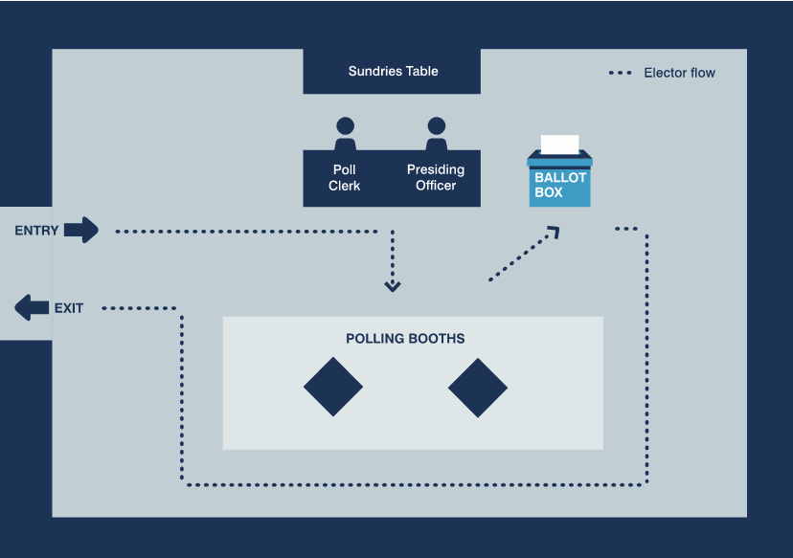
Polling station layouts
Notes:
The next 3 slides show different layouts of the polling station depending on the configuration of your venue and whether you are a single or a double polling station.
The example layouts on the slides also appear in the polling station handbook
As far as is possible the layout should utilise a one-way system throughout the station and allow for adequate ventilation – with windows open where possible. There may be further adaptations depending on local public health advice in light of Covid - RO should amend to reflect local arrangements / circumstances, for example:
Polling booths positioned at a safe distance apart
Tables arranged in a way that allows safe distance between the voter and the polling station staff and the staff themselves
Screens (if provided) placed between the voter and polling station staff
Trainer - refer to the polling station set-up list in Appendix 11 of polling station handbook
When setting up the station – remember that the layout must work for the voter.
Walk route voter expected to follow – ensure route is fully accessible to all voters, and that it is possible for them to keep their distance
Consider needs of those with mobility and visual impairments
Provide seats for electors who may need to rest, ensuring that they are a safe distance away from any other attendees
Ballot box position – accessible but safe, the PO must be able to see it clearly at all times and voters must pass by it on the route from booths to door
Think of the areas of the polling station where polling agents (including candidates and election agents) and observers can be positioned so that they can oversee proceedings but not get too close to put voters off.
At the discretion of the Presiding Officer, tellers can be within the building / area that has been hired but should keep their distance and not be able to see or hear what is going on in the polling station. They cannot demand information from electors. Think where they could be, perhaps arrange chairs to encourage the tellers to keep their distance. Be aware of tellers guidance.
Other supporters and any people who may be campaigning must remain in public places such as the public street. They must not impede the electors or cause undue influence. Contact the elections office if there are any issues.

Slide 14
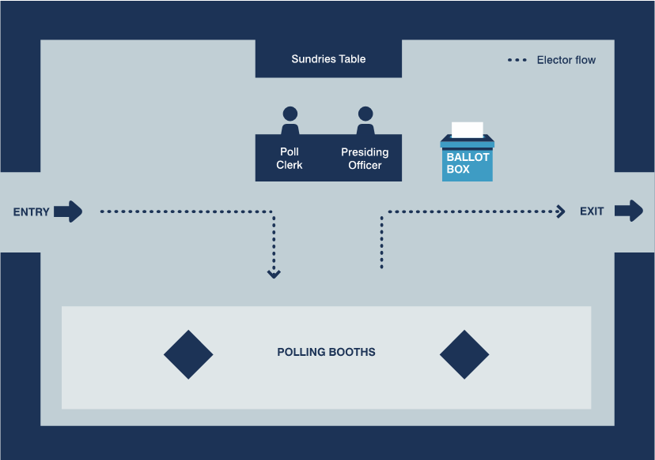
Polling station layouts (cont’d)

Slide 15
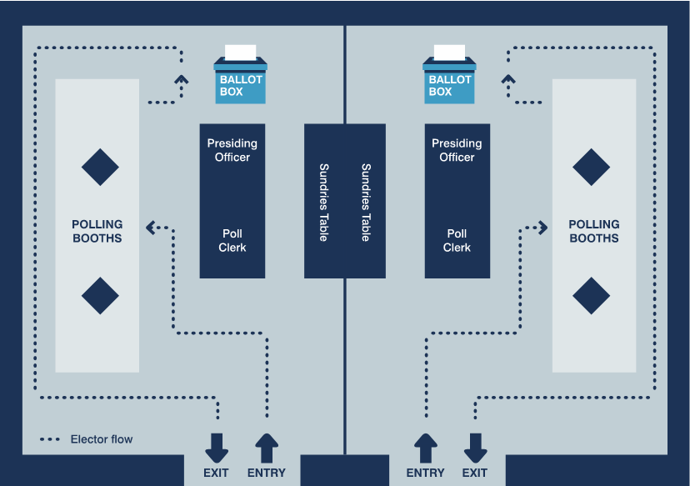
Polling station layouts (cont’d)

Slide 16
Getting ready to open the polling station
Before polls open….
check layout of the station
prepare and check the stationery
arrange the ballot papers in numerical order
prepare register and corresponding number list
complete the polling station checklist
any problems - contact the elections office
Just before 7am….
show box is empty
seal just before 7
don’t allow candidates / agents to add seal at this time
be ready to greet voters
Notes:
This slide aims to provide key points to consider on setting up before polls open.
Trainer – refer to the polling station set-up list in Appendix 11 of polling station handbook
Covid considerations [insert local arrangements]
Check layout - clear pathway – accessible to all – public health measures in place
Check all notices up, including additional public health notices in prominent positions
Check screens in place [if applicable] and that you have your face coverings to hand
If pencils are used, that they are ready and sharp
Check cleaning equipment is on hand
Check all notices up and in a place where voters can see them. Also, the graphical ‘Information for Voters’ notice in each polling booth; the notice entitled ‘Guidance for Voters’ inside the polling station.
Equipment – enlarged ballot paper, magnifier, tactile voting device –available for use at any time.
Trainer - have available examples of the polling station equipment and different types of notices at the briefing so that people can see it, ask how anything is used or what things are for.
Trainer – run through final tasks to carry out just before polls open.

Slide 17
Who can enter the polling station?
Voters
  Returning Officer and staff
  Candidates and election agents
  Polling agents
  Police officers and PCSOs on duty
  Representatives of the Electoral Commission
  Accredited observers
  Under 16s accompanying voters
  Companions of voters with disabilities
Notes:
Trainer - Ask trainees the question: ‘who can enter the polling station?’
Interactive slide – a click will make answers appear
16/17 year olds –– At local elections taking place on or after 5 May 2022, The Local Government and Elections (Wales) Act 2021 extends the franchise to 16/17 year olds.
NOTE - If election before 5 May 2022 , franchise is for voters is 18 and over. Those under 18 accompanying voters can enter the polling station
Discussion points
Can tellers wear rosettes with party names / candidates?
[Tellers should wear coloured rosettes of a reasonable size, as this assists electors by making it clear that they are activists and not electoral officials. The rosette may display the name of a candidate and/or an emblem or description]
Can the media enter the polling station to film a candidate/campaigner voting?
Representatives of the media have no right to enter a polling station except as voters or accredited observers. They must not be allowed to film or interview voters in the polling station.
Mayoral referendums
In addition to the above, the following can attend:
polling observers
the elected mayor (at mayoral referendums where the council already has an elected mayor)
petition organisers (if any)

Slide 18
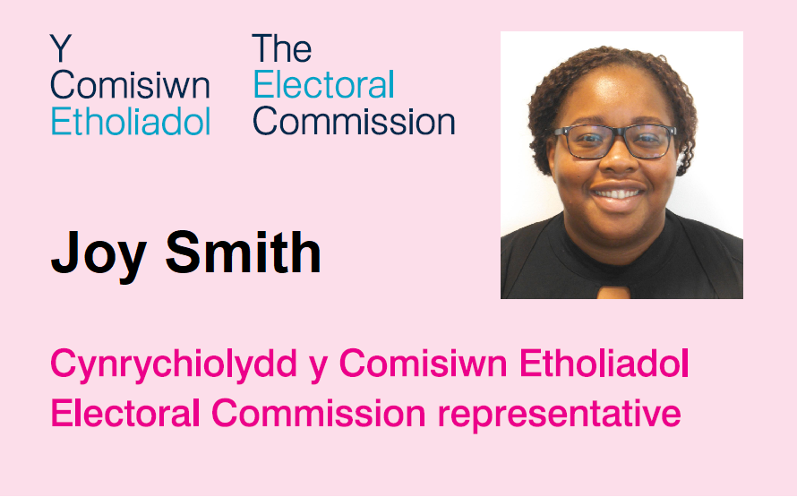
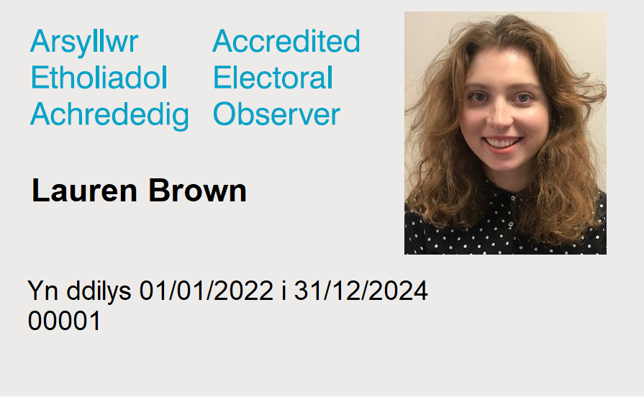
Accredited observers and Commission representatives
Notes:
The aim of this slide is to highlight what polling station staff should expect if observers and Electoral Commission Representatives visit the station.
Trainer – Explain that observation is an important part of the election process and should not be obstructed it in any way. All those who attend a polling station for the purposes of observing proceedings should follow any public health measures in place throughout.
Accredited observers and Electoral Commission representative will have photographic ID issued by the Electoral Commission
Accredited observers & Commission representatives do not need to give advanced warning of their visit, however they may have contacted the RO in advance to advise that they will be observing in your area.
Accredited observers and Commission representatives DO need to provide you with ID when they come into the station.
Silver badges (ie those issued to accredited observers) will have a start and expiry date, as well as a reference number above the picture.
To ensure the safe and effective conduct of the poll, Presiding Officers are entitled to limit the number of accredited observers (but not Commission representatives) present inside a polling station for a specified time – such as for 30 or 60 minutes. If, due to the number of electors waiting to vote or the number of observers already present, there is a risk to the safe and effective conduct of proceedings you may need to temporarily limit the number of observers and/or the amount of time observers that can stay in the polling station, to ensure that there is sufficient room for people to keep their distance where possible and that the poll can proceed effectively. However you cannot bar all observers from the entire process, only to limit the number of observers present at any one time. When such action is taken, this should be recorded in a polling station log.
Trainer - Refer POs to EC’ Guidance for observers: https://www.electoralcommission.org.uk/who-we-are-and-what-we-do/elections-and-referendums/observing-elections-and-referendums/guidance-and-feedback-observing-elections and the Commission’s Polling station handbook.

Slide 19
Customer care
Be professional
Show a personal interest
Put the voter first
Be helpful and approachable
Always use English or Welsh in the first instance
Allow them to put their point across before responding
Don’t say ‘No’, tell them what you can do for them and what they can do
But the election rules must be followed at all times, no matter how insistent, upset or angry they are
Public health guidelines should be followed, however you must allow all electors to vote
If in doubt, contact the elections office
Notes:
The aim of this slide is to highlight the importance of customer care, particularly if faced with a difficult situation.
Trainer - reinforce that voters who feel comfortable with the voting experience are more likely to participate regularly. All voters should receive a consistent level service.
Being positive and empathetic can often help to diffuse difficult situations.
Make sure that you do not lead voters to vote in a specific way when offering assistance.
The language used to assist or give instructions to voters in the polling station should be English or Welsh. The Returning Officer may have provided instructions or guidance in alternative languages or formats depending on requirements within the community.
The Presiding Officer should be familiar with what resources are available and provide these as and when appropriate. In some exceptional cases the translated notices may not be sufficient or appropriate. For example, a voter may have low levels of literacy or may have a question that falls outside of what is covered by the notices. In those circumstances, if polling station staff are able to provide information in a language spoken by the voter, assistance in a language other than English or Welsh may then be provided.
Where assistance is given in another language, you should explain to other staff and any polling agents or observers present what question has been asked and the response given.
The electoral rules must always be followed – refer to the polling station handbook and if in doubt, call the elections office. Public health guideline should be followed but you must allow all electors to vote.
Be aware of the security of voters personal details on the electoral register and poll cards. Ensure any poll cards left by voters at the station are destroyed in line with your document retention policy.
Discussion points
What types scenarios could occur in the polling station which may be challenging? For example, someone not on the register, someone in the wrong polling station etc.
What strategies could be used to meet those challenges? – Talk about customer services here – active listening, remaining calm etc

Slide 20
Ensuring access for all voters – what you can do
Clear access to building and in station
Speak directly to a disabled voter, even if they have a companion with them
Think about what help people with a disability and their supporters need. You could:
  ask if someone needs help
  offer to show someone set-up in the polling station and the process of casting their vote
  explain they can vote with the assistance of the PO or a companion
  [you may need to briefly remove your face covering if this will help with communicating with voters]
Notes:
The aim of this slide is to highlight the importance of ensuring all voters receive the same level of service and to highlight the tools available to polling station staff to ensure this happens.
To note that not all disabled voters will have a visible disability.
If applicable cover Covid consideration; discuss face covering / screens and how these may affect communication with the voters, especially those with a hearing impairment. Staff may need to remove their face coverings temporarily if they have voters that rely on lip-reading, for example
As far as practicable, anyone providing assistance to voters should follow public health advice:
- keep your distance where possible
- clean hands regularly
- wear a face covering
- avoid touching your face
However, providing assistance may mean that the PO cannot remain distanced from the voter and this should be clearly communicated and agreed before assistance is provided.
Trainer – refer to Appendix 1 in the polling station handbook
Equality issues – while physical access is important – not the only consideration in ensuring equality
Ensure clear access to the building and within the polling station
Ensure that any one-way system in place within the polling place and station is wheelchair accessible and if any ramps are needed that they are in place at both entrance and exit points.
Providing assistance
Disabled voters or those who cannot read or write may ask for assistance to mark the ballot paper – Presiding Officer can do this or a companion.
Polling station staff may consider removing their face covering if they feel comfortable to do so while they are speaking to, or providing assistance to, someone who relies on lip reading, but should make sure they keep their distance whilst doing do and should replace the face covering immediately afterwards. The RO may have provided a transparent visor that you could use in these circumstances.
Companions of voters with disabilities must be 18 years or over (16 years or over for Elections on or after 5th May 2022) and either a close relative (father, mother, brother, sister, spouse, civil partner, son or daughter), or a qualified elector [companions of voters must complete a declaration (SHOW COPY)]. Companion can assist no more than 2 voters – more information in the PSH.
Secrecy of the ballot must be ensured.
Enlarged copies of the ballot paper should be available to be taken into the polling booth with a voter to assist them marking the actual ballot paper. They can also be fixed to the wall/notice board for voters to look at before they enter the booth. Your RO may provide laminated copies of the enlarged ballot papers which can be cleaned after each use, or a stock of single-use copies which can be disposed of after use.
A person who is registered as an elector or entered on the list of proxies cannot be refused a ballot paper, or in other words be excluded from voting, on the grounds of mental incapacity.

Slide 21
Ensuring access for all voters – supporting people with sight loss
Make sure the large-print version of the ballot paper is displayed in a well-lit area
Make sure the enlarged sample ballot paper and the tactile voting device are available to voters
Offer partially sighted or blind voters the enlarged sample ballot paper as a guide
Make sure you know how to use the tactile voting device and that it is cleaned after each use
The experience of someone with sight loss when they vote in a polling station –RNIB video
Notes:
Ensure that any large print ballot papers, tactile voting template, magnifying glasses and easy-read/alternative format literature, are all visible and available when people enter the station.
Also make sure that you know how to use the TVD.
Everyone working with shared documents and papers should follow public health guidance, such as their cleaning hands regularly and avoiding touching their face. Any other materials to support blind or partially sighted electors, such as tactile voting devices, should be cleaned after each use.
A blind or partially sighted elector may use an app on their mobile phone or carry pocket-sized assistive equipment, such as a video magnifier to help them read documents. These could be used in conjunction with the template.
Providing assistance
Disabled voters or those who cannot read or write may ask for assistance to mark the ballot paper – Presiding Officer can do this or a companion.
Companions of voters with disabilities must be 18 years or over (16 years or over at elections on or after 5 May 2022) and either a close relative (father, mother, brother, sister, spouse, civil partner, son or daughter), or a qualified elector [companions of voters must complete a declaration (SHOW COPY)]. Companion can assist no more than 2 voters – more information in the PSH.
Secrecy of the ballot must be ensured.
Enlarged copies of the ballot paper should be available to be taken into the polling booth with a voter to assist them marking the actual ballot paper. They can also be fixed to the wall/notice board for voters to look at before they enter the booth.
A person who is registered as an elector or entered on the list of proxies cannot be refused a ballot paper, or in other words be excluded from voting, on the grounds of mental incapacity.
Trainer - provide a practical demonstration of how to use the tactile voting device. Where polls are combined and different voting systems are in use, different tactile voting devices may be required for the different ballot papers.
The PO should:
Remove the sticky tape at the back of the template and affix it to the ballot paper – reiterate the adhesive backing needs to be removed so the device firmly adheres to the ballot paper
Explain to the voter how to they should use the tactile voting device and ensure the voter is confident about using it
Explain the order of the candidates on the ballot paper

Slide 22
The experience of someone with a learning disability when they vote in a polling station
Charlotte – polling station https://www.youtube.com/watch?v=xmA_ZtYqGaE
Harry – polling station https://www.youtube.com/watch?v=-KjeqUkqj5Y
Notes:
These are videos of two people from Mencap about their experiences of voting in a polling station and what they think can be done to help someone with a learning disability.

Slide 23
Who can and cannot vote?
Using the electoral register and corresponding number list(s)

Slide 24

Who is eligible to vote at the polling station in the local government elections?
Electors with no letters or dates before their name
Electors who are 16 years of age or over on the day of the election – date on or before polling day before their name
Electors with a ‘G’, ‘L’ or ‘M’ before their name
[only include if relevant] Electors who have registered anonymously - will have an ‘N’ instead of a name
Notes:
24
This slide outlines who can vote at local government elections. Highlight the point that,
NOTE: Before 5 May 2022, those eligible to vote are:
electors who are 18 years of age or over on the day of the election – date on or before polling day before their name
electors with a ‘G’ or ‘L’ before their name
For polls, on or after 5 May 2022 – information on slide applies
Trainer – talk through each category of elector and how the register will be marked.
G = Citizen of European Union who is only entitled to vote at local government elections, PCC elections and Senedd elections
L = Peer who is entitled to vote at local government elections and Senedd elections
M = qualifying foreign national who is entitled to vote at local government elections and Senedd elections – will be entitled to vote at local elections from 5 May 2022
The following electors must not be given a ballot paper in the polling station:
NOTE - Before 5 May 2022, electors who will not be 18 years of age until after polling day;
On or after 5 May 2022, electors who will not be 16 years of age until after polling day
- Electors with an ‘A’ before their name (postal voters)
Electors with an ‘E’ before their name (overseas peers)
Electors with an ‘F’ before their name (overseas electors)

Slide 25
Issuing the ballot papers
Marking the register and the Corresponding Number List(s)
  Ask the elector to confirm their name and address
  Mark their elector number in the register
  Call out the name and elector number of the elector
  Enter the elector number on the Corresponding Number List (CNL)
  Do NOT write the elector number on the ballot paper!
Ballot papers
  Open up fully so the whole paper is visible
  Official mark, ballot paper number and unique Identifying mark (UIM)
Notes:
The aim of this slide is to summarise the voting process, explain corresponding number lists, UIM and official mark
Exceptions are dealt with separately and are covered in more detail in the Commission’s polling station handbook.
Corresponding number list – show example in next slide
There is a separate sheet of paper for the elector number to be written on - The elector number is written beside the number of the ballot paper to be issued.
NOTHING must be written on the ballot paper.
For combinations with other elections or referendums: Always give all the ballot papers the voter is entitled to receive, don’t ask which ones they want. Only if the voter tells you that they only want some of the ballot papers (before you have issued any to that voter) do you then only issue the ones that the voter has asked for. You should place the ballot paper down on the table in front of you for the voter to pick up.
The official mark will be [explain your official mark]. Refer to slide with example. Explain about watermark/barcode. Explain how to improvise an official mark – perforate the paper – in the absence of a watermark/barcode
The UIM will be [explain your UIM]. The UIM is another security device and is useful for a court if an election is challenged

Slide 26
Example Corresponding Number List (CNL)
BC 27/1
Notes:
26
Ballot paper numbers will be pre-printed on the list so all you need to write on is the elector number next to the relevant ballot paper number. Do not write the elector number on the ballot paper.

Slide 27
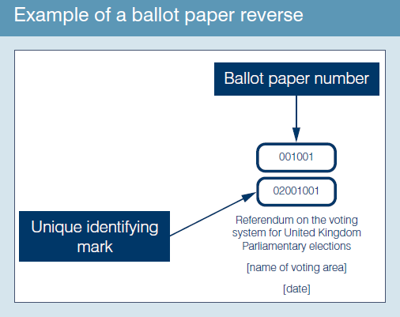
Example reverse of ballot paper
Notes:
Check that the ballot papers bear the unique identifying mark on the back (see example).

Slide 28
Marking the register
Queen’s Walk |  |  | BC
 |  |  | JP32 4LT
411 G |  | Vella, Eva | 1
412 F |  | Jolly, Simon | 1
413 |  | Vella, Christina | 1
414 |  | Brown, Robert | 3
415 |  | Evans, Gareth | 5
416 |  | Singh, Parvinder | 7
417 M |  | Myers, Martin | 7
418 A |  | Bishop, Stephanie | 15
418/1 | 02 Feb | Watts, Judith | 15
Notes:
28
NOTE: This slide applies to elections held on or after 5 May 2022. For polls held before this date, slide will need revising.
The aim of this slide it to provide a demonstration of how to mark the register - consistency and accurate
Here is an example of a register marked for elector numbers 414 and 416.
Use a ruler to mark the line.
Mistakes can be made as a result of poor quality/wobbly marks.
Be especially careful to accurately mark the register where there are family members with the same surname.
Always ask for full name and address – unless you are dealing with an anonymous elector - even if the elector has handed you their poll card.
Discussion points – Trainer to ask questions
Can 415 vote? Yes. No marker against their name.
Can 412 vote? No. They are an overseas elector so you cannot give them a ballot paper.
Can 411 vote? Yes. They are a citizen of the European Union who is entitled to vote at this election.
Can417 vote? Yes. They are a qualifying foreign citizen who is entitled to vote at this election
Can 418 vote? No. They are a postal voter so you cannot give them an ordinary ballot paper.
Can 418/1 vote? Yes. date they become 16 is before polling day.
Poll cards are not needed to vote (except for anonymous electors), and even where they are presented the elector’s name and address should still be asked for.

Slide 29
Anonymous electors [slide to be used only if relevant]
Anonymous electors
  Must have poll card
  Marked ‘N’ on register
  Name and address must not be called out
  Mark the register by their poll number as usual
Notes:
Only use this slide if you have anonymous electors
Explain anonymous elector voting procedure – refer to polling station handbook
Poll card should be returned to the elector to protect privacy

Slide 30
Secrecy of the vote
Make sure voters go to polling booths individually so that their right to a secret vote is protected.
No other person is allowed to accompany a voter to a polling booth unless a voter who is disabled or unable to read has requested assistance to vote.
Notes:
30

Slide 31
Marking the ballot paper for the local government election
Some electors may need to have the voting process explained to them:
Voters at local government elections may be able to vote for more than one candidate depending on how many candidates are to be elected, and should place an ‘X’ in the box to the right of the name of the candidate(s) for whom they wish to vote.
Notes:
Modify as required.
Show ballot papers for the elections.
Explain that the top of the ballot paper gives the instructions on how to complete the ballot papers. Some voters may still find the instructions unclear. They may ask, for example, to have their favoured candidate or party pointed out to them, or ask where they should make their mark on the ballot papers. In these circumstances, the Presiding Officer should read out the instructions printed at the top of each ballot paper and the list of candidates in the order that they appear on the ballot papers.
Explain that voters can only vote for the maximum number of candidates allowed on the ballot paper (according to the instructions) - usually at local government elections, voters have between one and three votes (but at community elections there may be more).

Slide 32
If voters ask you how to vote…..
If they ask you how to vote, read out the instructions on the ballot paper
If they make a mistake, follow the spoilt procedure
Don’t get into conversations about the council, the election or anything other than how to vote
More information in the polling station handbook
Notes:
Highlight importance of staff being professional and impartial when talking to voters.
If asked by a voter, how to vote/what to do – staff can explain:
The top of the ballot paper gives the instructions on how to complete the ballot paper.
Some voters may still find the instructions unclear. They may ask, for example, to have their favoured candidate or party pointed out to them, or ask where they should make their mark on the ballot paper.
In these circumstances, the Presiding Officer should read out the instructions printed at the top of the ballot paper and the list of candidates in the order that they appear on the ballot paper.
Even if you know about the topic the voter has a complaint about, or even work for the council, explain that you can’t talk about that today and direct them to contact the council if they wish after they have voted. On polling day you are working for the independent Returning Officer, not the council.

Slide 33
What happens if…?
you are handed a certificate of employment
a voter spoils a ballot paper
a voter has nominated a proxy but the voter arrives before the proxy
a person arrives to vote but the register indicates the person has already voted
a person arrives to vote but the register indicates the person is a postal voter
a person arrives wanting to vote as an emergency proxy
a person believes they should be on the register but they are not listed
there is a disturbance at the polling station
Notes:
Interactive slide –
Either work in groups or ask for answers from the trainees.
Use this slide to explain special voting procedures.
Explain what a certificate of employment looks like and what information the staff need from that form.
If the voter spoils their ballot paper they must be issued a replacement and the PO must account for any spoilt papers on the ballot paper account.
If the voter arrives before the nominated proxy then the proxy cannot vote and must be told the situation
This is a situation where the PO must put the prescribed questions to the voter before issuing a tendered ballot paper.
Questions about a person’s registration should be directed to the electoral registration office.
Electors or proxies marked as having been issued with a postal vote cannot be given an ordinary ballot paper in the polling station. However, an elector or proxy who claims never to have applied for a postal vote but is listed as a postal voter, is entitled to receive a tendered ballot paper at the polling station at any time. Alternatively, up until 5pm on polling day, they may be issued with a replacement postal ballot pack but only by the Returning Officer at the elections office. The Presiding Officer should refer the elector or proxy to the Returning Officer for advice on this procedure.
A’ markers cannot be given an ordinary ballot paper at the polling station:
If the voter has arrived at the correct polling station then contact electoral services as there may have been a clerical error when compiling the register – outline the process to be followed.
People with medical emergencies and those whose occupation, service or employment means they cannot go to the polling station in person can apply for an emergency proxy (provided the emergency occurred/became aware they were going to be away on polling day after 5pm on 6 working days before the poll). Emergency proxies can be granted up until 5pm on polling day. Explain how any updates would be notified on polling day.
Emphasise that poll never to be adjourned on the PO’s own initiative.
For further detail on the above please see the Commission’s polling station handbook.

Slide 34
The prescribed questions
No enquiry or questioning of electors is allowed other than asking the prescribed questions
The prescribed questions must be asked:
  when a candidate, an election agent or polling agent requests them
  before issuing a tendered ballot paper
The prescribed questions should be asked:
  when you suspect personation
  when a registered elector is clearly under age
  when an elector states their name is not as shown in the register of electors
Notes:
Refer to Appendix 5a of the polling station handbook.
Make clear that only the prescribed questions are able to be asked if there is concern about the eligibility of a person who applies for a ballot paper. If there is concern then ask the prescribed questions and record the event in the polling station log.
Make clear the point that they must not ask any other questions about the qualification to vote other than the prescribed questions.
Refer to: Personation advice for Presiding Officers and Log to record details of postal voters who claim not to have applied for a postal vote available on the Commission’s website.

Slide 35
Postal votes
voters can hand in their postal votes at any polling station in the ward
returned postal ballot packs must be stored, sealed and labelled as instructed
postal votes will be collected during the day. Any not collected will be returned with the ballot box at close of poll
It is important that you follow public health guidance, such as washing or sanitising your hands and avoiding touching your face after handling postal votes
Notes:
It is important to emphasise the correct process when dealing with postal votes that are handed into the polling stations.
It is important that staff follow any public health guidance, avoiding touching their face, and sanitising or cleaning their hands, particularly after handling paper.
Any completed packs that are handed in must be placed in the packet for postal votes handed in at the polling station. This packet must then be sealed at close of poll.
[insert any local instructions]

Slide 36
Postal votes
A’ markers cannot be given ordinary ballot papers at the polling station:
  direct to Returning Officer for replacement
    if a person has spoilt, lost or not received their postal ballot paper, it can be replaced until 5pm
  tendered ballot paper procedure

Slide 37
Close of poll
The procedures to be followed

Slide 38
Managing a queue
At 10pm:
  bring all the waiting electors into the room/building and close the door if people can keep their distance, OR
  if the room/building is not big enough, a member of the team should stand at the end of the queue, at a safe distance, to mark it
  continue to issue ballot papers until everyone who was in the queue by 10pm has voted
Anyone who was not in the queue at 10pm must NOT be issued with a ballot paper.
  Just before 10pm:
  make sure those waiting can cast their vote
  check that anyone waiting to vote is at the correct polling station for their address
Notes:
38
Explain that it is rare for there to be queues to vote at 10pm but there could be a queue even with only a few people. If someone arrived at the polling station in time, it is their right to cast their vote.
Electors in a queue at any time during the day should be reminded to keep their distance whilst in the queue [and to wear a face covering in the polling station unless exempt.]
If there are lengthy queues at any point in the day, particularly in the last couple of hours before the close of poll, polling station staff should contact the election office to discuss the situation and agree how to deal with it.
Electors must be in the queue for the polling station they have been allocated to. If they are in the queue for a different polling station in the same polling place or at the wrong polling place altogether, unless they get to the right one and are in the queue there by 10pm , they will be unable to vote.
Staff should manage a queue at the close of poll by either bringing all the electors into the room or building (if people can keep their distance) and closing the door so no-one else can join the queue after 10pm, or if the room or building isn’t large enough to ensure that voters and staff can keep their distance, a member of the polling station team should stand at the end of the queue to mark it and explain to anyone arriving that the polls closed at 10pm and, by law, they cannot vote.

Slide 39
Close of poll
Once the last voter has voted, seal the ballot box
Candidates/agents are also entitled to affix seals to the ballot box at this point, but should keep their distance while doing so
[Those present in the polling station at the close of poll should continue to follow public health advice on keeping their distance where possible, hand cleaning and the wearing of face coverings.]
Notes:
39
The PO should seal the ballot box and begin to complete paperwork and pack up the polling station with the Poll Clerk(s).
Should a candidate or polling agent wish to affix seals to the ballot box(es) they should be reminded to continue to keep their distancing while doing so and to clean their hands before and afterwards.

Slide 40
After close of poll
Absolutely essential that the ballot paper account is completed accurately
The ballot paper account must be placed in the envelope provided – keep it with the ballot box
Ensure all documents placed in correct packets and signed as appropriate
Poll Clerks to assist packing up station to allow Presiding Officer to do these important tasks
Notes:
40
Trainer - You could run a mock exercise in how to fill in the ballot paper account. The Commission has developed such an exercise as part of its suite of support materials.
Take time to complete the ballot paper account and make sure this is done accurately - otherwise it will cause problems at the count.
Take time to ensure that all documents are placed in the correct packets and are signed as appropriate.
Explain any other local arrangements with regard to equipment and left-over sundries and stationery.
Data protection – poll cards need to be disposed of securely and in line with both data protection legislation and your authority’s data retention policy.
Give any specific instructions regarding the transportation of ballot boxes and polling station materials to the verification and count centre, including any instructions for the safe delivery of materials.

Slide 41
Any questions?
Notes:
You may want to test if all the polling station staff have understood and feel fully confident about their role on the day. [The Commission has developed a multi-choice quiz which can be used for this purpose as part of its suite of support materials].

Slide 42
Additional information
Election team contacts
Electoral Commission website
  www.electoralcommission.org.uk
Feedback sheets

