Slide 1
WELCOME TO
WELCOME TO
WELCOME TO
WELCOME TO
WELCOME TO
Welcome to your vote
Campaign planning

Slide 2
Learning objective
You will be able to produce persuasive campaign materials encouraging everyone to register to vote

Slide 3
Campaigning
What is a campaign?
A series of actions or events that are meant to achieve a particular result.
Think of your favourite brand and how they advertise to you.
What do you like about the brand?
How do they reach you? For example: social media, adverts
What works?

Slide 4
The Electoral Commission challenge you to run your campaign to get young people to register to vote

Slide 5
Young people and registering to vote
Why?
In 2024:
43% of 16-17 year olds in Wales were registered to vote
97% of 65+ year olds were registered to vote
How does this make you feel?
Notes:
https://www.electoralcommission.org.uk/who-is-registered

Slide 6
Campaign analysis
20 minutes
In pairs, look at these examples of campaign posters.
Analyse and discuss how effective each poster is.
Notes:
Posters are from elections or campaigns in USA, Poland, China (1971), Lebanon, Tanzania and UK.

Slide 7
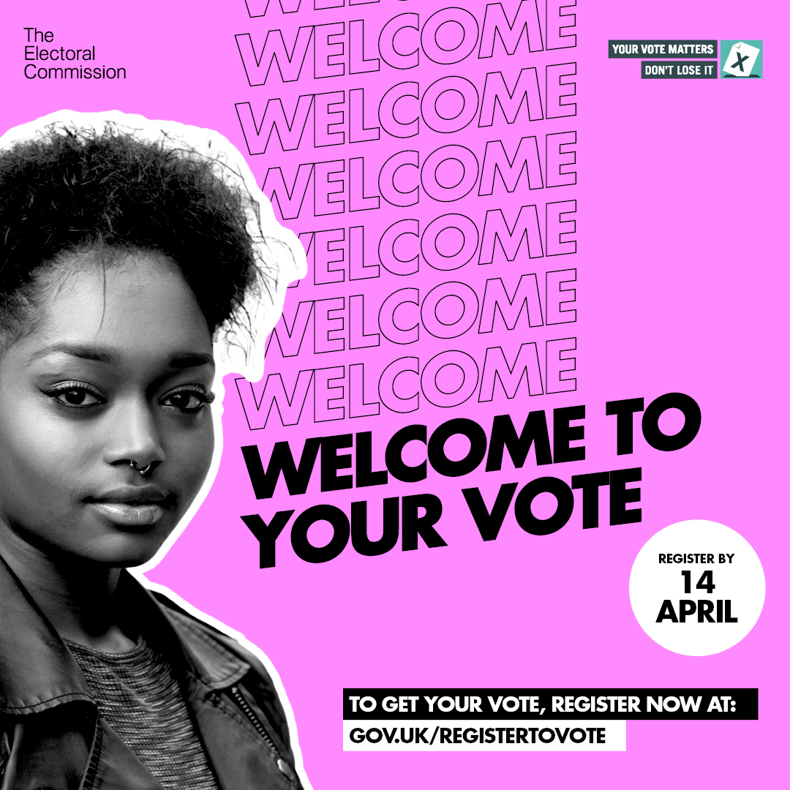


Welcome to your vote
In 2020, the Electoral Commission created Welcome to Your Vote, designed to get young people to register to vote
What part of this campaign got your attention?
What do you like about the campaign?
Would this make you register to vote?
Notes:
In pairs, ask the students to reflect on the campaign images and answer the following questions
What do you like about the campaign?
Is there anything you don’t like about the campaign?
Would this make you register to vote?
Make students aware that Electoral Commission’s campaigns use posters, billboards, radio, TV adverts, social media and many more to bring the campaign to life.

Slide 8
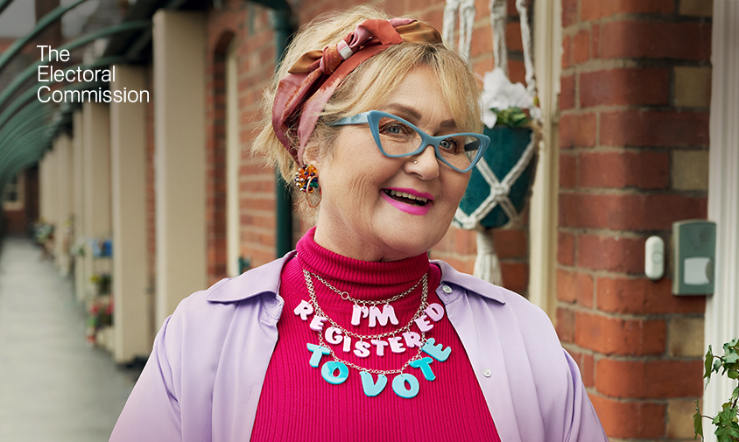
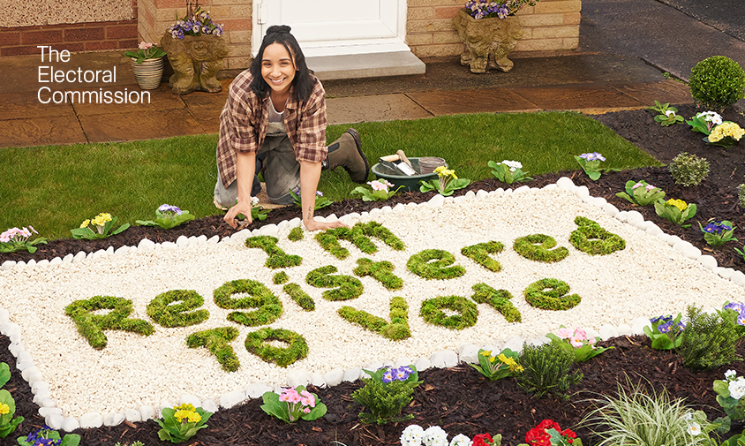
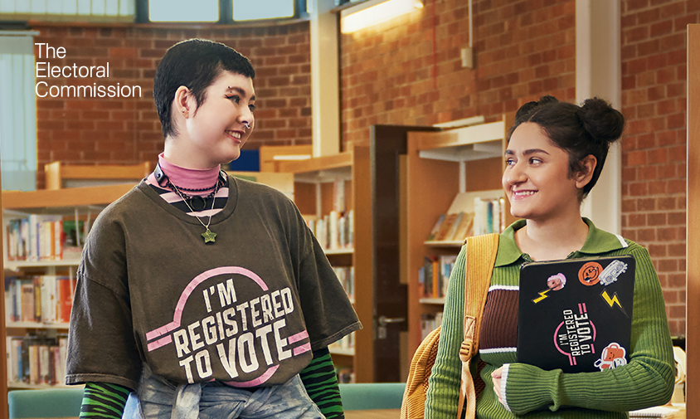
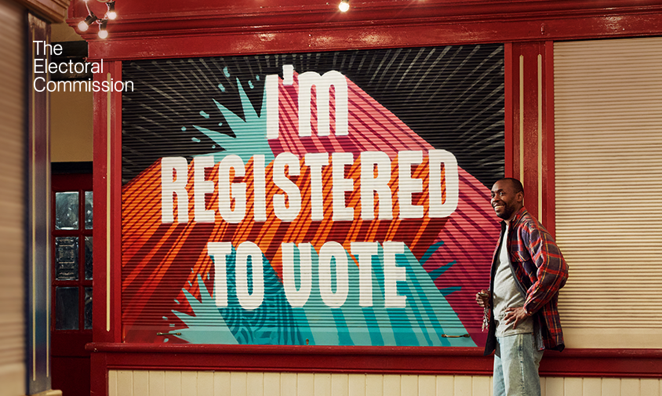
Show it Off
In 2024 the Electoral Commission ran a campaign across the UK to get everyone to register to vote. This campaign is called Show it Off. It is designed to make registering
to vote and having your say at elections feel like something to be proud of.
What part of this campaign got your attention?
What do you like about the campaign?
Would this make you register to vote?
Notes:
In pairs, ask the students to reflect on the campaign images and answer the following questions
What do you like about the campaign?
Is there anything you don’t like about the campaign?
Would this make you register to vote?
Make students aware that Electoral Commission’s campaigns use posters, billboards, radio, TV adverts, social media and many more to bring the campaign to life.

Slide 9

Campaign planning
10-20 minutes
In your campaign teams, start work on producing materials for your campaigns. This could include:
designing posters
writing a speech
creating a display and getting permission to put it up
Look at the message you created last lesson and stay focused on the aim:
Encourage people aged 14 and over to register to vote at gov.uk/registertovote
Notes:
Some possible roles for the team are outlined on the next slide. Each team is likely to need a campaign manager and a designer, but the other roles are optional depending on their campaign plan, and each student might have multiple roles.

Slide 10
Possible campaign roles
Campaign manager | Responsibilities include: leadership and making final decisions, ensuring that the planned activity goes ahead, contacting any senior stakeholders such as your local councillor, MS or MP.
Designer | Decides which colours, images and symbols will be most effective, produces materials like posters or flyers, plans display boards.
Fixer | Secures the relevant permissions, e.g. for use of display boards, to hold an information session in the library or for the group to deliver speeches in form time.
Speech writer | Writes speeches or prepares presentations which will be delivered to other students either by themselves or by the campaign manager. Might also write letters to stakeholders such as form tutors or prefects.
Researcher | Tests materials (e.g. poster, lines from a speech) to check they convey the key message effectively. Talks to students during or after campaign events to check whether they have decided to register to vote and collect feedback on the campaign.
Media / social media manager | Writes an article for the school blog or newspaper, plans a takeover of the school Twitter account for a day, writes a letter to a local newspaper or other publication to promote the campaign.

Slide 11
Running your campaign
Over the next few weeks, we encourage you to run your campaign in your school and in your local community
This could include delivering an assembly, putting up posters or making videos
We will meet again to discuss how effective you think your campaigns have been

Slide 12
Good luck

