Slide 1
WELCOME TO
WELCOME TO
WELCOME TO
WELCOME TO
WELCOME TO
WELCOME TO YOUR VOTE
KS4 and KS5 assembly

Slide 2
Traffic should be banned from the roads around our school
Raise your hand if you think…
Notes:
Pose each of the questions in turn and give students a chance to share their views, balancing those who support the statement and those who oppose it.

Slide 3
Education should be compulsory until the age of 21
Raise your hand if you think…
Notes:
Pose each of the questions in turn and give students a chance to share their views, balancing those who support the statement and those who oppose it.

Slide 4
The UK should ensure every child in the world has enough to eat
Raise your hand if you think…
Notes:
Pose each of the questions in turn and give students a chance to share their views, balancing those who support the statement and those who oppose it.

Slide 5
Who has the power to change these things?
Notes:
Ask students: who has the power to change these things? Answers might include: local Member of Senedd (MS), local Member of Parliament (MP) or local councillors, ourselves through campaigning, public sector or charity organisations.
Elicit that responsibility for different areas of our lives sits with the local council, Senedd and UK Parliament.

Slide 6


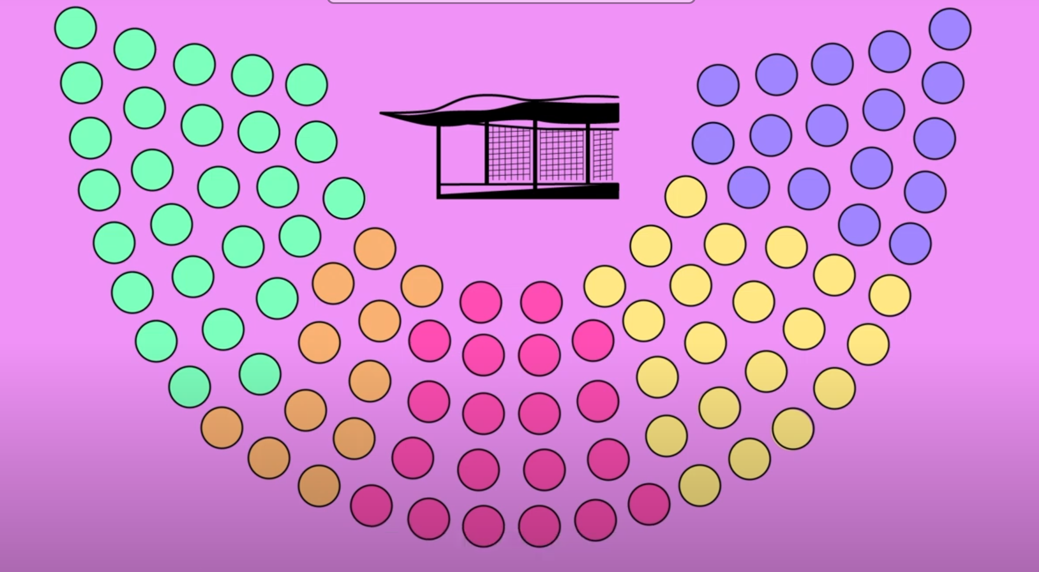
Who has the power to change these things?
Local council
Senedd
UK Parliament
Responsible for roads and traffic
Responsible for education
Responsible for
foreign affairs
Notes:
If necessary, share this illustration showing which government is responsible for each of the areas outlined.

Slide 7
How do they make decisions?
Local council
Senedd
UK Parliament
Responsible for roads and traffic
Responsible for education
Responsible for
foreign affairs
Notes:
Answers might include:
Through debate and discussion
Based on advice from experts and public sector organisations
By listening to people views, received via petitions, letters and protests
Holding an election or a referendum

Slide 8

Notes:
Alternative link for video: https://www.youtube.com/watch?v=jbKxPfI1LKA&list=PLm0G6YKL5VxICxsda9-6SoIfmA6SLiVHr&index=1

Slide 9
Democracy
Notes:
Ask students if they know what the word democracy means.

Slide 10
A system of government where people vote to elect the people who represent them
Democracy
Notes:
If need be, secure understanding through discussion. Establish that Wales is a democracy because people have a chance to vote for representatives in local, Senedd and UK-wide elections. It might be helpful to outline some alternative societal structures such as a dictatorship or socialist state.

Slide 11
Who could vote?
(Match the answer to the correct date)
1914 | Men and women over the age of 21
1918 | Men and women over the age of 18
1928 | Men over the age of 21, and women who were over the age of 30 and owned their own home
1969 | Men and women over the age of 16 (for Senedd and local elections)
2021 | Men over the age of 21
Notes:
Working chronologically, ask students to identify who could vote in elections by selecting the correct answer on the right hand side.

Slide 12
Who could vote? Answers
(Match the answer to the correct date)
1914 | Men over the age of 21
1918 | Men over the age of 21, and women who were over the age of 30 and owned their own home
1928 | Men and women over the age of 21
1969 | Men and women over the age of 18
2021 | Men and women over the age of 16 (for Senedd and local elections)
Notes:
Correct answers.
Ask students how people might have felt when they couldn’t vote. For example, 21 year old women in 1918 or 18 years olds in 1928? Answers might include: angry, unimportant, disempowered.

Slide 13
Who could vote?
(Alternative slide option)
1914
1918
1928
1969
2021
Notes:
Working chronologically, ask students who could vote in the elections in each year before revealing the answers.

Slide 14

UK Parliament elections: 18 years old
Scottish Parliament elections: 16 years old
Senedd elections, Wales: 16 years old
Northern Ireland Assembly elections: 18 years old
Local elections in England and Northern Ireland: 18 years old
Local elections in Scotland and Wales: 16 years old
Notes:
The voting age for the UK Parliament is 18 in England, Wales, Scotland and Northern Ireland.
However, in 2020 Wales and Scotland passed a law making it possible for 16 year olds to vote in local, Senedd and Scottish Parliament elections.

Slide 15
How would you feel if you were not allowed to vote?
Notes:
Ask students to share their thoughts and feelings in response to this question. If there are students present who are over the age of 16 ask whether they voted in 2021 and how it made them feel. Make clear that Wales is one of very few countries in the world who have a voting age of 16.

Slide 16
QUIZ
QUIZ
QUIZ
QUIZ
QUIZ
Notes:
Quiz can be found at the end of this webpage: https://www.electoralcommission.org.uk/resources/resources-young-people/who-responsible

Slide 17
Final thoughts
A democracy gives people the chance to vote to show what matters to them
In Wales, you can vote from the age of 16 in Senedd and local elections
You can register to vote from the age of 14
Use your vote, don’t lose it!
Register to vote at gov.uk/registertovote
Notes:
Remind students that voting is a way they make their voice heard to representatives in the local council, Senedd and UK Parliament. Encourage any students aged over 14 to register to vote at gov.uk/registertovote

