Slide 1
Welcome to your vote
WELCOME TO
WELCOME TO
WELCOME TO
WELCOME TO
WELCOME TO
Learning sequence
Suitable for Year 10+
Linked to the Welsh Curriculum
electoralcommission.org.uk/learning

Slide 2
CURRICULUM MAPPING - WALES
Curriculum mapping
A good democracy education will ensure that all learners have the opportunities they need to become “ethical, informed citizens who understand and exercise their human and democratic responsibilities and rights” (Curriculum for Wales).
Schools can support progress both by teaching learners about democracy but also giving them opportunities to learn through democracy by creating a participatory school culture. Through a literature review, The Electoral Commission have identified 6 principles for good democracy education.
Principle 1: Learn about democracy
Principle 2: Participate in democratic processes
Principle 3: Use their voice in open discussions
Principle 4: Contribute to their community
Principle 5: Be part of an inclusive culture
Principle 6: Get involved in decision making
In addition to these principles, the evidence is clear that commitment by the headteacher to meaningful participation all year round is essential. This includes developing a genuinely participatory school culture that intentionally empowers learners, rather than using it as a means of control or as a way to imitate democracy.

Slide 3
CURRICULUM MAPPING - WALES
Curriculum mapping
Embedding democratic education in the Curriculum for Wales: Humanities
Statement of What Matters | Informed, self-aware citizens engage with the challenges and opportunities that face humanity, and are able to take considered and ethical action Human societies are complex and diverse, and shaped by human actions and beliefs
Cross-curricular skills | Speaking (see Literacy and Numeracy Framework) Producing digital content (see Digital Competence Framework) Integral skills: creativity and innovation, critical thinking and problem solving
Specific areas of consideration | Local, national and wider world perspectives, including Welsh Politics Deep thinking and reflection
Social studies | Develop an understanding of the discipline and its value Encourage conceptual understanding of the world by learning about people and their values, in different times, places and circumstances Provide rich contexts to explore social issues, identity, rights and responsibilities, and social organisation Encourage active participation and engagement with social issues through social enquiry, discussions and social action Develop an understanding of how systems of government in Wales operate and affect people’s lives, and how they compare with other systems Explore the concepts of governance, rights, equality, inequality, ethnicity, gender and poverty

Slide 4
CURRICULUM MAPPING - WALES
Curriculum mapping
Embedding democratic education in the Curriculum for Wales: Humanities
Considerations for provision of learning experiences | A range of opportunities to visit and explore including: places of political, religious or spiritual significance A range of opportunities to engage with: political, business, community and/or cultural leaders A range of opportunities to observe or participate in: social action project
Cross-cutting themes | Local, national and international contexts Local, national and international contexts are integral and form part of the key principles relating to the choice of content. Human rights education and diversity Experiences can help learners develop an understanding of their responsibilities as citizens of Wales, the diversity of Wales, and an awareness of how their own rights are influenced by interpretations of human rights, values, ethics, philosophies, and religious and non-religious views. In this Area there should be opportunities to develop understanding of the United Nations Convention on the Rights of the Child (UNCRC) and for encouraging learners to recognise their own and others’ rights.

Slide 5
Your vote
LESSON PLAN
01.
Students will use comprehension and analysis skills to identify and understand how politics affects their lives and which politicians represent them.
Learning objective:
Students will be able to identify issues controlled by the Senedd and UK Parliament, and understand how their vote is counted.
Time needed:
60 minutes
Differentiation options:
Extension and challenge activities are suggested throughout.
If necessary, copy the key vocabulary and make available on each table or a display board.
Resources required:
      ‘Your Vote’ film
      Highlighters/ coloured pens
      ‘Who represents you?’ worksheet and internet access
Key vocabulary
Senedd
Member of the Senedd (MS)
UK Parliament
Member of Parliament (MP)
Constituency
Devolved

Slide 6
Your vote
LESSON PLAN
01.
Starter
Take the temperature of students’ understanding and attitudes towards politics using a ‘washing line’ where students stand one side of the classroom if they agree strongly, and the opposite side if they disagree strongly, or somewhere in the middle.
Read out the following statements and ask students why they have chosen their position along the spectrum.
I am interested in politics
politics affects my life
everyone should vote
Alternatives for this activity could include ‘thumbs up, thumbs down’ or paired discussion.
Everyday politics – group activity
In pairs or small groups, ask students to write out the timetable for their typical day. Using highlighters or coloured pens have them mark or label any activities which are affected by politics.
Challenge: can students identify who is responsible for each area they have labelled? For example, the local council, the Senedd or UK Parliament.
Everyday politics examples:
7am – get the bus to school
School bus services are controlled by the Senedd.
12.15pm – have a school dinner
Guidelines for healthy eating in schools are published by the Senedd.
4pm – go to the park
Parks, leisure and libraries are managed by the local council.
6pm – watch BBC news
The BBC is funded by the UK government.
Feedback as a class to identify the different areas of students’ lives affected by politics.
Key vocabulary
Devolved
Central government giving power to local government

Slide 7

Your vote
LESSON PLAN
01.
‘Your Vote’ film
Watch the film and ask students to make a note of the different areas managed by local councils, the Senedd and UK Parliament.
Watch the film again if needed and then discuss as a class:
are there any words or terms they did not understand? (See vocabulary box below)
was there anything in the film they didn’t know before?
what are some of the differences between the Senedd and UK Parliament? (Elicit that you can vote at the age of 16 to elect a Member of the Senedd)
Ask students to look back at their timetable and update any activities they can with ways politics affects them.
Research
Using the internet, have students complete the ‘Who Represents You?’ worksheet.
If students have time, ask them to think about the final question: three things they would do if they were First Minister and share with the class.
Plenary
Ask students to write down any questions or uncertainties they have about politics. These can be anonymous and collected in a box to be looked at in later lessons.
Remind students to register to vote at gov.uk/registertovote
Senedd
The Welsh Parliament which makes decisions about issues like education, housing and the NHS.
Member of the Senedd (MS)
Person who represents their area in the Senedd.
UK Parliament
The Parliament of the UK which looks after issues like defence and foreign affairs.
Member of Parliament (MP)
Person who represents you in the UK Parliament.
Constituency
A local area which is represented in the Senedd and UK Parliament.

Slide 8
Who Represents You?
WORKSHEET
01
My name is ……………………………………………………………………………………………………………….
The date that I will be eligible to vote at an election is …………………………
My Senedd constituency is ……………………………………………………………………………….
My MSs are ………………………………………………………………………………………………………………………………………
………………………………………………………………………………………………………………………………………
My UK Parliamentary constituency is ………………………………………………………….
My MP is ……………………………………………………………………………………………………………………
My local council is …………………………………………………………………………………………..….…
My ward is …………………………………………………………………………………………………………….….
My councillors are …………………………………………………………………………………………………
Three things I would do if I were First Minister:
………………………………………………………………………………………………………………………..………
…………………………………………………………………………………………………………………………..……
………………………………………………………………………………………………………………………………..
Top tip
The following websites might be helpful:
Find your Member of the Senedd – search: ‘Find my MS’
Find your MP – search: ‘Find my MP’
Find your councillors – search: ‘Find my councillors’

Slide 9
Our democracy
LESSON PLAN
02.
Students will explore how democracy functions in their local community, the UK and internationally. They will be introduced to the concept of suffrage
Learning objective
Students will be able to discuss how democracy works in their community.
Time needed
60 minutes
Differentiation
For the timeline activity there are two options – a card sort or a worksheet with dates on to match.
Resources required
Letter from Bertha Brewster
Campaigning video
Timeline activity – card sort or worksheet options
Completed Who represents you? worksheets from lesson 1
Quizzes on the Electoral Commission’s website
Key vocabulary
Democracy
Suffrage
Suffragist / suffragette
Representation of the People Act
Campaigning

Slide 10
Our democracy
LESSON PLAN
02.
Starter
Introduce the word ‘suffrage’ using a dictionary race, a game of hangman or using the key vocabulary sheet for this unit.
Share the letter by Bertha Brewster with the class and discuss what the writer is asking for and how she is making her point.
Prompt questions might include:
any words or phrases students didn’t already know?
what were the suffragists (and suffragettes) fighting for?
what emotions do you feel as a reader? Why do you think Bertha tried to evoke these emotions?
Timeline – group activity
In small groups provide students with the cards from the timeline activity. They should arrange the elections in chronological order.
Once you’ve been through the correct answers with the class, discuss. Prompt questions might include:
are there any dates that are surprising?
do they notice any patterns or any gaps?
are there any other election ‘firsts’ they would be interested to find out more about?
Discussion
How do politicians get elected?
Discuss as a class to generate initial ideas.
Remind students that in some elections, we are voting for a person but often we are voting for the representative of a political party. Watch this film about campaigning during elections and address any questions that arise.
Who Represents You?
In pairs students should look at the list they produced for the ‘Who Represents You?’ worksheet.
Through discussion, students should decide whether they feel the list is representative of their community. Useful prompts might include:
do the people listed have a similar family and educational background to you or to someone from your community?

Slide 11

Our democracy
LESSON PLAN
02.
are there any similarities or differences between the representatives on your list?
is there an equal number of men and women on the list?
do you agree with the political views of the people representing you?
Challenge:
would everyone in your community feel represented by the people on this list in some way?
if someone did not feel represented by the people on the list, what possible actions could they take? (For example, use their vote or stand for election themselves)
Plenary
Take a quiz as a class and discuss any incorrect answers.
Alternatively, pull out some of the anonymous questions – answer them yourself, give students the chance to answer them or look up the answers online together.
Remind students to register to vote at gov.uk/registertovote
Key Vocabulary
Democracy
A system of government where people vote to elect the people who represent them.
Suffrage
The right to vote in a political election.
Suffragette
The name given to women who fought for their right to vote.
Representation of the People Act
The law passed in 1918 that gave permission for some women to vote. The law was updated in 1928 to allow all women over 21 year old to vote.
Campaigning
Activities that encourage people to support an issue or political party.

Slide 12
Our democracy
WORKSHEET
02.
Cut out the events and put them in chronological order from earliest to most recent.
First country to lower voting age to 16 years |  | Aboriginal people won the right to vote in Australian elections
The first ever recorded election |  | 16 and 17 year olds can vote in Senedd elections for the first time
First election in India after independence from British colonial rule |  | Voting age in the UK lowered from 21 to 18 years
Some women allowed to vote in UK elections |  | The first recorded election in which Black South African citizens were able to vote
First national parliament to elect more female representatives than male |  | First devolved election in Wales
The first women in the world allowed to vote, without any conditions |  | First Black MP elected in the UK

Slide 13
Our democracy
WORKSHEET
02.
Correct answers for timeline activity.
The first ever recorded election |  | 754 BC in Ancient Greece
First Black MP elected in the UK |  | 1832 - John Stewart, Conservative MP for Lymington, 1832-1847
The first women in the world allowed to vote, without any conditions |  | 1893 – both indigenous Maori and European settlers in New Zealand won the right to vote
Some women allowed to vote in UK elections |  | 1918 (women were granted the same voting rights as men in 1928)
First election in India after independence from British colonial rule |  | 1951 – 52
Aboriginal people won the right to vote in Australian elections |  | 1962
Voting age in the UK lowered from 21 to 18 years |  | 1970
First country to lower voting age to 16 years |  | 1984 - Nicaragua
The first recorded election in which Black South African citizens were able to vote |  | 1994 – the ANC were elected and Nelson Mandela became President
First devolved election in Wales |  | 1999 – as National Assembly for Wales before it became the Senedd
First national parliament to elect more female representatives than male |  | 2008 – in Rwanda
16 and 17 year olds are able to vote in Senedd elections for the first time |  | 2021

Slide 14
Our democracy
WORKSHEET
02.
Match the election to the correct year
First country to lower voting age to 16 years |  | 754 BC
Aboriginal people won the right to vote in Australian elections |  | 1832
The first ever recorded election |  | 2008
16 and 17 year olds are able to vote in Senedd elections for the first time |  | 1893
First election in India after independence from British colonial rule |  | 1918
Voting age in the UK lowered from 21 to 18 years |  | 1951 – 52
Some women allowed to vote in UK elections |  | 1962
The first recorded election in which Black South African citizens were able to vote |  | 1970
First national parliament to elect more female representatives than male |  | 1984
First devolved election in Wales |  | 1994
The first women in the world allowed to vote, without any conditions |  | 1999
First Black MP elected in the UK |  | 2021

Slide 15
People power
LESSON PLAN
03.
Students will explore the role of voting by preparing for and participating in a debate.
Learning objective:
Students will be able to discuss the importance of voting.
Time needed:
60 minutes
Differentiation options:
Extension and challenge activities are suggested throughout.
Resources required:
four sheets of paper labelled ‘mad’, ‘bad’, ‘sad’ and ‘glad’ or individual whiteboards
materials to prepare for a debate - for example, internet access, sticky notes, or coloured pens
film: How to register to vote

Slide 16
People power
LESSON PLAN
03.
Ground rules
Establish ground rules for discussions. Remind students that they don’t have to agree with each other, but they do have to be respectful of each other’s opinions.
It might be useful to keep this list of ground rules on a working wall or somewhere visible in the room to refer back to throughout this unit.
Starter
Place a volunteer student at the front of the room and provide them with four signs: ‘mad’, ‘bad’, ‘sad’ and ‘glad’.
Share a range of different statements with the student. Ask them to hold up the sign that best describes how they feel about the statement and explain their response.
Statements might include:
voting should be made compulsory
young people are not interested in politics
young people in Wales can vote at the age of 16
the minimum age for voting in UK Parliament elections is 18
politics is boring
not everyone in the world has the right to vote
Give other students the chance to sit in the hot seat and respond – they may want to respond differently to some of the same statements. Encourage the rest of the class to pose statements about politics.
Alternatively, you could give the whole class the chance to respond using individual whiteboards or label the four corners of the room ‘mad’, ‘bad’, ‘sad’ and ‘glad’ and ask students to move to the corner that describes their response.

Slide 17
People power
LESSON PLAN
03.
Preparation for debate
Divide the class into two teams and give them time to prepare for a debate on the following statement:
“Everyone should use their vote”
They may need internet access, sticky notes, large sheets of paper and other materials.
Debate
Run a class debate in whatever format you typically use. Alternatively, select one of the options from the box below.
Ask students to reflect on whether they personally agreed or disagreed with the outcome of the debate.
Plenary
Watch the film: ‘How to Register to Vote’.
Explain to the class that they are going to design a campaign to encourage young people to register to vote.
Remind students to register to vote at gov.uk/registertovote
Homework (optional)
Before the next lesson, they should produce a list of some of the possible barriers they might need to overcome in their campaign.
Whole class debate
Divide the class into two teams and ask them to elect two representatives. The first proposition speaker will make opening remarks, following by the first opposition speaker, second proposition speaker and second opposition speaker. The discussion then opens to the floor with teams given a chance to make statements and ask questions challenging each others’ position. A chair (teacher or student panel) will summarise and decide the winning team.
Goldfish bowl
A small group of students sit in the middle of the room and debate opposing positions, while the rest of the class actively listens around the outside. Listeners might support their candidate by providing sticky notes. Excellent for modelling good discussion and providing stretch.
Talking Threes
In groups of three, students take it in turns to take on the role of Supporter, Opposer and Summariser. The Supporter and Opposer argue for their position and the Summariser displays active listening skills and asks probing questions.

Slide 18
Campaigning
LESSON PLAN
04.
Students will understand what is meant by political campaigning and will explore what influences people to vote.
Learning objective:
Students will be able to analyse where power is held in their community.
Students will be able to discuss the factors that influence people’s voting choices
Time needed:
60 minutes
Differentiation options:
Extension and challenge activities are suggested throughout.
Resources required:
Political bingo worksheet
‘What Influences?’ cards

Slide 19
Campaigning
LESSON PLAN
04.
Starter
Give each student a ‘political bingo’ worksheet and allow them to move around the room finding a classmate for each statement. They should aim to have a different name for each one.
‘What Influences?’ group activity
In small groups give students a set of ‘What Influences?’ cards.
It may be helpful to start with a class discussion about what influences decision making in our everyday lives. For instance, how do we choose what to watch on television, or what we are going to do at the weekend?
In their groups students should imagine that there is an election tomorrow and they have decided to vote. Ask them to pick the three main things that might influence which candidate or political party they vote for.
Come back together as a class and discuss why they picked particular influences.
Challenge: are there any other influences not listed on the cards that might affect their choice?
Research
Remind students that they will be planning a campaign. We will take what we have learnt about how political parties campaign and apply it to a different scenario. We will be campaigning to encourage students to register to vote.
The first step is for them to identify the possible barriers that might prevent young people from registering to vote. They can do this by interviewing their classmates. (This could also be extended as a homework task to enable students to gather more data.)
Remind students of the importance of asking open questions and, if necessary, generate research questions as a class. Examples might include:
have you registered to vote? Why/ why not?
do you intend to register to vote before you turn 16/ before the next election? Why/ why not?
what might stop you or your friends from registering to vote?

Slide 20
‘What Influences?’ cards
WORKSHEET
04.
The views of adults at home | What candidates say they are going to do for young people | Political party leaders | Who is the most popular | The views of my friends
How trustworthy I find a political candidate or political party | What I have seen on TV | My personal experience of political party or candidate | What I have read online and in newspapers | The election campaign
A candidate’s former job | My job | Talking to a political party campaigner when they knock on my door | The political parties policies or manifestos | Meeting a candidate
A candidate’s age | My age | A candidate’s educational background | My gender | Celebrities or influencers
Leaflets | Where a candidates lives | My background | A candidate’s background | What a candidate looks like

Slide 21
Campaigning
LESSON PLAN
04.
Campaign planning
Put the class into campaign teams. Once they have completed their research, ask the team to compare the responses and generate a list of barriers young people face in registering to vote. Did any of these barriers come up more than once?
Teams should choose the most significant barrier they want to challenge with their campaign and design a ‘key message,’ for example the idea they want people to take from their campaign.
They should then plan activities that they think will encourage young people aged 14 or over to register to vote.
Additional support: students can use the ‘What Influences?’ cards and look back at the film about political campaigning from the second lesson in this unit to help them generate ideas for their campaign.
Plenary
Give each team 60 seconds to share their findings and pitch their campaign key messages.
The rest of the class may have the opportunity to provide positive and constructive feedback using whatever feedback framework they are familiar with.
Remind students to register to vote at gov.uk/registertovote
Success criteria:
list of barriers
key message
campaign activities plan

Slide 22
Political Bingo
WORKSHEET
04.
Find someone who has met a politician Name: |  | Find someone who can name the First Minister Name:
Find someone who has taken part in a mock election at school or college Name: |  | Find someone who has signed a petition Name:
Find someone who can name one of their Members of the Senedd Name: |  | Find someone who has gone on a march Name:
Find someone who has made a speech Name: |  | Find someone who intends to vote or has voted at an election Name:
Find someone who has donated money to a charity in the last three months Name: |  | Find someone who is interested in environmental issues Name:
Find someone who can name four political parties Name: |  | Find someone who can name their local councillor Name:

Slide 23
Campaign planning
LESSON PLAN
05.
Students will work together in teams to produce campaign materials.
Learning objective:
Students will be able to produce persuasive campaign materials encouraging everyone to register to vote.
Time needed:
60 minutes
Differentiation options:
Extension and challenge activities are suggested throughout.
Resources required:
campaign poster example worksheets
materials for making posters such as sugar paper and felt pens
Internet access

Slide 24
Campaign planning
LESSON PLAN
05.
The Electoral Commission challenge your students to run a campaign to get young people to register to vote.
Starter
Explain to the class that young people are the age group which are least likely to be registered to vote.
In 2024:
43% of 16-17 year olds in Wales were registered to vote
97% of 65+ year olds were registered to vote
Ask the class how this makes them feel.
Campaign analysis
In pairs ask students to look at the examples of voter registration campaigns provided. They should aim to analyse how effective the poster is.
These prompt questions might be helpful:
what colours have been used? Why?
what images or symbols have been used? What message does this give the viewer?
‘
what does the text say? What message does this give the viewer?
how does the text appear? What impression does this give the viewer?
is the campaign poster effective? Why / why not?
Join pairs together to compare their posters and decide which poster is more effective.

Slide 25
Campaign planning
LESSON PLAN
05.
Campaign planning – group activity
In their campaign teams, students should look back at the activities they planned and start work on producing any materials such as campaign posters, writing a speech or presentation for an assembly, securing permission to put up a display in the school.
Remind students to look back at the key message they generated in their last lesson and to stay focused on the aim of their campaign: to encourage students aged 14 years and over to register to vote at gov.uk/registertovote
Some possible roles for the team are outlined below. Each team is likely to need a campaign manager and a designer, but the other roles are optional depending on their campaign plan, and each student might have multiple roles.
Campaign manager
Roles include: leadership and making final decisions, ensuring that the planned activity goes ahead, contacting any senior stakeholders such as their local councillor, MS or MP.
Designer
Decides which colours, images and symbols will be most effective, produces materials, like posters or flyers, plans display boards.
Fixer
Secures the relevant permissions, such as for use of display boards, to hold an information session in the library, for the group to deliver speeches in form time.
Speech writer
Writes speeches or prepares presentations which will be delivered to other students either by themselves or by the campaign manager. Might also write letters to stakeholders such as form tutors or prefects.
Researcher
Tests materials (such as poster, lines from a speech) to check they convey the key message effectively. Talks to students during or after campaign events to check whether they have decided to register to vote and collect feedback on the campaign.
Media/ Social media manager
Writes an article for the school blog or newspaper, plans a takeover of the school Twitter account for a day, writes a letter to a local newspaper or zine that is widely read by students to promote the campaign.

Slide 26
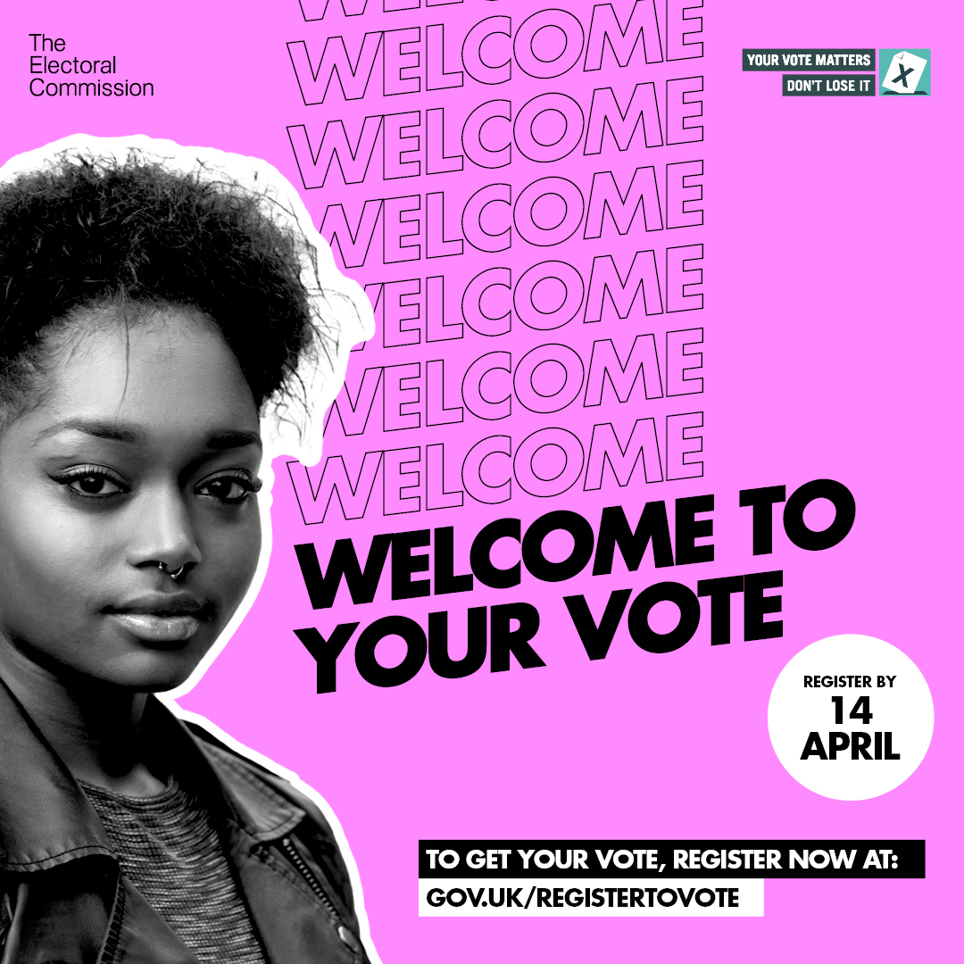


Campaign planning
05.
The Electoral Commission’s 2020 campaign designed to encourage young people to register to vote.

Slide 27
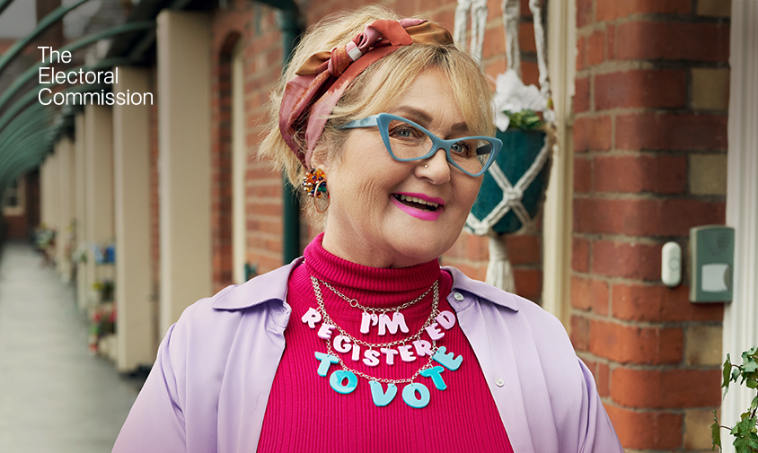
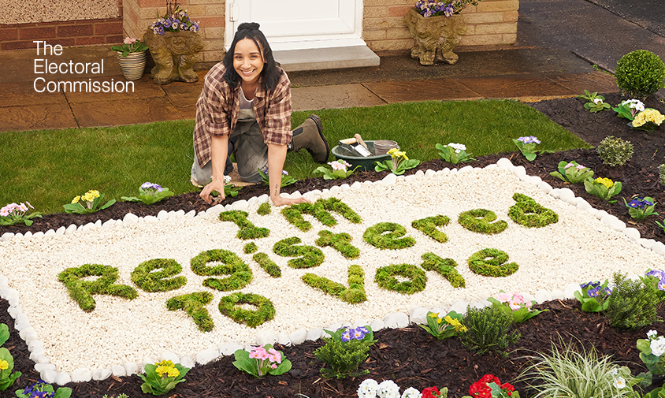
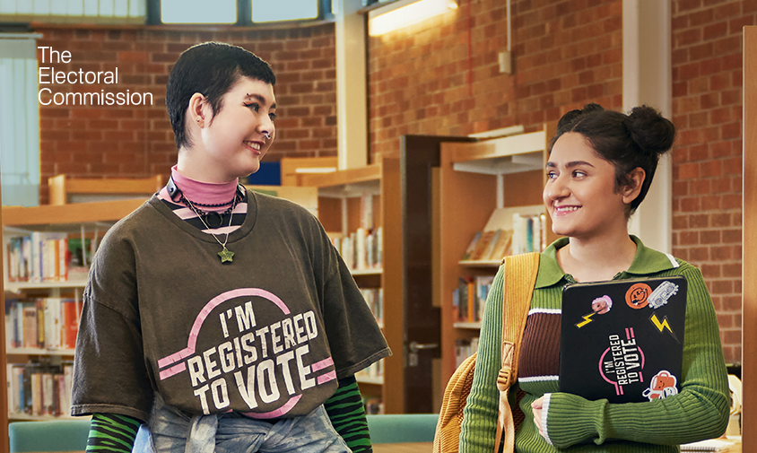
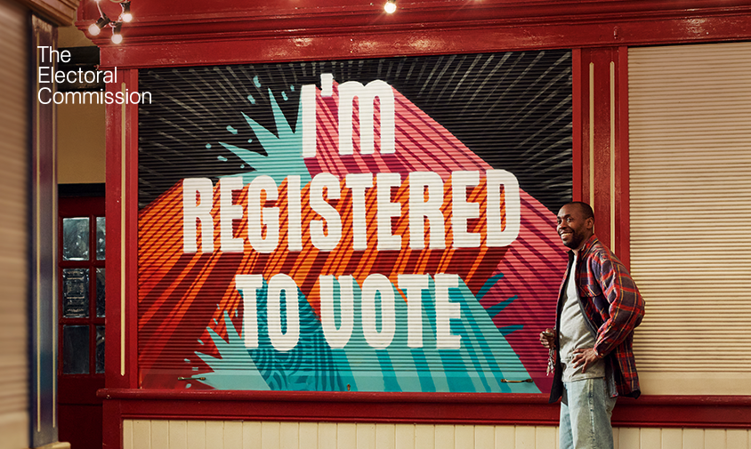
Campaign planning
05.
In 2024 the Electoral Commission ran a campaign across the UK to get everyone to register to vote. This campaign is called Show it Off. It is designed to make registering to vote and having your say at elections feel like something to be proud of.

Slide 28
Democracy in action
LESSON PLAN
06.
Students will present their campaigns and reflect on what makes a successful campaign, and will have the opportunity to register to vote.
It might be helpful for this lesson to take place a number of weeks after the students have delivered their campaign in school, to give them a chance to discuss any feedback or successes.
Learning objective:
Students will be able to reflect on the effectiveness of their campaigns.
Time needed:
60 minutes
Differentiation options:
We have suggested that young people run their campaigns before coming back together to participate in this session. An alternative is to run this session first and the winning campaign is delivered throughout the school as a class.
Resources required:
materials to produce a presentation of each campaign if necessary (this could be set as a homework task ahead of the lesson)
access to the internet to register to vote

Slide 29
Democracy in action
LESSON PLAN
06.
Starter
By show of hands ask students the following questions:
who had already registered to vote before this term?
who plans to register to vote now?
who is not planning to register to vote?
Ask students to share their reasons (reminding them of the ground rules for respectful discussion if necessary).
Team presentations
Ask each team to present their campaign to the rest of the class. It would be useful for them to include:
what was their key message?
what materials did they use (for example, share posters or an extract from a letter or speech)
what campaign activities did they deliver?
what was really effective about their campaign?
what didn’t work or was more difficult than they expected?
did anything change from their campaign plan?
did they receive any feedback about the campaign? Do they know of any students who have registered to vote as a result of their campaign?
Vote
As a class or in groups, discuss which campaigns were most effective. Why was this? Were there similar elements in the most successful campaigns?
As a class vote for the most successful campaign, using the campaign managers’ names on the ballot slips.
Register to vote
Give students a chance to register to vote online at gov.uk/registertovote
Watch the ‘Register to Vote’ film again, if useful.

Slide 30
Democracy in action
WORKSHEET
06.
Ask the class to vote for their favourite campaign. Put the campaign managers’ names in the left hand column of this sample ballot paper.
Vote for your favourite candidate by putting an ‘X’ in the box

