Slide 1




2026 Senedd Election
Assembly or form time session
Notes:
These slides can be used to introduce the 2026 Senedd election and share key information about taking part during an assembly or form time.

Slide 2

Senedd Election 2026
The Senedd election will take place on Thursday 7 May 2026
You can vote if you're aged 16 and over on polling day and live in Wales
To cast your vote, you must register to vote by midnight on 20 April 2026
The Senedd makes decisions about things that affect you and your community
Notes:
This slide can be used to introduce the election.
The election will take place on 7 May 2026
You need to be 16, living in Wales and registered to vote to vote in this election
You will be voting for the political party or independent candidate you want to represent you in the Senedd
The Senedd makes decisions about your education, health, transport, housing, and the environment

Slide 3
Today's session
We will learn about:
Your rights and how they relate to the election
What the Senedd is and why it's important
How to register and cast your vote in the Senedd election

Slide 4

Which of these do you have a right to? Why?
Notes:
Look at the topics on the slide. Which of these do we have right to by law? Why?
Form-time lesson - provide learners with time to discuss the question in pairs or small groups, before discussing their answers as a class.
Assembly – give learners time to think about the question and ask for responses from individuals in the audience.

Slide 5











Which of these do you have a right to?
Healthcare
Branded trainers
Clothes
Education
Chocolate
A safe place to live
Being able to
join clubs
Social media
Birthday presents
Being listened to
Notes:
Run through answers and highlight some of the key rights children have.
Highlight the right 'being listened to'. How might this link to taking part in elections?

Slide 6
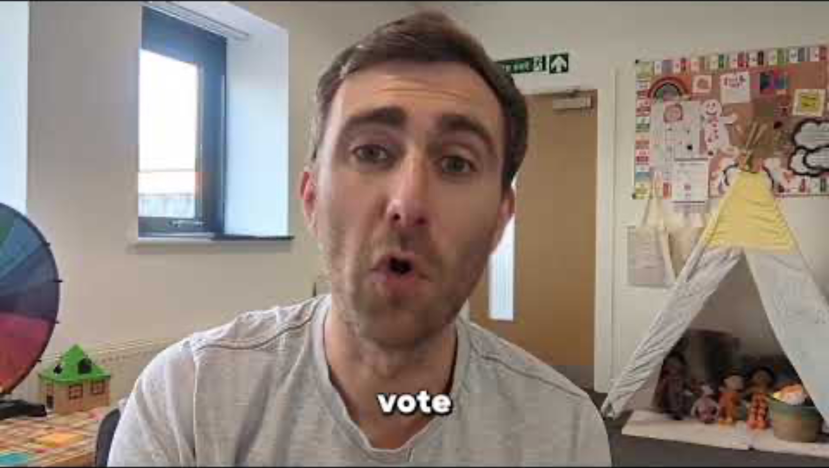
Notes:
Play the video.
Highlight that you have a right to have your say, and casting your vote in the Senedd election is one way you can have your say and make your voice heard.
Video link: https://youtu.be/7QBtRPxzqu4

Slide 7

What is the Senedd?
The Senedd (Welsh Parliament) is a democratically elected body made up of representatives from across Wales
It is their responsibility to:
Represent Welsh people and interests
Make sure the Government are doing their work properly.
Makes rules for Wales (laws)
Pass (some) taxes
Notes:
Introduce what the Senedd is.

Slide 8
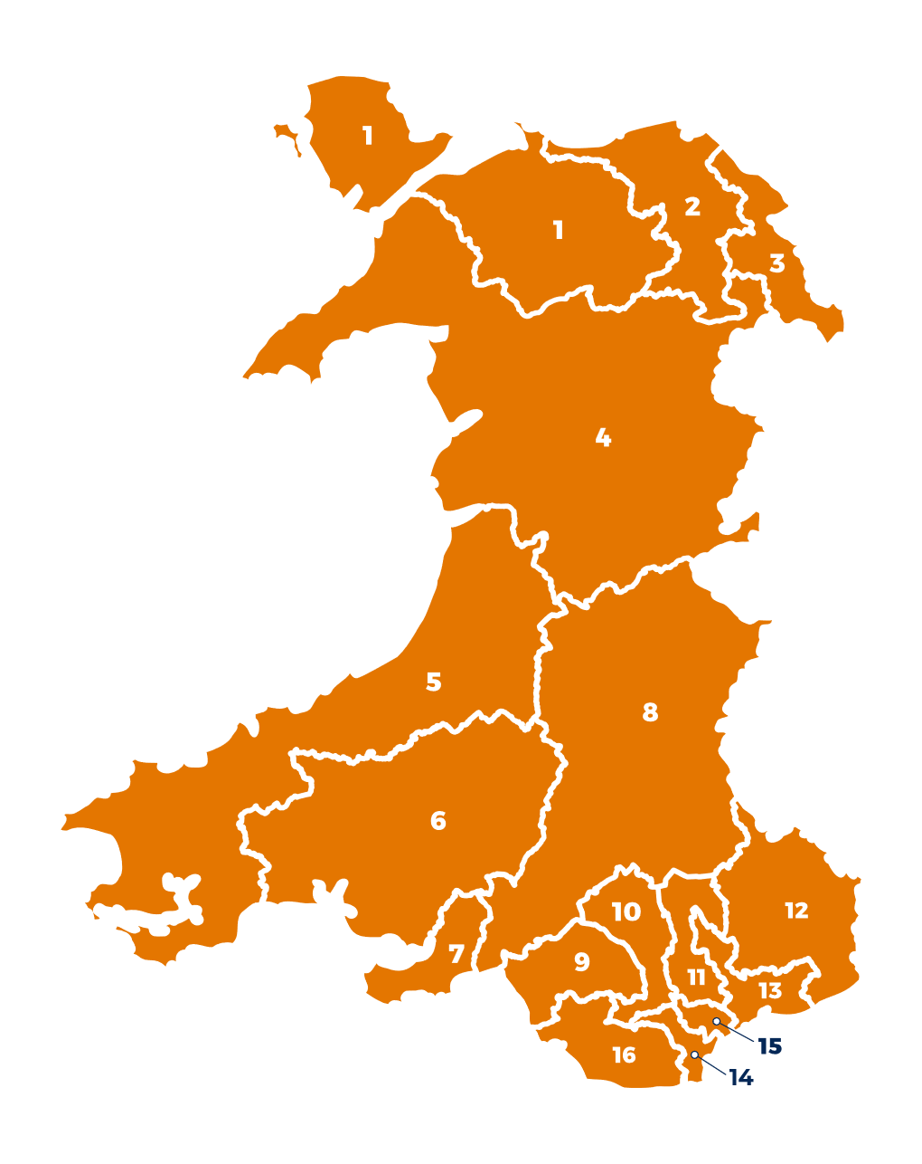
Members of the Senedd
Members of the Senedd are elected to represent us and our communities
From May 2026, you’ll see some changes to how the Senedd is formed:
96 Members
16 Constituencies
6 Members of the Senedd in each Constituency
Notes:
Talk through the role of Members of the Senedd.
Introduce changes to the Senedd. You may not want to cover this in detail, if learning about the Senedd is new to students. For students that want more information, the changes are:
96 Members: From the election in May 2026, the Senedd will have 96 Members instead of 60.
New voting system: Everyone 16+ will now have one vote, choosing a political party or independent candidate.
New constituencies: Wales will have 16 constituencies. Each constituency will elect six Members.
New rules: Anyone standing for election must live in Wales.

Slide 9




What is the Senedd responsible for?
UK Parliament
Senedd
The areas of governance the UK parliament are responsible for are known as Reserved Powers.
The areas of governance the Senedd are responsible for are known as Devolved Powers.
Notes:
Introduce the history of the Senedd and explain the difference between reserved and devolved powers.
Wales used to be governed by the UK Parliament in London. The UK Parliament used to make a lot of decisions here in Wales.
But since Welsh Devolution and the set up of the Senedd in Wales, this means the Senedd is able to make it’s own decisions on a lot of things that affect our everyday lives.

Slide 10
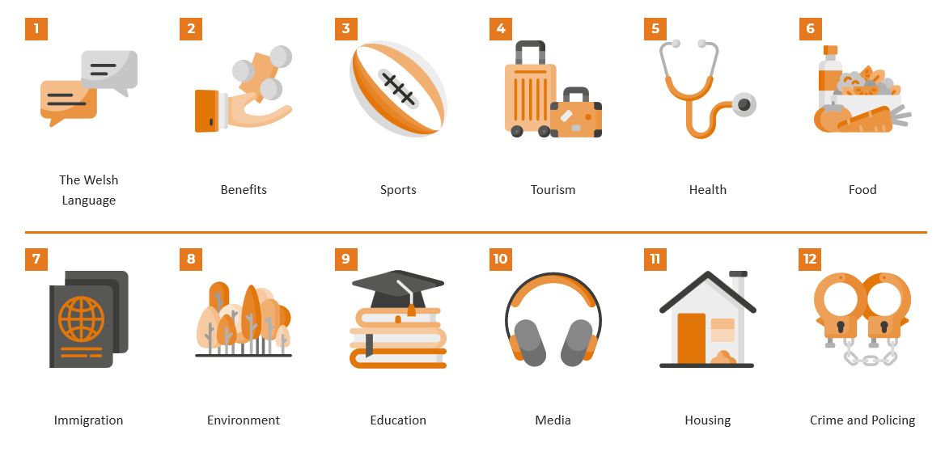
What is the Senedd responsible for?
Look at the different areas of governance
Decide which you think the Senedd is responsible for and which you think the UK government is responsible for
Notes:
What can the Senedd makes decisions on?
Look at the topics on the slide. Some are things the UK Parliament still makes decisions on here in Wales and others are things the Senedd makes decisions on.
Ask students to work in pairs or small groups (if you are in a form-time session) to decide which of the following aspects of our lives or powers do you think are decided by the UK government and which are decided by the Senedd in Cardiff Bay?
Answers are on the next slide.

Slide 11













Answers
The Welsh
Language
Benefits
Sports
Tourism
Health
Food
Immigration
Environment
Education
Media
Housing
Crime and Policing
Notes:
Show the answers and highlight the powers not crossed out which the Senedd makes decisions on.

Slide 12


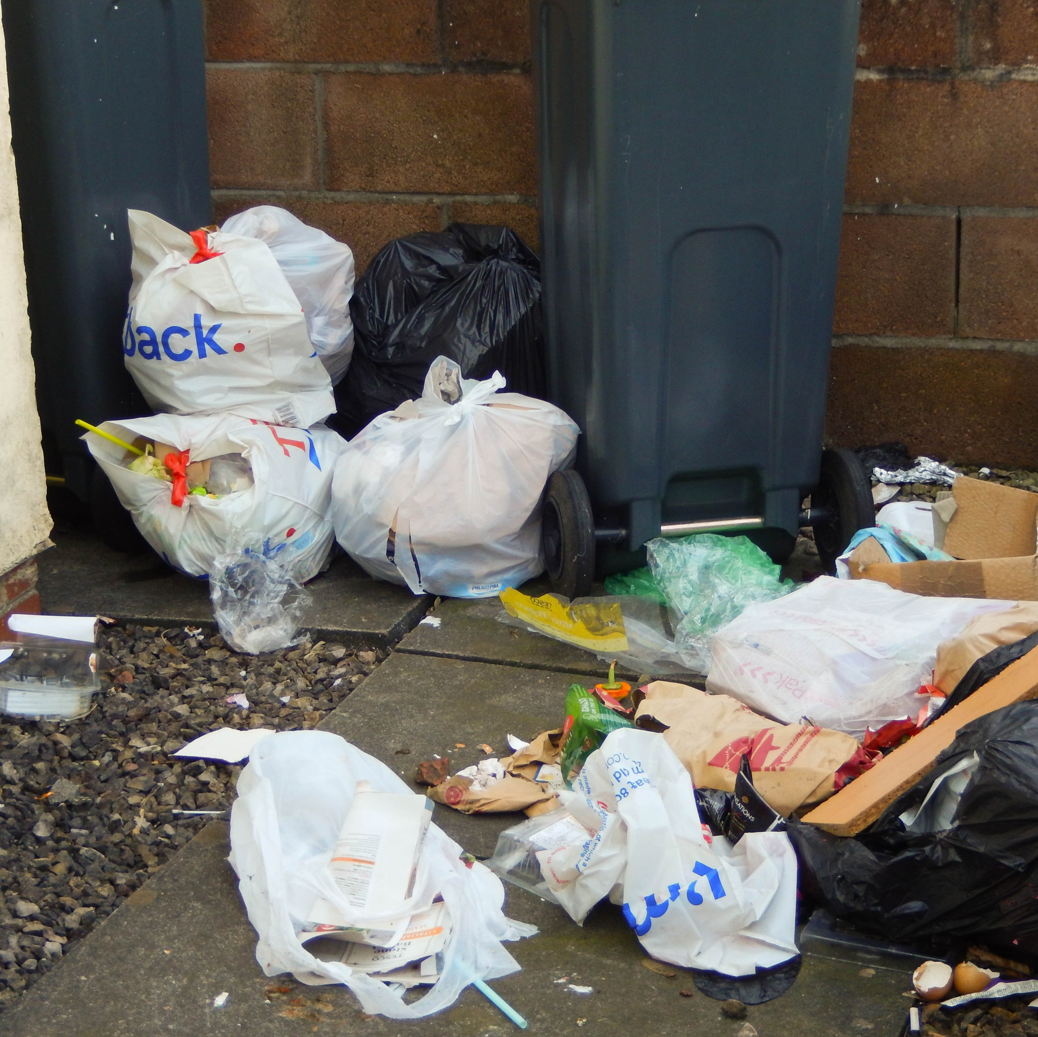

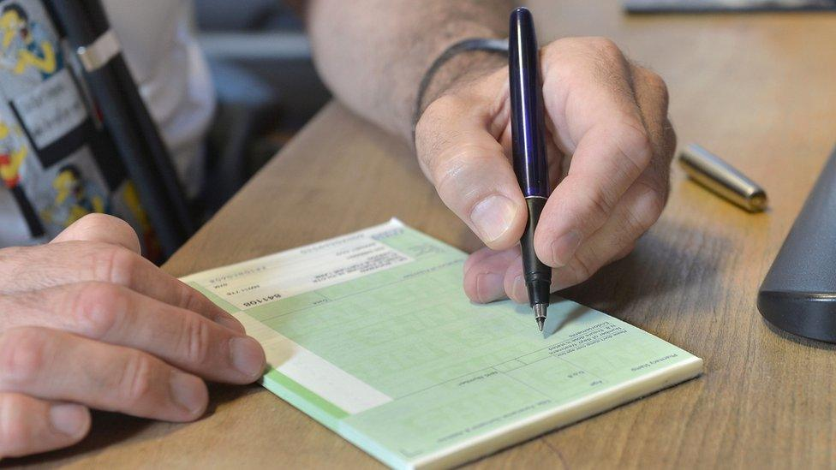

Why should I vote?
The Senedd has passed many different laws throughout its history.
Look at the images:
Which laws do they represent?
Notes:
Learners will work in pairs or small groups to come up with suggestions as to which Senedd laws each of the images represent.
Encourage learners to discuss.

Slide 13
Laws passed by the Senedd
Ban on smoking in public places
£1 bus fare for young people aged 16-21
5p charge for plastic bags
Presumed consent for organ donation
20 Mph speed limit for most built up roads
Free prescriptions
Notes:
Go through the answers with learners. You may wish to add some additional context.
Ban on smoking: The initial ban on smoking in enclosed public places came into force in 2007 and was extended to hospital grounds, school grounds, public playgrounds and childcare settings in 2021
£1 bus fare: Came into force in 2025, and will be extended until at least August 2026
5p Charge for plastic bags: Came into force in 2011
Presumed consent for organ donation: An “opt-out” system was introduced in 2015, where people are required to state whether they do not want to donate organs rather than if they do.
20 Mph speed limit: Introduced in 2020
Free prescriptions: Introduced in 2007, NHS prescriptions are free for everyone registered with a Welsh GP, regardless of age, income, or savings.

Slide 14
Who do these laws impact?
What do they suggest about why voting is important in the Senedd election?
Ban on smoking in public places
£1 bus fare for young people aged 16-21
5p charge for plastic bags
Presumed consent for organ donation
20 Mph speed limit for most built up roads
Free prescriptions
Notes:
Encourage learners to discuss the questions with the person next to them (or in small groups if you are using this as a form-time resource).
Emphasise that learners can have their say on issues that affect their daily lives by voting in the Senedd election and getting involved in democracy.

Slide 15

How to vote
Watch this video about how to vote in a Senedd election
Notes:
Watch the video about how to vote in a Senedd election.
Video link: https://vimeo.com/1121829010?fl=pl&fe=cm

Slide 16
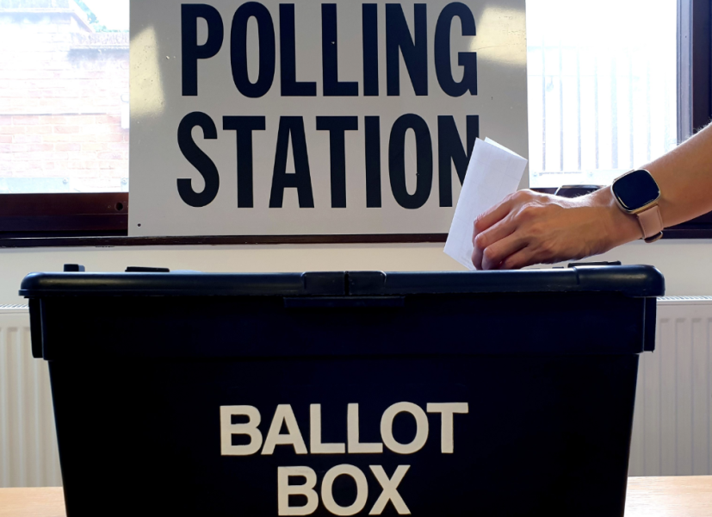

How to vote
You get one vote and will be given one ballot paper
You will vote for the political party or independent candidate you want to represent you in the Senedd
Always read the instructions on your ballot paper – it tells you exactly what to do!
Ask for help at the polling station if you need equipment or support
Election day:
7 May 2026
Notes:
Talk through what to expect on polling day and how to vote.

Slide 17

Preparing for the election
Register to vote by midnight on 20 April 2026
Decide how you’ll vote (you can vote in person, by post, or by proxy)
If you're voting in person, find your polling station
Put the date in your phone or school planner
Research who you can vote for and what they stand for
Election day:
7 May 2026
Notes:
Talk through they key steps to get ready to vote in the Senedd election. Highlight that you must register to cast your vote.
Extra info:
To vote by post you need to apply for a postal vote by Tuesday 21 April 2026. You can only apply to vote by proxy in certain circumstances. More information can be found on the Electoral Commission website - https://www.electoralcommission.org.uk/voting-and-elections/ways-vote
You can visit the Electoral Commission website to find your polling station and who you can vote for - https://www.electoralcommission.org.uk/i-am-a/voter/your-election-information
You can also visit https://whocanivotefor.co.uk/ to find out more about who you can vote for in your constituency.

Slide 18
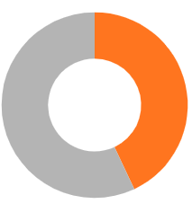
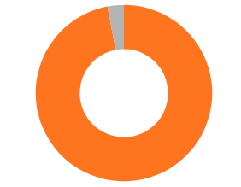
How many 16-17 year olds are registered to vote in Wales?
7%
43%
57%
Registered
16-17
+65
Not registered
93%
Notes:
Answer will reveal after click.
Ask learners what % of 16-17 year olds they think are registered before revealing the answer.
Only 43% of 16-17 year olds were registered to vote in 2024.
You could also ask 60% of the group to raise their hand or stand up to demonstrate that this % of 16-17 year olds in Wales are not registered to vote to have their voice heard.
Highlight that 16-17-year-olds in Wales are much less likely to be registered to vote than older voters and explain it’s important you know how to register to vote, so you can have your say.

Slide 19
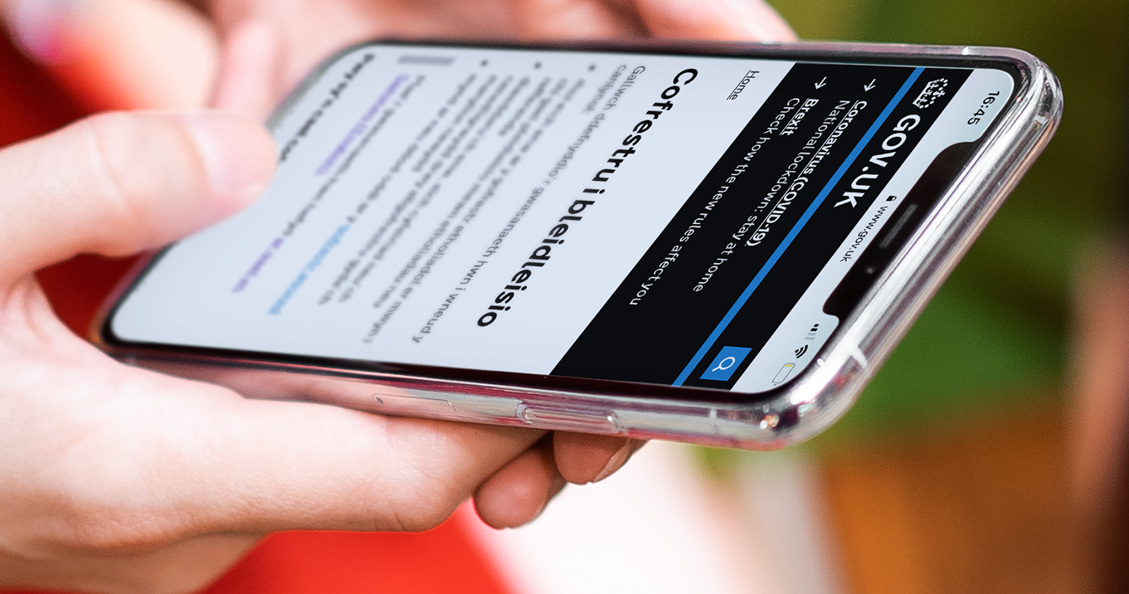
How to register to vote
You can register to vote in a Senedd election when you’re 14
You’ll be asked for your National Insurance number (but you can still register if you don’t have one)
It only takes five minutes
Register online at gov.uk/registertovote
Notes:
Share key information about registering to vote and answer any questions.
You don’t need to register before every election - you only need to register if:
you’ve never registered to vote before
you’ve moved house recently
you’ve changed your name
Talk to your local elections team at your council if you need help
More information on registering to vote can be found on the Electoral Commission website - https://www.electoralcommission.org.uk/voting-and-elections/register-vote

Slide 20






Who do I vote for?
Party manifestos will help you to decide who to vote for in the Senedd election.
You should vote for the party whose manifesto you agree with the most.
Vote for the policies that will make life better for you here in Wales.
Notes:
Explain how students can decide who to vote for.
They can check who they can vote for here - https://www.electoralcommission.org.uk/i-am-a/voter/your-election-information
The party / parties with most support will form a Government after the election and will be responsible for spending approx. £26 billion on services in Wales.

Slide 21

What do you need to do to get ready for the Senedd election?
Notes:
Encourage learners to turn to the person next to them and tell them the three main things they need to do to prepare for the upcoming Senedd election.

Slide 22
Senedd Election Checklist
Save the date - 7th May 2026
Register to vote by the 20th April 2026
Find out where your polling station is
Find out more about candidates and parties
Notes:
Option to show slide with election checklist after discussion.

Slide 23
Any questions?
Notes:
Answer any questions and remind students to register to vote.

Slide 24
Senedd Election 2026
The Senedd election will take place on Thursday 7 May 2026
You can vote if you're aged 16 and over and live in Wales
To cast your vote, you must register to vote by midnight on 20 April 2026
The votes will be counted after polling stations close
Once all the votes have been counted your new Members of the Senedd will be announced!
Notes:
Option to show slide with key info about the election again at the end.

