Slide 1
Polling station staff training session
Scottish Parliament election
Notes:
Aim
This PowerPoint presentation has been designed to assist with the briefing of polling station staff for the Scottish Parliament election. This presentation refers to the polling station handbook and quick guide produced by the Electoral Commission to support this election.
Additional materials
Polling station handbook, Polling station quick guide.
Equipment
PowerPoint, flip chart, sundries box, notices, ballot papers, ballot box, sample paperwork.

Slide 2
Introduction
Constituency Returning Officer
Electoral Services Manager
Notes:
Introduce yourself and anyone else involved in the briefing session.
If you have any key staff who deal specifically with polling stations and/or staff issues introduce them and/or give key contact details (this may encourage people to call with questions or problems when they know exactly who it is they need to contact).

Slide 3
Scottish Parliament elections
Constituency and Regional elections
Additional Member electoral system
No voter ID
No postal vote handling rules
Notes:
Notes for the trainer:
Explain the context of the poll(s) and any key local information
Display large copies of example ballot papers to show that they will look like (explaining that the actual ballot papers can’t be finalised until the nominations are closed).
Explain that more information on the voting system and the instructions to be given to voters can be found in the polling station handbook. Explain about any other information that voters will have received about the voting system e.g. household booklets.
Explain that there is no requirement for voters to show ID in order to vote at these polls, nor is there a requirement for postal vote handling forms to be completed.

Slide 4
Your role working in a polling station
Your role is vital in ensuring that voters, political parties, candidates and agents have confidence in the election process
It is essential that you:
Act impartially at all times
Comply with any instructions issued by the Returning Officer
Ensure the secrecy and security of the ballot
Ensure voters are able to cast their vote safely and privately
Call the elections office without delay in event of problems
Notes:
Notes for the trainer
Outline the session:
At this session we will:
outline what we expect you to do on polling day
discuss the voting procedures
highlight a number of administrative arrangements
Start with highlighting the importance of polling station staff being prepared for and confident about their duties.
Explain:
The role is vital in ensuring:
that voters have confidence in the election process
that all voters have a good experience, with any person who is entitled to vote being able to do so
that all voters are able to vote in private unless they are disabled / unable to read and they have requested assistance by either a companion or the PO
Highlight the key aims at the election:
that the poll is professionally delivered
that we produce accurate results in which all stakeholders are confident
that the process is transparent
that the poll is consistently administered

Slide 5
Staff in the polling station
Presiding Officers
Poll Clerks
Polling station inspectors
All should:
be polite and professional
understand the process for issuing ballot papers
dress appropriately
Notes:
Aim of this slide is to highlight what the main duties of Presiding Officers, Poll Clerks and polling station inspectors are and what is expected of staff working in the polling station.
Trainer - Broadly explain the main duties of staff working at the station – refer to the polling station handbook and in particular the added information regarding arrangements to help ensure the poll is accessible and any new processes to follow.
Presiding Officers will:
Be in charge of proceedings
Instruct and supervise the work of the Poll Clerks
Account for all the ballot papers, ballot boxes and paperwork
Ahead of the poll, POs should:
Visit the polling place and check out contact and access arrangements
Make contact with the key holder on at least two occasions: one early on and one near to the day.
Organise getting the keys, alarm codes, access, facilities, furniture.
Make sure any problems with contact are highlighted to elections team immediately.
Check out arrangements for ballot box collection and check contents as soon as possible. If ballot papers are collected in advance of polling day by Presiding Officers, these should be checked in advance to ensure the ballot papers are numbered in sequence and match those pre-printed on the CNL(s) and are stored securely. Check the register and absent voting lists are the correct ones for the polling station and that the register contains the expected number of electors for your polling station.
Contact other members of the team – in particular, you should be making contact with Poll Clerks on at least two occasions. Staff problems such as possible sickness should always be referred to the elections team to manage.
Poll Clerks will:
Assist with the layout of the polling station and prepare for the opening of the poll
Check that electors are eligible to vote at that polling station
Thinking points for poll clerks –
Make sure you know where the polling station is and where you can park if you are driving
Make sure PO contact details are available – contact in case of emergency
Polling station inspectors will:
Check things are set up correctly and running smoothly
Collect any returned postal votes
Trainer - Explain what is expected of all staff working in the station
Be polite and professional in dealing with the voters
Fully understand the process for issuing ballot papers
Dress appropriately –ensure clothing reflects professionalism and impartiality but is also comfortable and warm.
Trainer - Emphasise that both Presiding Officers and Poll Clerks must work together to understand their respective roles and, where required, carry out each other’s duties.

Slide 6
Specific duties of the Presiding Officer
Certain duties must only be carried out by the Presiding Officer. These are:
Instructing a police officer to remove someone from the polling station (but they must be allowed to vote)
Limiting the number of accredited observers at any one time
Notes:
Trainer - List the specific duties below which must be carried out by the Presiding Officer, as defined by law.

Slide 7
Staying Safe
All staff throughout the day should:
never put the safety of anyone inside the polling station at risk
be aware of any potential risks to safety
inspect the premises regularly
if hazards are discovered – find a remedy
if an accident occurs – follow procedures
be careful when lifting heavy objects
Notes:
The aim of this slide is to highlight the importance of health and safety for those working in the polling station.
Use common sense.
Call elections office if you find something you aren’t happy about.
Make use of polling station inspectors throughout the day

Slide 8
What happens if…
You can’t make contact with key-holder
You can’t gain access to the polling station
Staff fail to turn up or are late
A member of staff becomes ill
You have problems displaying notices
You have the wrong registers allocated to the station
The ballot paper numbers do not match those pre-printed on the CNL
Notes:
What are the risks?
This is an interactive slide – click on the slide and a scenario will appear
Ask trainees – what they would do in each of these situations?
Q - Can’t make contact with key-holder – If you can’t make contact don’t leave it, contact the elections office.
Q - Can’t gain access to the polling station – PO to contact the key holder and/or elections office.
Q - Staff failing to turn up or being late – contact the elections office
Q – Staff become ill–staff should contact the elections office immediately for further instruction
Q - Problems displaying notices – check polling station handbook and contact the elections office
Q - Wrong registers allocated to the station – contact the elections office
Q - The ballot paper numbers do not match those pre-printed on the CNL – contact the elections office
Discussion – discuss how the risks on the slide could be mitigated (emphasise that PO’s job starts before polling day). Could use flipchart.
Key learning point - Most issues can be avoided or resolved more quickly by making early contact with the elections office – MAKE CONTACT .

Slide 9
The Polling station
Setting up, layout and who can enter the polling station

Slide 10
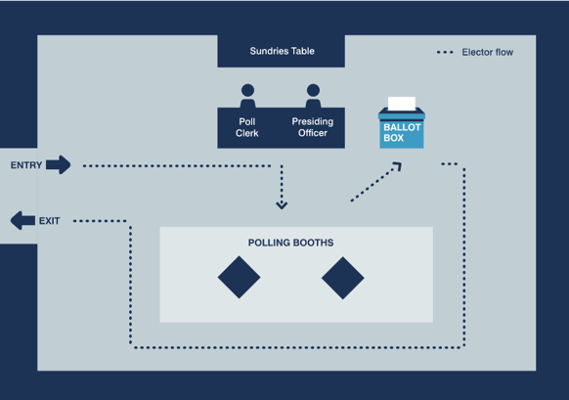
Polling station layouts
Notes:
The aim of the next 3 slides is to provide key points to consider on the lay out of the polling station
The example layouts on the slides also appear in the polling station handbook
Trainer - refer to the polling station set-up list in Appendix 11 of polling station handbook
As far as is possible the layout should support the flow of electors through the polling station and prevent bottle-necks or areas where voters can congregate, particularly around polling booths, to help maintain the secrecy of the ballot.
RO should amend to reflect local arrangements/circumstances.
Trainer – refer to the polling station set-up list in Appendix 11 of polling station handbook.
When setting up the station – remember that the layout must work for the voter.
Walk route voter expected to follow – ensure route is fully accessible to all voters
Consider needs of those with mobility and visual impairments
Provide seats for electors who may need to rest
Ballot box position – accessible but safe, the PO must be able to see it clearly at all times and voters must pass by it on the route from booths to door
Privacy screen/ area- conveniently located, but positioned to allow privacy for the users
Think of the areas of the polling station where polling agents (including candidates and election agents) and observers can be positioned so that they can oversee proceedings but not get too close to put voters off.
At the discretion of the Presiding Officer, tellers can be within the building / area that has been hired but should not get too close to others and not be able to see or hear what is going on in the polling station. They cannot demand information from electors. Think where they could be, perhaps arrange chairs to encourage the tellers to keep their distance. Be aware of tellers guidance.
Other supporters and any people who may be campaigning must remain in public places such as the public street. They must not impede the electors or cause undue influence. Contact the elections office if there are any issues.

Slide 11
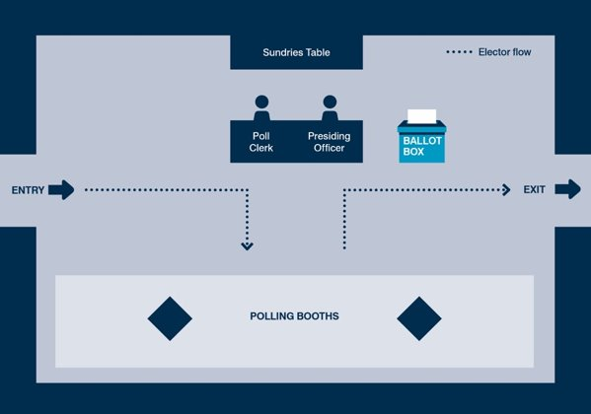
Polling station layouts (cont’d)

Slide 12
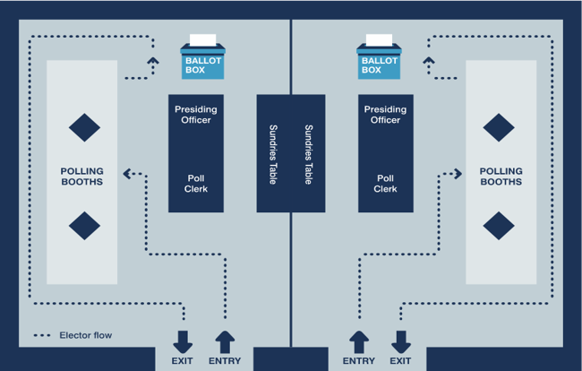
Polling station layouts (cont’d)

Slide 13
Getting ready to open the polling station
Before polls open….
check layout of the station
prepare and check the stationery
arrange the ballot papers in numerical order
prepare register and corresponding number list
complete the polling station checklist
any problems - contact the elections office
Just before 7am….
show box is empty
seal just before 7am
don’t allow candidates / agents to add seal at this time
be ready to greet voters
Notes:
This slide aims to provide key points to consider on setting up before polls open.
Trainer – refer to the polling station set-up list in Appendix 11 of polling station handbook
Check layout - clear pathway – accessible to all –
Check all notices up
Check screens in place [if applicable]
If pencils are used, that they are ready and sharp
Check all notices up and in a place where voters can see them. Also, the ‘Information for Voters’ notice in each polling booth and the notice entitled ‘Guidance for Voters’ is displayed inside the polling station.
Equipment – enlarged ballot paper, magnifier, tactile voting device any other equipment provided to assist with accessibility – –available for use at any time
Trainer - have available examples of the polling station equipment and different types of notices at the briefing so that people can see it, ask how anything is used or what things are for.
Trainer – run through final tasks to carry out just before polls open.

Slide 14
Who can enter the polling station?
  Voters
  Returning Officer and staff
  Candidates – (only one candidate from a particular party list may be present at any given time)
  Election agents
  Polling agents
  Police officers
  Representatives of the Electoral Commission
  Accredited observers
  Under 16s accompanying voters
  Companions of voters with disabilities
Notes:
Trainer – Ask trainees the question; ‘who can enter the polling station?’
Interactive slide – a click will make answers appear
Discussion point
Can tellers wear rosettes with party names / candidates?
[Tellers should wear coloured rosettes of a reasonable size, as this assists electors by making it clear that they are activists and not electoral officials. The rosette may display the name of a candidate or party and/or emblem or description; the rosette should not bear a slogan and must not be oversized]
Can the media enter the polling station to film a candidate/campaigner voting?
Representatives of the media have no right to enter a polling station except as voters or accredited observers. They must not be allowed to film or interview voters in the polling station.

Slide 15
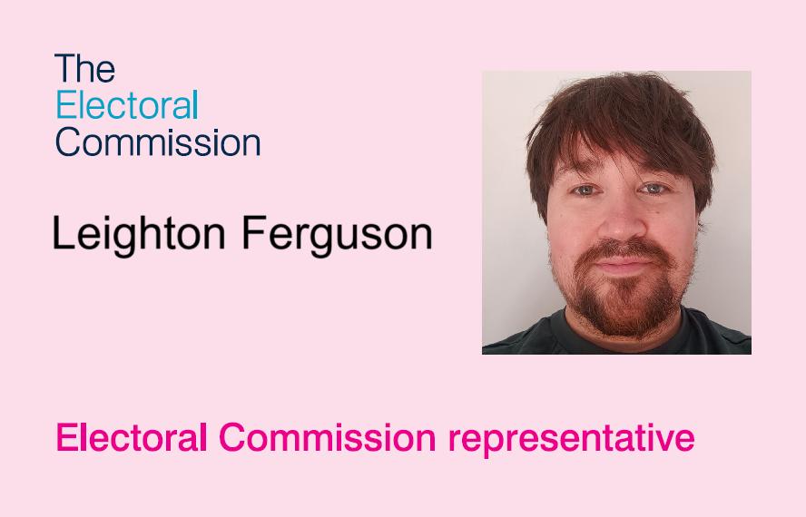
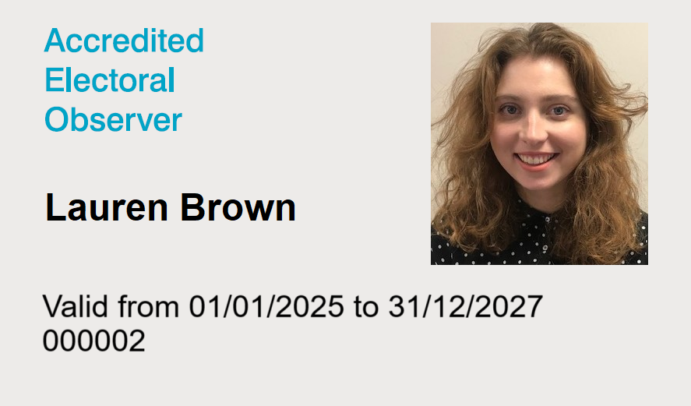
Accredited observers and Commission representatives
Notes:
The aim of this slide is to highlight what polling station staff should expect if observers and Electoral Commission Representatives visit the station.
Trainer – Explain that observation is an important part of the election process and should not be obstructed it in any way.
Accredited observers and Electoral Commission representative will have photographic ID issued by the Electoral Commission
Accredited observers & Commission representatives do not need to give advanced warning of their visit, however they may have contacted the RO in advance to advise that they will be observing in your area.
Accredited observers and Commission representatives DO need to provide you with ID when they come into the station.
Silver badges (ie those issued to accredited observers) will have a start and expiry date, as well as a reference number above the picture.
To ensure the safe and effective conduct of the poll, Presiding Officers are entitled to limit the number of accredited observers (but not Commission representatives) present inside a polling station for a specified time – such as for 30 or 60 minutes. If, due to the number of electors waiting to vote or the number of observers already present, there is a risk to the safe and effective conduct of proceedings you may need to temporarily limit the number of observers and/or the amount of time observers that can stay in the polling station, to ensure that there is sufficient room to maintain physical distancing and that the poll can proceed effectively. However you cannot bar all observers from the entire process, only to limit the number of observers present at any one time. When such action is taken, this should be recorded in a polling station log.
Trainer - Refer POs to EC publication Observers at UK elections: www.electoralcommission.org.uk/elections/electoral_observers (guidance for POs can be found at the bottom of the page, under the heading: Returning, Counting and Presiding Officers) and the Commission’s Polling station handbook.

Slide 16
Customer care
Be professional
Show a personal interest
Put the voter first
Be helpful and approachable
Allow them to put their point across before responding
Don’t say ‘No’, tell them what you can do for them and what they can do
But the election rules must be followed at all times, no matter how insistent, upset or angry people are
If in doubt, contact the elections office
Notes:
The aim of this slide is to highlight the importance of customer care, particularly if face with a difficult situation.
Trainer - reinforce that voters who feel comfortable with the voting experience are more likely to participate regularly. All voters should receive a consistent level service.
Being positive and empathetic can often help to diffuse difficult situations.
Make sure that you do not lead voters to vote in a specific way when offering assistance.
The language used to assist or give instructions to voters in the polling station should be English. The Returning Officer may have provided instructions or guidance in alternative languages or formats depending on requirements within the community.
The Presiding Officer should be familiar with what resources are available and provide these as and when appropriate. In some exceptional cases the translated notices may not be sufficient or appropriate. For example, a voter may have low levels of literacy or may have a question that falls outside of what is covered by the notices. In those circumstances, if polling station staff are able to provide information in a language spoken by the voter, assistance in a language other than English may then be provided.
Where assistance is given in another language, you should explain to other staff and any polling agents or observers present what question has been asked and the response given.
The electoral rules must always be followed –refer to the polling station handbook and if in doubt, call the elections office.
Be aware of the security of voters personal details on the electoral register and poll cards. Ensure any poll cards left by voters at the station are destroyed in line with your document retention policy.
Discussion points
What types scenarios could occur in the polling station which may be challenging? For example, someone not on the register, someone in the wrong polling station etc.
What strategies could be used to meet those challenges? – Talk about customer services here – active listening, remaining calm etc

Slide 17
Ensuring access for all voters – being aware of the barriers faced by disabled voters
Not all disabilities are visible or obvious
Some voters may have more than one impairment
Communication with electors is important
Electors may use alternative methods of communication
Equipment provided can help overcome certain barriers
Electors may bring their own form of additional assistance
Notes:
The aim of the following 3 slides is to highlight the importance of ensuring all voters receive the same level of service and to explain the tools available to polling station staff to ensure that any barriers faced by disabled voters can be overcome or reduced.
Given the legislative requirements to meet accessibility standards, you may wish to have separate, specific training to cover this in more detail working in conjunction with your Equality, Diversity and Inclusion (EDI) officer or HR department.
Polling station staff should have an awareness that:
not all disabilities are visible or obvious- polling station staff should not make assumptions about what equipment voters might need. It is important to consider the needs of the person, not a specific disability.
some voters may have more than one impairment – for example, a visual impairment and dementia. This may require a combination of different methods to enable an elector to vote
communication with electors is important- emphasise the importance of clear communication about the voting process and of clearly communicating that assistance and equipment is available if required
electors may use alternative methods of communication- cover alternative methods of communication that voters may use for example verbal, written, Makaton, and British Sign Language (BSL)
equipment provided can help overcome certain barriers- show how the equipment provided at the polling station can enable or make easier the process of voting in the polling station for disabled voters, particularly where polling station staff may be less familiar with some types of equipment, for example hearing loops
electors may bring their own form of additional assistance
a voter may bring a companion to assist them in voting- more information on next slide
they may also need to have an assistance animal present- assistance animals should not be prevented from entering the polling station
voters with sight loss may use apps on their mobile phones or carry pocket-sized assistive equipment, such as video magnifiers, to help them read documents in the polling booth or in conjunction with a tactile voting device- the use of text to speech apps are acceptable for use in polling stations
TRAINER: Cover any specific equipment/support that has been provided, particularly if it has been done following a request from an elector, and any relevant public awareness campaign messages that you have been using locally. We have produced a template survey for polling station voters who required additional assistance when voting, which you may want to provide in polling stations. If you are providing the polling station survey, please highlight during this briefing.

Slide 18
Ensuring access for all voters – what you can do
Clear access to the building and in the station
Speak directly to a disabled voter, even if they have a companion with them
Think about what help people with a disability and their supporters need. You could:
  ask if someone needs help
  offer to show someone the set-up in the polling station and the process of casting their vote
  explain they can vote with the assistance of the PO or a companion
Notes:
Trainer – refer to Appendix 1 in the polling station handbook
Equality issues – while physical access is important, this is not the only consideration in ensuring equality
Ensure clear access to the building and within the polling station with ramps where necessary, temporary alerters/doorbells for doors that are required to remain shut, appropriate lighting inside and out, and a reserved parking space for disabled voters if parking is available.​
Ensure that any large print ballot papers, tactile voting template, magnifying glasses, easy-read/alternative format literature, easy grip pencils, chairs/seating, the wheelchair accessible booth, are all visible and available when people enter the station.
Providing assistance
Disabled voters or those who cannot read or write may ask for assistance to mark the ballot paper – Presiding Officer can do this or a companion.
Companions of voters with disabilities must be 16 years or over and either a close relative (grandparent, father, mother, brother, sister, spouse, civil partner, son, daughter, or grandchild), or a qualified elector [companions of voters must complete a declaration (SHOW COPY)]. Companion can assist no more than 2 voters – more information in the PSH.
Secrecy of the ballot must be ensured.
Enlarged copies of the ballot paper should be available to be taken into the polling booth with a voter to assist them marking the actual ballot paper. They can also be fixed to the wall/notice board for voters to look at before they enter the booth.
Your RO may provide laminated copies of the enlarged ballot papers which can be cleaned after each use, or a stock of single-use copies which can be disposed of after use.
A person who is registered as an elector or entered on the list of proxies cannot be refused a ballot paper, or in other words be excluded from voting, on the grounds of mental incapacity.

Slide 19
Ensuring access for all voters – supporting people with sight loss
Voting – by making a cross in a specific location on a piece of paper – is principally a visual exercise
Make sure the large-print version of the ballot paper is displayed in a well-lit area
Make sure the enlarged sample ballot paper and tactile voting device are available to voters
Offer partially sighted or blind voters the enlarged sample ballot paper as a guide
Make sure you know how to use the tactile voting device and that it is cleaned after each use
The experience of someone with sight loss when they vote in a polling station – RNIB video
Notes:
Ensure that any large print ballot papers, tactile voting template, magnifying glasses and easy-read/alternative format literature are all visible and available when people enter the station.
Also make sure that you know how to use the TVD. Also demonstrate any audio solutions you have to support the use of the TVD (if applicable).
A blind or partially sighted elector may use an app on their mobile phone or carry pocket-sized assistive equipment, such as a video magnifier to help them read documents. These could be used in conjunction with the template.
Trainer - provide a practical demonstration of how to use the tactile voting device and any audio solutions (if appropriate). Where polls are combined and different voting systems are in use, different tactile voting devices may be required for the different ballot papers.
The PO should:
Remove the sticky tape at the back of the template and affix it to the ballot paper – reiterate the adhesive backing needs to be removed so the device firmly adheres to the ballot paper
Explain to the voter how to they should use the tactile voting device and ensure the voter is confident about using it
Explain the order of the candidates on the ballot paper

Slide 20
The experience of someone with a learning disability when they vote in a polling station
Charlotte – polling station https://www.youtube.com/watch?v=xmA_ZtYqGaE
Harry – polling station https://www.youtube.com/watch?v=-KjeqUkqj5Y
Notes:
These are videos of two people from Mencap about their experiences of voting in a polling station and what they think can be done to help someone with a learning disability.

Slide 21
Who can and cannot vote?
Using the electoral register and corresponding number list

Slide 22

Who can vote at the polling station at Scottish Parliament elections?
Electors with no letters or dates before their name
Electors who are 16 years of age or over on the day of the election
Electors with a ‘M’ or ‘L’ before their name
[only include if relevant] Electors who have registered anonymously - will have an ‘N’ instead of a name
Notes:
If you have any anonymously registered electors in your area, explain that any electors registered anonymously will appear without reference to their name or address on the register. Their entry will only consist of their elector number and the letter ‘N’ and can be found at the very end of the register and that Presiding Officers may not have any anonymous electors.
M is a qualifying foreign national who is entitled to vote at SP election and local government elections .
M – marker also includes convicted prisoners serving a sentence of 12 months or less, who are also entitled to vote. However as they are only entitled to vote by post or proxy there shouldn’t be an instance when they arrive in the polling station.
L = Peer who is entitled to vote at local government elections and SP elections
Refer to polling station quick guide, which will list franchise markers.
The following electors must not be given a ballot paper in the polling station:
-Electors who will not be 16 years of age until after polling day
-Electors with an ‘A’ before their name (postal voters)
Electors with an ‘E’ before their name (overseas peers)
Electors with an ‘F’ before their name (overseas electors)

Slide 23
Issuing the ballot papers
Marking the register and the CNL
  Ask the elector to confirm their name and address
  Mark elector’s elector number in the register
  Call out the name and elector number of the elector
  Enter the elector number on the Corresponding Number List (CNL)
  Do NOT write the elector number on the ballot paper!
  The ballot papers
  Open up fully so the whole paper is visible
  Official mark, ballot paper number and Unique Identifying Number (UIN)
Notes:
The aim of the slide is to summarise the normal voting process – explain corresponding numbers lists, UIN and official mark.
Exceptions are dealt with separately and are covered in more detail in the Commission’s polling station handbook.
Corresponding number list- show example on next slide
There is a separate sheet of paper for the elector number to be written on – the Corresponding Number List. The elector number is written beside the number of the ballot paper to be issued.
Make clear NOTHING must be written on the ballot paper.
The official mark will be [explain your official mark]. Refer to slide with example. Explain about watermark/barcode. Explain how to improvise and official mark – perforate the paper – in the absence of a watermark/barcode
The UIM will be [explain your UIM]. Also sometimes referred to as the Unique Identifying Mark. The UIM is another security device and is useful for a court if an election is challenged

Slide 24
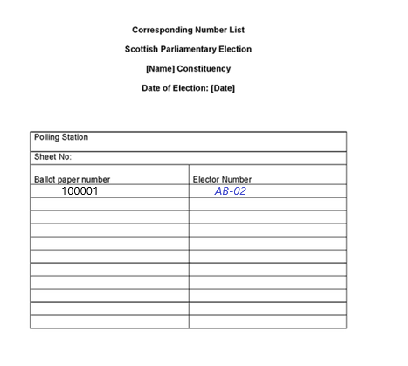
Example Corresponding Number List (CNL)
Example Corresponding Number List (CNL)
[Insert example]
Notes:
24
Ballot paper numbers will be pre-printed on the list so all you need to write on is the elector number next to the relevant ballot paper number. Do not write the elector number on the ballot paper.

Slide 25
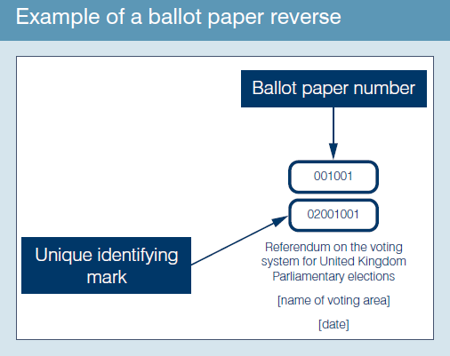
Example reverse of ballot paper
Unique identifying number
Notes:
Check that the ballot paper bears the unique identifying number on the back (see example).

Slide 26
Marking the register
Queen’s Walk |  |  | BC
 |  |  | JP12 7AS
411 M |  | Vella, Eva | 1
412 F |  | Vella, Tolek | 1
413 L |  | Vella, Christina | 1
414 |  | Brown, Robert | 3
415 |  | Evans, Gareth | 5
416 |  | Hall, Peter | 7
417 02/05/21 |  | Myers, Martin | 7
418 A |  | Bishop, Stephanie | 13
Notes:
The aim of this slide it to provide a demonstration of how to mark the register – consistently and accurately.
An example of a register marked for elector numbers 414 and 416.
Use a ruler to draw the line
Mistakes can be made as a result of poor quality/wobbly marks.
Be especially careful to accurately mark the register for members of the same household with the same surname.
Always ask for full name and address – unless you are dealing with an anonymous elector – even if the elector has presented you their card.
Discussion points
Can 415 vote? Yes. No marker against their name.
Can 412 vote? No. They are an overseas voter and cannot vote.
Can 418 vote? No. They are a postal voter so you cannot give them an ordinary ballot paper.
Can 411 vote – yes – they are qualifying foreign national and are entitled to vote
Can 413 vote – yes – they are a peer and are entitled to vote
Poll cards are not needed to vote (except for anonymous electors), and even where they are presented the elector’s name and address should still be asked for.

Slide 27
Providing information on the number of ballot papers issued
An election agent or polling agent might ask you for information on the number of ballot papers issued.
You can obtain the current total number of ballot papers that have been issued as follows:
the ballot paper number of the next ballot paper to be issued
minus
the ballot paper number of the first ballot paper issued
minus
the total number of spoilt ballot papers in the envelope for spoilt ballot papers (if any)
Notes:
*You should only include this slide if you have decided to allow the provision of this information
This request may come under the guise of ‘how busy have you been’ or ‘what is the rolling turnout figure’ etc?
You should only deal with requests where to do so would not negatively impact on any voters who are in a queue at the polling station and are waiting to be issued with a ballot paper. If this is not possible, you should advise the agent making the request to return later.
You can find the number of the next ballot paper to be issued by looking at:
the back of the next ballot paper to be issued; or
the corresponding number list (i.e. the list pre-printed with ballot paper numbers against which you record the elector’s number when you issue a ballot paper)
You can find the number of the first ballot paper issued by looking at:
the first ballot paper number on the corresponding number list
You must place spoilt ballot papers in the envelope provided, count them at the close of poll and enter the total figure on the ballot paper account. You should keep a running tally of spoilt ballot papers to avoid having to count them each time a request is made.

Slide 28
Anonymous electors [slide to be used only if relevant]
Anonymous electors
  Must have poll card
  Marked ‘N’ on register
  Name and address must not be called out
  Mark the register by their poll number as usual
Notes:
Only use this slide if you have anonymous electors
Explain anonymous elector voting procedure
Poll card should be returned to the elector to protect privacy

Slide 29
Secrecy of the vote
Make sure voters go to polling booths individually so that their right to a secret vote is protected.
No other person is allowed to accompany a voter to a polling booth unless a voter who is disabled or unable to read has requested assistance to vote.

Slide 30
Marking the ballot paper
Some electors may need to have the voting process explained to them:
voters are given two ballot papers: one for the constituency election and one for the regional election.
On the lilac constituency ballot paper, voters are asked to place an ‘X’ next to the candidate of their choice.
On the peach regional ballot paper, voters are asked to place an ‘X’ next to the party or individual candidate of their choice
Notes:
Modify as required.
Show ballot papers for the election.
Members of the Scottish Parliament are elected under the additional member electoral system . Under this system, voters are given two ballot papers: one for the constituency election and one for the regional election.
On the lilac constituency ballot paper, voters are asked to place an ‘X’ next to the candidate of their choice. On the peach regional ballot paper, voters are asked to place an ‘X’ next to the party or individual candidate of their choice
Explain that if a voter votes for more than one party or candidate on each of the ballot papers, their vote will not be counted

Slide 31
If voter ask you how to vote…..
If a voter asks you how to vote, read out the instructions at the top of each ballot paper.
If voters make a mistake, simply follow the spoilt procedure.
Don’t get into conversations about the election, the police, the council or anything other than how to vote.
More information in the polling station handbook
Notes:
Highlight importance of staff being professional and impartial when talking to voters.
If asked by a voter, how to vote/what to do – staff can explain:
The top of the ballot paper gives the instructions on how to complete the ballot paper.
Some voters may still find the instructions unclear. They may ask, for example, to have their favoured candidate or party pointed out to them, or ask where they should make their mark on the ballot paper.
In these circumstances, the Presiding Officer should read out the instructions printed at the top of the ballot paper and the list of parties and candidates in the order that they appear on the ballot paper.
Even if you know about the topic the voter has a complaint about, or even work for the council, explain that you can’t talk about that today and direct them to contact the council if they wish after they have voted. On polling day you are working for the Constituency Returning Officer, not the council.

Slide 32
What happens if…?
you are handed a certificate of employment
a voter spoils a ballot paper
a voter has nominated a proxy but the voter arrives before the proxy
a person arrives to vote but the register indicates the person has already voted
a person arrives to vote but the register indicates the person is a postal voter
a person arrives wanting to vote as an emergency proxy
a person believes they should be on the register but they are not listed
there is a disturbance at the polling station
Notes:
Interactive slide –
Either work in groups or ask for answers from the trainees.
Use this slide to explain special voting procedures.
Explain what a certificate of employment looks like and what information the staff need from that form.
If the voter spoils a ballot paper they must be issued a replacement and the PO must account for any spoilt papers on the ballot paper account.
If the voter arrives before the nominated proxy then the proxy cannot vote and must be told the situation.
This is a situation where the PO must put the prescribed questions to the voter before issuing a tendered ballot paper.
A’ markers cannot be given an ordinary ballot paper at the polling station:
Electors or proxies marked as having been issued with a postal vote cannot be given an ordinary ballot paper in the polling station. However, an elector or proxy who claims never to have applied for a postal vote but is listed as a postal voter, is entitled to receive a tendered ballot paper at the polling station at any time. Alternatively, up until 5pm on polling day, they may be issued with a replacement postal ballot pack but only by the elections office. The Presiding Officer should refer the elector or proxy to the Returning Officer for advice on this procedure.
An elector may appoint an emergency proxy to vote on their behalf at the polling station in certain circumstances:
In the case of a disability (whether a medical condition, illness or otherwise) arising after the deadline for ordinary proxy applications (i.e. after 5pm on the sixth working day before the poll)
if they are a mental health patient detained under civil powers (i.e., who are not also detained offenders)
if their occupation, service or employment means they cannot go to the polling station in person, provided that they only become aware of this fact after the deadline for ordinary proxy applications (i.e. 5pm on the sixth working day before the poll)
Emergency proxies can be granted up until 5pm on polling day. Explain how any updates would be notified on polling day.
At Scottish Parliamentary and local council elections, if a person becomes disabled before 5pm, 6 working days before polling day and the person’s disability meant that they could not reasonably be expected by virtue of that disability to have made an application before the deadline for an ordinary proxy, they may apply for an emergency proxy, but they must provide an explanation of why they were unable to apply before the ordinary deadline
If the voter has arrived at the correct polling station then contact electoral services as there may have been a clerical error when compiling the register – outline the process to be followed.
Emphasise that poll never to be adjourned on the PO’s own initiative.
For further detail on the above please see the Commission’s polling station handbook. [The Commission has developed a polling station scenarios role play which can be used to support this slide].

Slide 33
The prescribed questions
No other enquiry or questioning of electors is allowed other than asking the prescribed questions
The prescribed questions must be asked:
  when a candidate, an election agent or polling agent requests them
  before issuing a tendered ballot paper
The prescribed questions should be asked:
  when you suspect personation
  when a registered elector is clearly under age
  when an elector states their name is not as shown in the register of electors
Notes:
Refer to Appendix 5a of the polling station handbook.
Make clear that only the prescribed questions are able to be asked if there is concern about the eligibility of a person who applies for a ballot paper. If there is concern then ask the prescribed questions and record the event in the polling station log.
Make clear that they must not ask any other questions about the qualification to vote other than the prescribed questions.
Refer to: Personation advice for Presiding Officers and Log to record details of postal voters who claim not to have applied for a postal vote available on the Commission’s website.

Slide 34
Postal votes
voters can hand in their postal votes at any polling station within the constituency
returned postal ballot packs must be stored, sealed and labelled as instructed
postal votes will be collected during the day. Any not collected will be returned with the ballot box at close of poll
Notes:
It is important to emphasise the correct process when dealing with postal votes that are handed into the polling stations.
They must be for the constituency
Any completed packs that are handed in must be placed in the relevant packet for postal votes handed in at the polling station. The packet must then be sealed at close of poll.
[insert any local instructions]

Slide 35
Postal votes
‘A’ markers cannot be given ordinary ballot papers at the polling station:
  direct to Constituency Returning Officer for replacement
    if a person has spoilt, lost or not received their postal ballot paper, it can be replaced until 5 pm
  tendered ballot paper procedure
Notes:
Explain the procedure for directing people for a replacement ballot pack and explain tendered ballot paper procedure.

Slide 36
Close of poll
The procedures to be followed

Slide 37
Managing a queue
At 10pm:
  bring all the waiting electors into the room/building and close the door, OR
  if the room/building is not big enough, a member of the team should stand at the end of the queue, to mark it, OR
  hand out tokens to identify electors in the queue
  continue to issue ballot papers until everyone who was in the queue by 10pm has voted
Anyone who was not in the queue at 10pm must NOT be issued with a ballot paper
  Just before 10pm:
  make sure those waiting can cast their vote
  check that anyone waiting to vote is at the correct polling station for their address
Notes:
37
Explain that it is rare for there to be queues to vote at 10pm but there could be a queue even with only a few people. If someone arrived at the polling station in time, it is their right to cast their vote.
If there are lengthy queues at any point in the day, particularly in the last couple of hours before the close of poll, polling station staff should contact the election office to discuss the situation and agree how to deal with it.
Electors must be in the queue for the polling station they have been allocated to. If they are in the queue for a different polling station in the same polling place or at the wrong polling place altogether, unless they get to the right one and are in the queue there by 10pm , they will be unable to vote.
Staff should manage a queue at the close of poll by either bringing all the electors into the room or building and closing the door so no-one else can join the queue after 10pm, or if the room or building isn’t large enough, a member of the polling station team should stand at the end of the queue to mark it and explain to anyone arriving that the polls closed at 10pm and, by law, they cannot vote.

Slide 38
Close of poll
Once the last voter has voted, seal the ballot box
Candidates/agents are also entitled to affix seals to the ballot box at this point
Notes:
38
The PO should seal the ballot box and begin to complete paperwork and pack up the polling station with the Poll Clerk(s).

Slide 39
After close of poll
Complete the ballot paper accounts accurately
The ballot paper account must be placed in the envelope provided – keep it with the ballot box
Ensure all documents placed in correct packets and signed as appropriate
Poll clerks to assist packing up station to allow presiding officer to do these important tasks
Notes:
39
You could run a mock exercise in how to fill in the ballot paper accounts [The Commission has developed such an exercise as part of its suite of support materials].
Take time to complete the ballot paper accounts and make sure this is done accurately - otherwise it will cause problems at the count.
Take time to ensure that all documents are placed in the correct packets and are signed as appropriate.
Explain any other local arrangements with regard to equipment and left over sundries and stationery.
Data protection – poll cards need to be disposed of securely and in line with both data protection legislation and your authority’s data retention policy.
Give any specific instructions regarding the transportation of ballot boxes and polling station materials to the verification and count centre, including any instructions for the safe delivery of materials.

Slide 40
Any questions?
Notes:
You may want to test if all the polling station staff have understood and feel fully confident about their role on the day. [The Commission has developed a multi-choice quiz which can be used for this purpose as part of its suite of support materials].

Slide 41
Additional Information
Election team contacts
Electoral registration team contacts
Electoral Commission website
  www.electoralcommission.org.uk
Feedback sheets
Notes:
Personalise this slide as appropriate.

