Slide 1
WELCOME TO
WELCOME TO
WELCOME TO
WELCOME TO
WELCOME TO
WELCOME TO YOUR VOTE
2026 Senedd Election How to Vote

Slide 2
Today's session
We will learn about:
Why voting is important
What the Senedd election is and what you are voting for
How to register and cast your vote at a Senedd election

Slide 3

Why is voting important?
10 minutes

Slide 4


2026 Senedd Election
A Senedd election will take place on Thursday 7 May 2026
You can vote if you're aged 16 and over on polling day and live in Wales
Why does it matter?
The Senedd makes decisions about things that affect you
This election is your chance to have your say
Election day:
7 May 2026
Notes:
Explain that there is a Senedd election taking place in 2026 and emphasise why it matters.
You could also invite learners to share their ideas.
Why it matters:
The Senedd makes decisions about your education, health, transport, housing, and the environment
Your voice matters. This election is your chance to have a real say in shaping Wales’ future, show that young people’s votes count, influence decisions that affect you and your community every single day
If young people don’t vote, decisions will still be made - but without your voice

Slide 5
Starter – everyday politics
Everyday politics examples
7am – get the bus to school
School bus services are controlled by local councils
12.15pm – have a school dinner
Guidelines for healthy eating in schools are published by the Senedd
4pm – go to the park
Parks, leisure and libraries are managed by the local council
6pm – watch BBC news
The BBC is funded by the UK Parliament
10 minutes
In pairs write down the timeline of your typical day.
Highlight the activities that you think are impacted by politics.
Let’s discuss.
Notes:
Ask students to write down the timeline of their typical day, highlighting activities that are impacted by politics.
Challenge learners to identify who is responsible for each area at they have labelled: local councils, the Senedd or UK Parliament.
Feedback as a class, highlighting areas of their lives impacted by the Senedd. Remind learners that to have their say on these issues, they can vote in elections.

Slide 6
What is a Senedd election and what are we voting for?
20 minutes

Slide 7

What is the Senedd?
The Senedd (Welsh Parliament) is a democratically elected body that represents the interests of Wales and its people.
Notes:
Introduce what the Senedd is.

Slide 8

Powers of the Senedd
Instructions:
Watch the video about the Senedd on the next slide
Note down as many of the powers and responsibilities it mentions
Notes:
Introduce the activity and how you'd like students to record their answers.
You may want them to use a mini whiteboard or a piece of paper.

Slide 9

Watch this video about the Senedd
Powers of the Senedd
Notes:
Show the video about the Senedd and askstudents to list as many responsibilities of the Senedd as they can think of.
Video link: https://youtu.be/5rPOXt-ZfsY

Slide 10
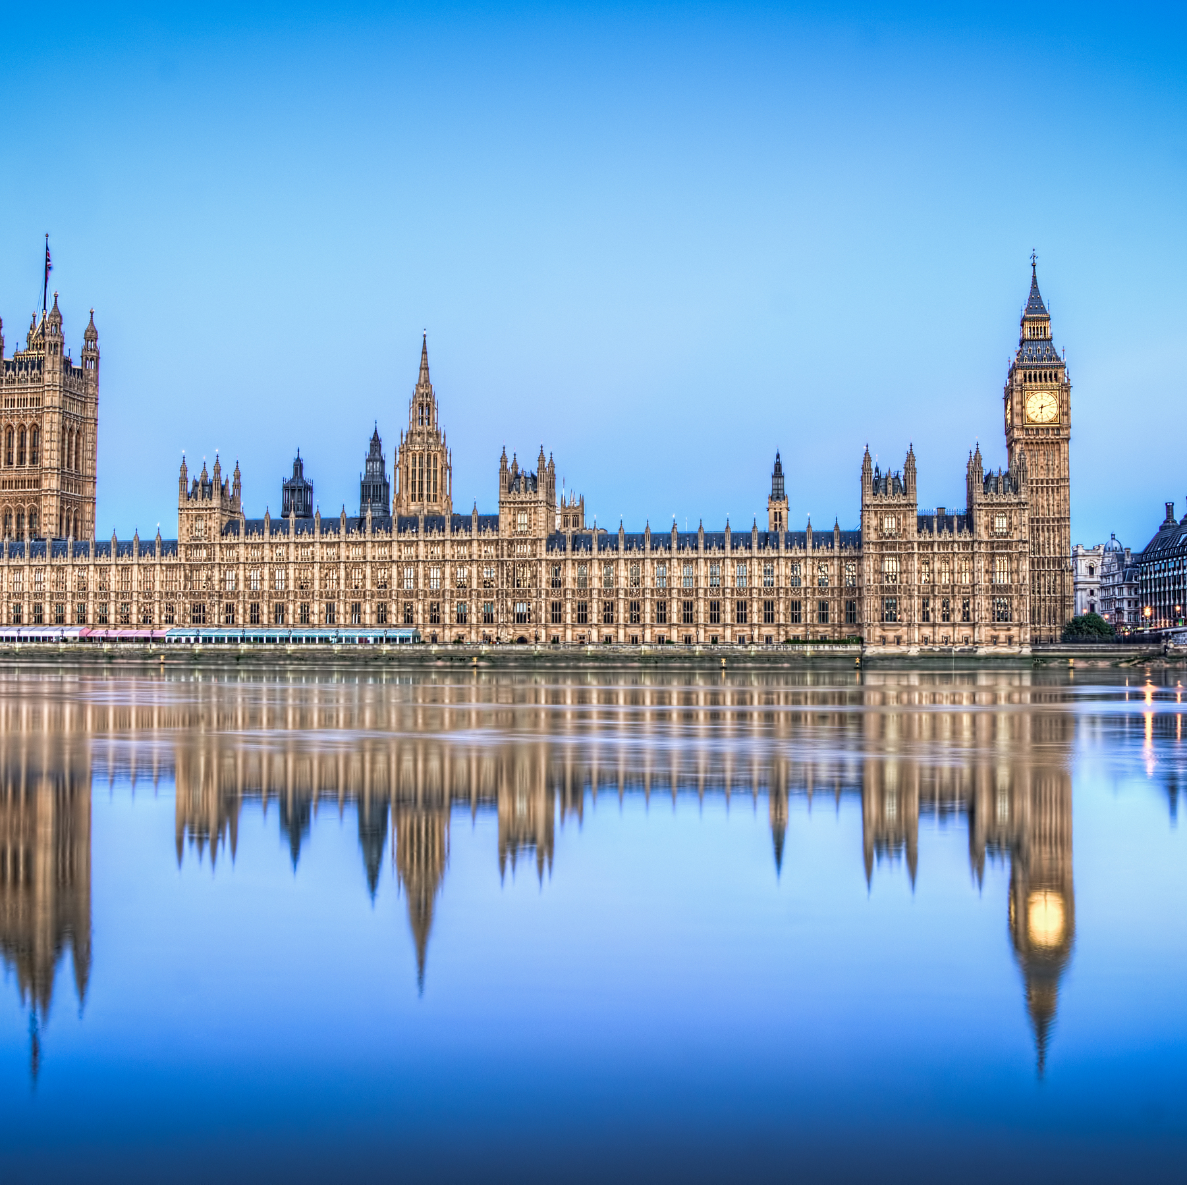
  The Senedd is responsible for:
  Education
  Healthcare
  Training
  Heritage
  Transport
  Housing
Agriculture
The Welsh Language
Sports
Tourism
Food
Fire and Rescue services
The Environment
Culture
UK Parliament is responsible for:
Some Benefits
The internet
Media
Nuclear Energy
Defence
Crime and policing
Outer Space
Import and Export
Air transport
Immigration
Notes:
Talk through the different Senedd powers and responsibilities, these are called devolved powers.
Then show responsibilities of the UK Parliament, these are called reserved powers.
What do these responsibilities mean in practice? Show laws introduced by the Senedd on the next slide.

Slide 11
Laws passed by the Senedd
Environmental Protection Act
Banned the use of single-use plastic items, e.g. plates, cutlery, stirrers etc. in Wales
The Restricted Roads Order
Made 20mph the default speed for most built up roads in Wales
Curriculum and Assessment Act Provided a framework for a new national curriculum for schools and colleges in Wales
Children (Abolition of Defence of Reasonable Punishment) Act Ended the legal defence for the physical punishment of children in Wales
Visitor Accommodation Act Introduced a register and levy (tax) for tourist accommodation in Wales
Notes:
Introduce the different laws, explaining they were all created and implemented by the Senedd. This shows the impact of the Senedd on life in Wales.

Slide 12
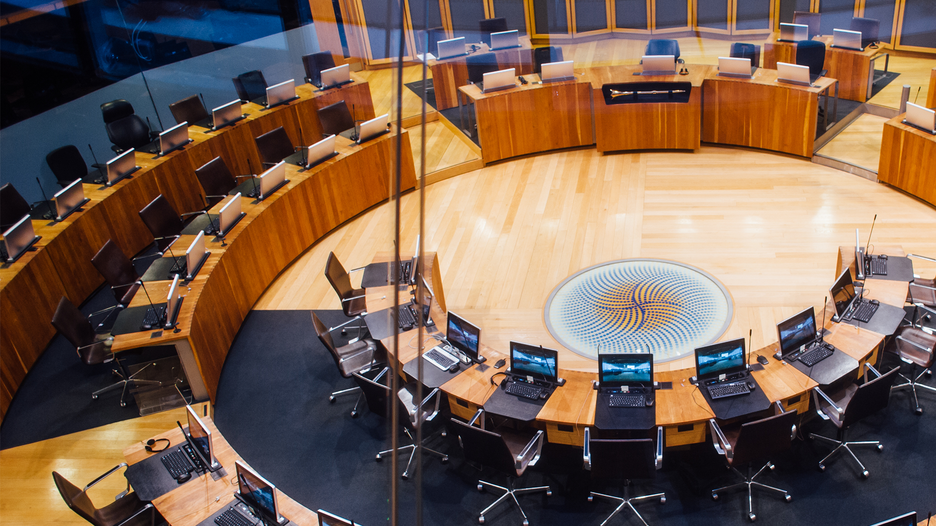
Laws passed by the Senedd
Instructions:
Look at the laws passed by the Senedd
What law do you think has impacted you and your community the most and why?
Notes:
Ask learners to discuss which law has the most impact on them and their community in pairs or small groups.

Slide 13
What would you change?
In pairs, discuss:
What is one law would you like the Senedd to pass in the future?
Think back to the powers of the Senedd. ​​
​​
Which of these areas matter most to you?
What problem would you like to solve or what positive change would you like to see in this area?
Notes:
Ask learners to now decide one law they would like to see passed by the Senedd in the future and why.
Emphasise that learners can have their say on these issues by voting in the Senedd election and getting involved in democracy.

Slide 14
How to vote
15 minutes

Slide 15
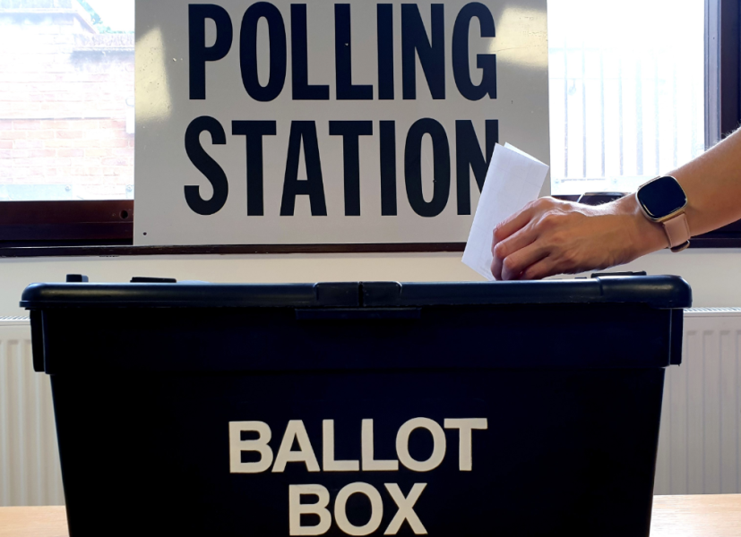
How to vote – quiz
Instructions:
Watch the video about how to vote in a Senedd election
Answer the quiz questions on the slide to test your knowledge
Notes:
Introduce the activity.

Slide 16
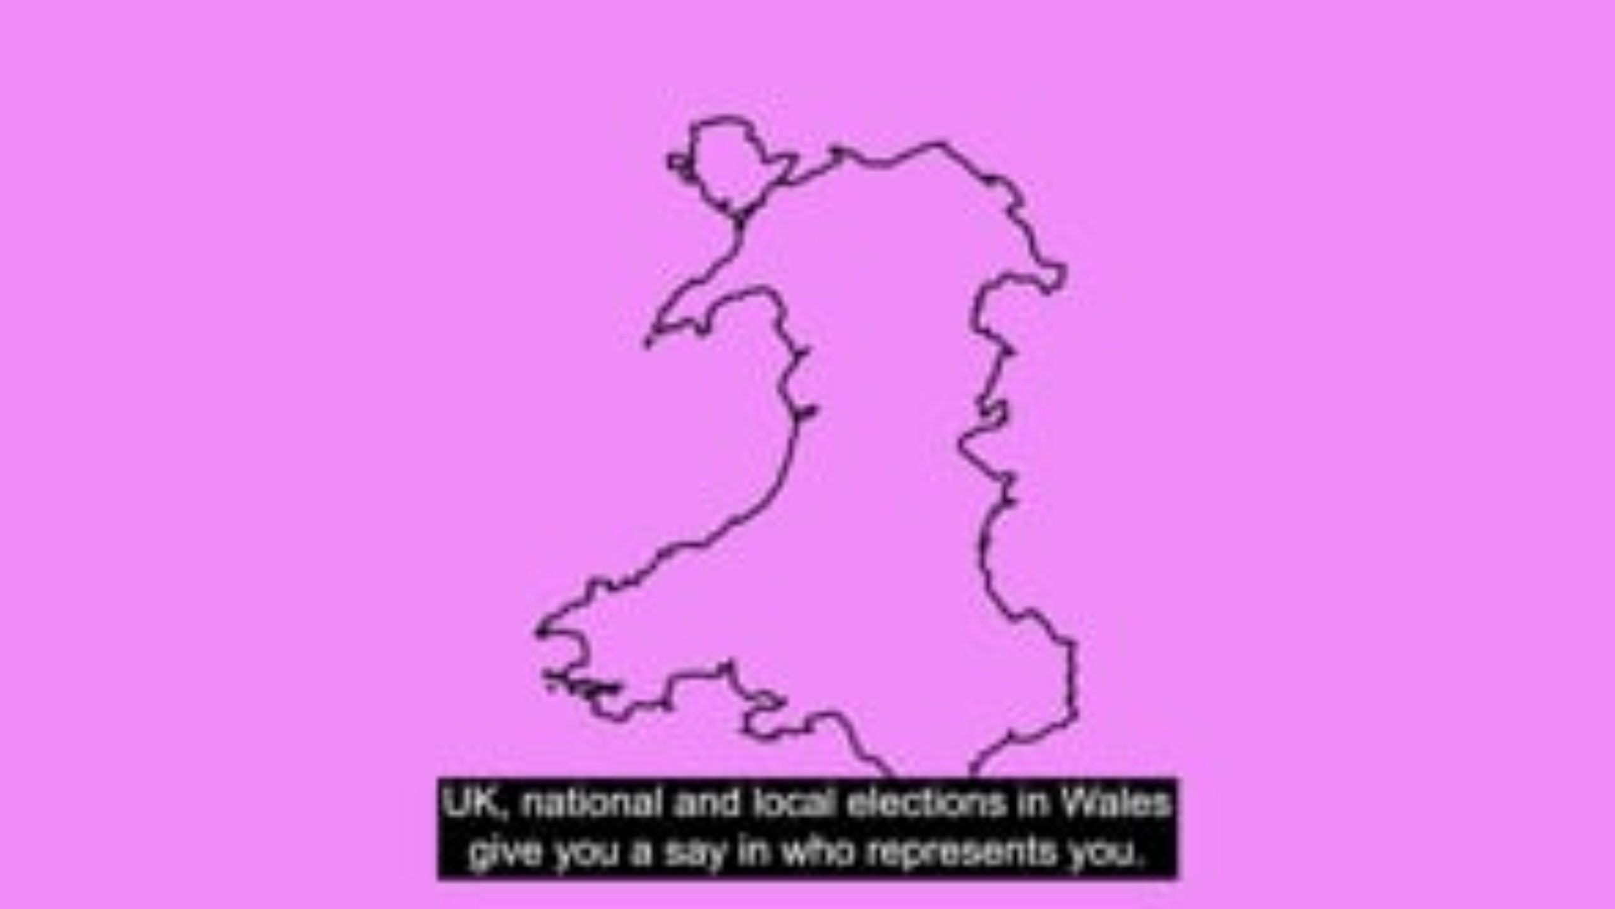
Watch this video about how to vote in Senedd elections
Notes:
Show the video about how to vote in Senedd elections.
Video link: https://vimeo.com/1121829010?fl=pl&fe=cm

Slide 17
Quiz
Quiz
Quiz
Quiz
Quiz
Notes:
Tell learners you’ll be testing what they learn from the video.
Give instructions on how you’d like the group to share their answers to the quiz questions. You may want to use mini whiteboards to gather answers from the whole class. You could also use a leaderboard to support engagement.
Option to make the quiz multiple choice for learners who find the questions challenging.

Slide 18

Quiz
How many ballot papers will you be given when voting in a Senedd election?
You will have one vote and will be given one ballot paper
Notes:
Extra info:
Make sure you read the instructions on your ballot paper and ask the staff at the polling station if you need help.

Slide 19

Quiz
Fill in the gap.
In Senedd elections, you vote for a ___________ or ___________.
In Senedd elections, you vote for a political party or independent candidate
Notes:
Extra info:
The ballot paper will still show the list of candidates for each political party, but remember, you are voting for a political party or an independent candidate, rather than specific candidates on a party’s list.

Slide 20
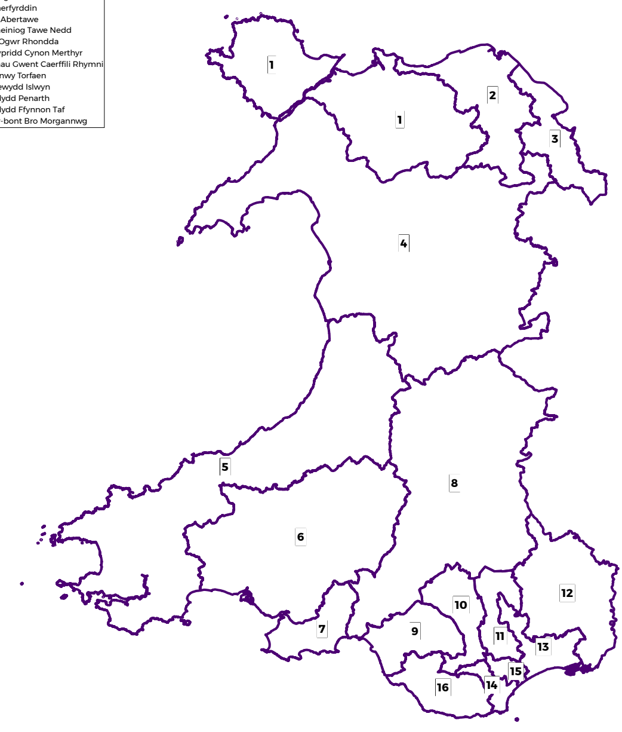
Quiz
How many Members of the Senedd will be elected to represent your constituency?
6 Members of the Senedd will be elected to represent your constituency
Notes:
Extra info:
your constituency is the local area where you live
There are 16 constituencies in Wales that each elect 6 Members of the Senedd

Slide 21
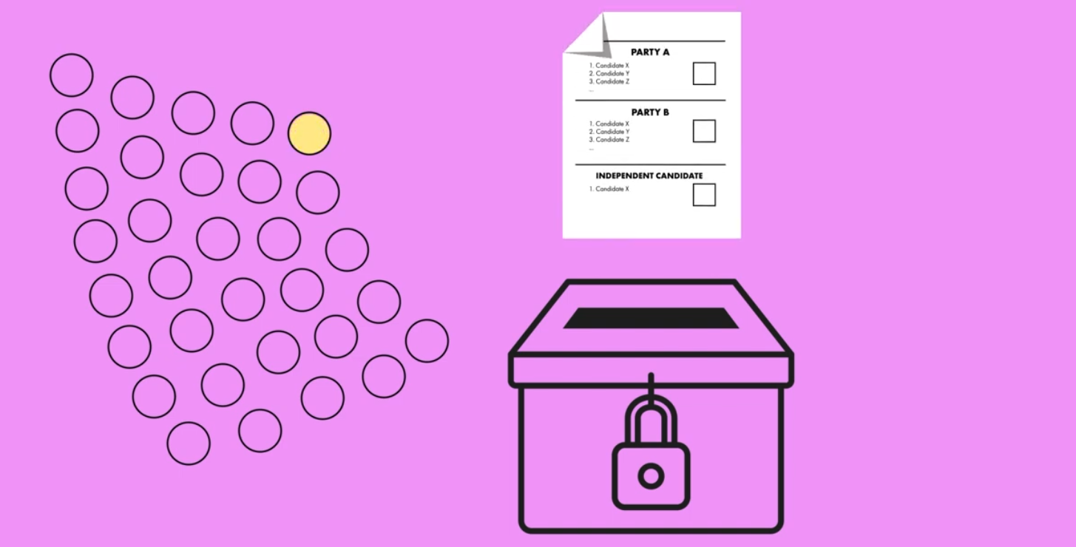
Quiz - bonus question
What is the name of the voting system used to elect Members of the Senedd?
A closed proportional list system
Notes:
Optional quiz question if time allows or you want to challenge your group.
Extra info:
This voting system affects how candidates are elected and sets out the rules for how your vote is counted.

Slide 22

Quiz – bonus question
True or False? The voting system for Senedd elections is a form of proportional representation.
True!
The number of seats each party or independent candidate wins in the Senedd will reflect the percentage of votes they receive in each constituency
Notes:
Optional quiz question if time allows or you want to challenge your group.
Extra info:
Proportional representation means the number of candidates elected for each political party roughly matches the number of votes received

Slide 23
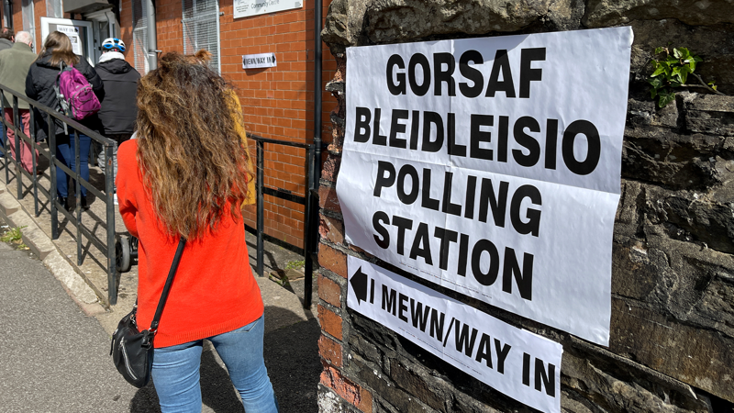
Voting in person
Instructions:
Read the key steps to voting in person on the next slide
Put the steps in the correct order to create a timeline for voting in person
Notes:
Introduce the activity.

Slide 24
Voting in person – timeline activity
To cast your vote, put a cross [X] in the box next to your choice of political party or independent candidate.
Fold your completed ballot paper and put it in the ballot box.
Take your ballot paper to a polling booth, so that you can cast your vote in secret.
B
C
A
Receive a poll card saying where your polling station is. You can also check online.
At the polling station, you will be given one ballot paper. Ask staff if you need any help.
Register to vote
D
E
F
Notes:
Ask learners to discuss the key steps to voting in person and to correctly order them to create a timeline for voting in person.
They can present their ideas on paper or on mini whiteboards.

Slide 25
Voting in person – timeline activity
1
2
Register to vote
Receive a poll card saying where your polling station is. You can also check online.
3
At the polling station, you will be given one ballot paper. Ask staff if you need any help.
D
E
F
Take your ballot paper to a polling booth, so that you can cast your vote in secret.
To cast your vote, put an 'X' in the box next to your choice of political party or independent candidate.
Fold your completed ballot paper and put it in the ballot box.
4
5
6
C
B
A
Notes:
Show the correctly ordered steps and talk through how to vote in person.

Slide 26
Preparing for the election
15 minutes

Slide 27
Preparing for the election
Register to vote by midnight on 20 April 2026
Decide how you’ll vote (you can vote in person, by post, or by proxy)
If you're voting in person, find your polling station
Put the date in your phone or school planner
Research who you can vote for and what they stand for
Election day:
7 May 2026
Notes:
Share key information on how to prepare for the election.
Extra info:
To vote by post you need to apply for a postal vote by Tuesday 21 April 2026. You can only apply to vote by proxy in certain circumstances. More information can be found on the Electoral Commission website - https://www.electoralcommission.org.uk/voting-and-elections/ways-vote
You can visit the Electoral Commission website to find your polling station and who you can vote for - https://www.electoralcommission.org.uk/i-am-a/voter/your-election-information
You can also visit https://whocanivotefor.co.uk/ to find out more about who you can vote for in your constituency.

Slide 28
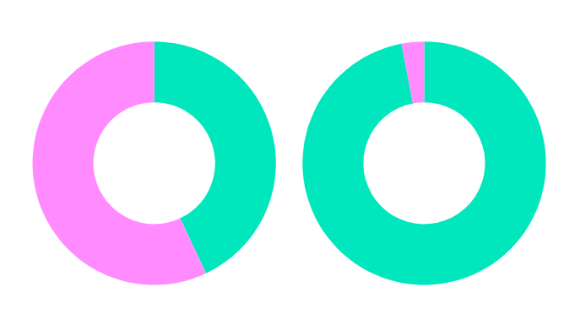

Registering to vote
What percentage of 16-17 year olds in Wales are registered to vote?
In 2024, 43% of 16-17-year-olds in Wales were registered to vote, compared to 97% of voters over 65
Registered
16-17
+65
Not registered
Notes:
Ask learners what % of 16-17 year olds they think are registered before revealing the answer. You could also ask about 60% of the group to raise their hand or stand up to demonstrate that this % of 16-17 year olds in Wales are not registered to vote to have their voice heard.
Highlight that 16-17-year-olds in Wales are much less likely to be registered to vote than older voters and explain it’s important you know how to register to vote, so you can have your say.

Slide 29
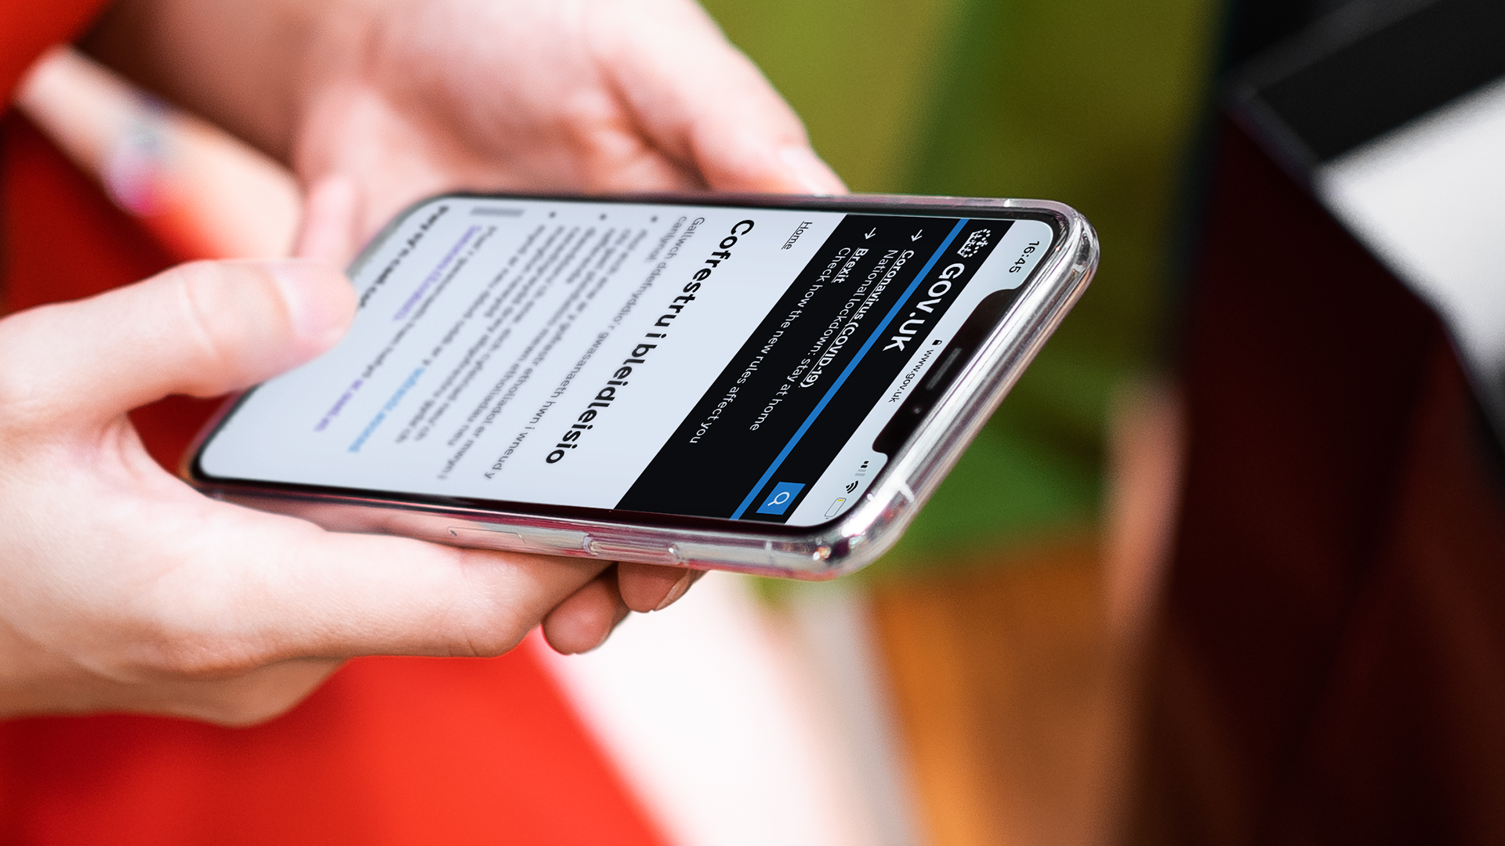
How to register to vote
You can register to vote in a Senedd election when you’re 14
You’ll be asked for your National Insurance number (but you can still register if you don’t have one)
It only takes five minutes
Register online at gov.uk/registertovote
Notes:
Share key information about registering to vote and answer any questions.
You don’t need to register before every election - you only need to register if:
you’ve never registered to vote before
you’ve moved house recently
you’ve changed your name
Talk to your local elections team at your council if you need help
More information on registering to vote can be found on the Electoral Commission website - https://www.electoralcommission.org.uk/voting-and-elections/register-vote

Slide 30

Why register to vote?
Instructions:
Think about what you have learned today
If you had to tell someone why they should register to vote, what would you say?
Prepare a 60 second pitch to encourage someone to register to vote
Notes:
For a final activity, support students to work in pairs/groups to develop a short 1 minute pitch about why you should register to vote for the Senedd election.

Slide 31
60 seconds to share your ideas
Notes:
You can adapt this slide depending on how/if you want students to share their ideas.
If you want to explore reasons to register to vote further, our lesson on designing a voter registration campaign can be found here - https://www.electoralcommission.org.uk/media/12653

Slide 32
2026 Senedd Election
What’s going to happen?
The Senedd election will take place on Thursday 7 May 2026
You can vote if you're aged 16 and over on polling day and live in Wales
You must register to vote by midnight on 20 April 2026
Why does it matter?
The Senedd makes decisions about things that affect you
This election is your chance to have your say
Election day:
7 May 2026
Notes:
Option to show this slide with key information about the 2026 Senedd election:
The election will take place on 7 May 2026
You need to be 16, living in Wales and registered to vote to vote in this election
You can vote in person, by post or by proxy (when someone votes on your behalf)
You get one vote, and will be given one ballot paper
You will be voting for the political party or independent candidate you want to represent you in the Senedd
For each local area, called a constituency, 6 Members of the Senedd will be elected
Why it matters:
The Senedd makes decisions about your education, health, transport, housing, and the environment.
Your voice matters. This election is your chance to have a real say in shaping Wales’ future, show that young people’s votes count, influence decisions that affect you and your community every single day
If young people don’t vote, decisions will still be made - but without your voice.

