Slide 1
WELCOME TO
WELCOME TO
WELCOME TO
WELCOME TO
WELCOME TO
WELCOME TO YOUR VOTE
Senedd Election 2026:
Short Activities

Slide 2

2026 Senedd Election
What’s going to happen?
The Senedd election will take place on Thursday 7 May 2026
You can vote if you're aged 16 and over on polling day and live in Wales
You must register to vote by midnight on 20 April 2026
Why does it matter?
The Senedd makes decisions about things that affect you
This election is your chance to have your say
Election day:
7 May 2026
Notes:
This slide can be used to introduce the election.
Key info:
The election will take place on 7 May 2026
You need to be 16, living in Wales and registered to vote to vote in this election
You can vote in person, by post or by proxy (when someone votes on your behalf)
You get one vote, and will be given one ballot paper
You will be voting for the political party or independent candidate you want to represent you in the Senedd
For each local area, called a constituency, 6 Members of the Senedd will be elected
Why it matters:
The Senedd makes decisions about your education, health, transport, housing, and the environment.
Your voice matters. This election is your chance to have a real say in shaping Wales’ future, show that young people’s votes count, influence decisions that affect you and your community every single day
If young people don’t vote, decisions will still be made - but without your voice.

Slide 3
Activity 1
True or false?
Notes:
Activity 1 – True or false quiz about the Senedd election

Slide 4


True or false?
5 minutes
Instructions:
Put your hands up to show whether you think these statements about the next Senedd election are true or false.
Notes:
Introduce the activity and adapt according to how you'd like students to share their answer.
If learners need support, they can first watch this video on Senedd elections: https://vimeo.com/1121829010?fl=pl&fe=sh

Slide 5
1. The next Senedd election will take place on 7 May 2026.

Slide 6
1. The next Senedd election will take place on 7 May 2026.
True ✓

Slide 7
3. In Senedd elections, you get one vote and will be given one ballot paper.

Slide 8
3. In Senedd elections, you get one vote and will be given one ballot paper.
True ✓

Slide 9
2. You can vote in Senedd elections when you're 14.

Slide 10
2. You can vote in Senedd elections when you're 14.
False✘

Slide 11
You must be 16 to vote in Senedd elections. You can register when you're 14.

Slide 12
5. In Senedd elections, you vote for a political party or independent candidate.

Slide 13
5. In Senedd elections, you vote for a political party or independent candidate.
True ✓

Slide 14
4. Each local area in Wales is represented by 5 Members of the Senedd.

Slide 15
4. Each local area in Wales is represented by 5 Members of the Senedd.
False✘

Slide 16
Each local area in Wales is represented by 6 Members of the Senedd.

Slide 17
5. You need to register before you can vote in the election.

Slide 18
5. You need to register before you can vote in the election.
True ✓
Notes:
You must register to vote before voting in an election. You only need to register to vote once, not for every election. You can register to vote online on GOV.UK.

Slide 19
Activity 2
Real or rubbish?
Notes:
Activity 2 – Real or rubbish? Myth busting activity about how to vote

Slide 20


Election checklist: real or rubbish?
10 minutes
Instructions:
You’ll see a list of tasks that people might do to get ready for the Senedd election.
Some of them are real steps that every voter should take - others are made up!
In your groups, work out which are real, and which are rubbish.
Notes:
Introduce the activity.

Slide 21
Election checklist: real or rubbish?
Check if you’re eligible to vote
Learn about the parties and what they stand for
Write to your MS to ask permission to vote
Ask your friends who to vote for
Go online to register to vote
Take your passport to vote
Decide whether to vote in person or by post
Pay the voting fee when you register
Check your polling place and what time it opens
Notes:
Support learners to discuss which statements are real and which are made up.

Slide 22
Election checklist: real or rubbish?
REAL
Check if you’re eligible to vote
Learn about the parties and what they stand for
Go online to register to vote
Decide whether to vote in person or by post
Check your polling place and what time it opens
RUBBISH
Write to your MS to ask permission to vote
Take your passport to vote
Pay the voting fee when you register
Ask your friends who to vote for
Notes:
Talk through correct answers.
Explainers for the ‘rubbish’ statements:
You don’t need anyone’s permission to vote – if you’re eligible and registered, it’s your right.
In Senedd elections, you don’t need photo ID – just your name and address. You do, however, need to show photo ID at UK Parliamentary elections.
Registering and voting are completely free – you should never pay to take part in an election.
It’s OK to talk about politics, but your vote is your choice – it should reflect your views and values.

Slide 23
Activity 3
My Senedd
Notes:
Activity 3 – My Senedd. Learners think about what positive change they would like the Senedd to make in Wales

Slide 24
My Senedd
Devolved powers:
Education
Healthcare
Training
Heritage
Transport
Housing
Agriculture
The Welsh Language
Sports
Tourism
Food
Fire and Rescue services
The Environment
Culture
10 minutes
Members of the Senedd elected in the 2026 election will have the opportunity to make decisions that impact you!
Choose one area the Senedd is responsible for that you’d like to focus on (these are called devolved powers)
Working in pairs or small groups, decide a law you would introduce in this area to positively impact the people of Wales
Notes:
Introduce the activity.
You might want to ask different groups to look at different devolved powers.
Ask students to share their ideas.

Slide 25
Activity 4
Mis- and disinformation
Notes:
Activity 4 – Mis- and disinformation. A video and quiz to explore the difference between mis- and disinformation

Slide 26
Misinformation or disinformation?
10 minutes
Watch the video to find out the difference between misinformation and disinformation
Take the quiz to test your knowledge!
Notes:
Slide 3: “What is the difference between?” (1 minute)
Read the instructions and questions on the slide.
This should be a brief discussion. If preferred, this can be done as a group instead.

Slide 27

Watch this video to find out more about misinformation and disinformation:
Notes:
Slide 4: Video (2 minutes)
Watch video on how to dismiss dis/misinformation (YouTube link: https://youtube.com/shorts/CuariWFkSU0?feature=shared)

Slide 28
Let’s look at some examples in this quiz!
Notes:
Slide 5: Quiz set up
This quiz can be done as a group using hands up polling. If preferred, students can be put into teams/pairs to answer instead.
Please note: there are 6 questions in the quiz.

Slide 29
Quiz: Mis or disinformation?
1) An influencer advertises a health supplement that causes harmful side effects that were not previously known.
Misinformation
Misinformation
Disinformation
Explanation: It's likely the influencer didn't know about the side effects, so they were spreading false information unintentionally.
Notes:
Slide 6: Quiz Question 1 (1 minute)
Read out the slide and ask the students to answer.
Click ‘next’ to reveal the answer.
Click ‘next’ again to reveal the explanation.

Slide 30
Quiz: Mis or disinformation?
2) Someone creates a deepfake video of a politician saying something the politician never said.
Misinformation
Disinformation
Disinformation
Explanation: Deepfakes of politicians are usually intentionally created to deceive. Manipulating audio/video of a politician can have serious consequences for individuals, society and politicians themselves.
Notes:
Slide 7: Quiz Question 2 (1 minute)
Read out the slide and ask the students to answer.
Click ‘next’ to reveal the answer.
Click ‘next’ again to reveal the explanation.

Slide 31
Quiz: Mis or disinformation?
3) Your friend sends you a video of a conspiracy theory they believe, but you know it includes false information.
Misinformation
Misinformation
Disinformation
Explanation: Your friend is likely sharing the video because they believe it, not with the intent to deceive you. This makes it misinformation - false information spread unintentionally.
Notes:
Slide 8: Quiz Question 3 (1 minute)
Read out the slide and ask the students to answer.
Click ‘next’ to reveal the answer.
Click ‘next’ again to reveal the explanation.

Slide 32
Quiz: Mis or disinformation?
4) A family member tells you that you can only register to vote in the Senedd election at 16, but you learnt in school that you can register at 14.
Misinformation
Misinformation
Disinformation
Explanation: Your family member is likely mistaken about the voting age, rather than deliberately trying to tell you false information. This is another example of misinformation.
Notes:
Slide 9: Quiz Question 4 (1 minute)
Read out the slide and ask the students to answer.
Click ‘next’ to reveal the answer.
Click ‘next’ again to reveal the explanation.

Slide 33
Quiz: Mis or disinformation?
5) Someone chooses to present statistics in a way that creates a false impression, while attacking a political party.
Misinformation
Disinformation
Disinformation
Explanation: The word "chooses" highlights the intent to mislead, making this disinformation. Although statistics seem more “factual”, they can be used to mislead people about political parties.
Notes:
Slide 10: Quiz Question 5 (1 minute)
Read out the slide and ask the students to answer.
Click ‘next’ to reveal the answer.
Click ‘next’ again to reveal the explanation.

Slide 34
Activity 5
How we vote
Notes:
Activity 5 – How we Vote. Fill the gap activity to build understanding of the voting process for Senedd elections

Slide 35
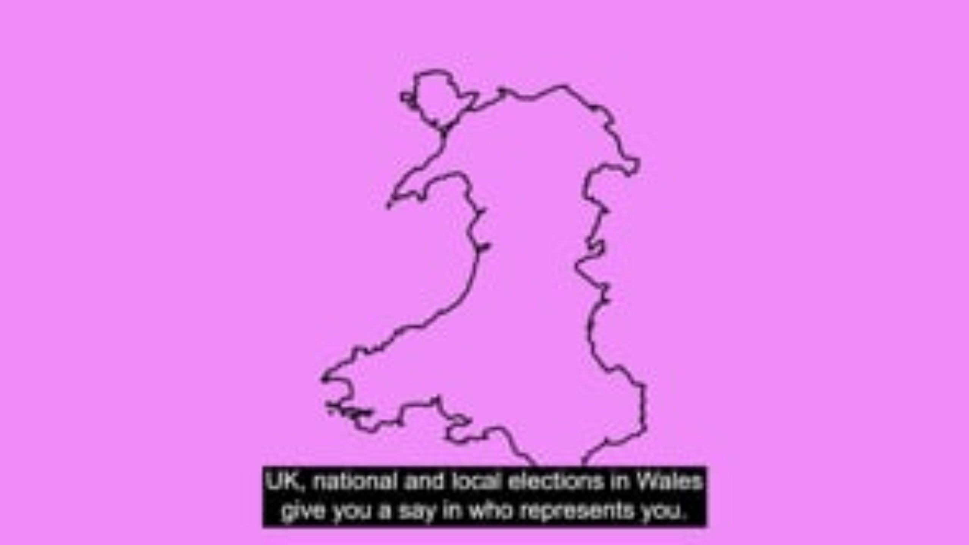
How we vote
10 minutes
Instructions
Watch the video to learn about how we vote in a Senedd election
Fill in the gaps in the sentences with the missing words in the box
Notes:
How we vote
Read the instructions on the slide
Show the video about how to vote in Senedd elections.
https://vimeo.com/1121829010?fl=pl&fe=cm
You may want to print off the gap fill exercise on the next slide for students to have in front of them while the slide is playing.
To add additional challenge, you may want to show this to them after playing the video.

Slide 36
How we vote
Voting systems affect how ______________ are elected.
At each election, every voter is given a __________________ __________________.
In Senedd elections we use a system called a____________ __________________________________________________to elect Members of the Senedd.
When you cast your vote, you will vote for either a _______________________________________or an ___________ __________________________.
Each party has a list of candidates that they want to get elected in _________________________.
The candidates for each constituency are decided depending on the percentage of _______________ each political party or independent candidate gets.
Missing words
Votes
Ballot paper
Closed proportional system
Independent candidate
Priority order
Candidates
Political party
Notes:
Learners will need to choose the correct words from the missing words list to fill in the gaps.
You can either print the gap fill exercise for learners to complete or provide them with paper or a mini whiteboard to record their answers.

Slide 37
How we vote: Answers
Voting systems affect how candidates are elected.
At each election every voter is given a ballot paper.
In Senedd elections we use a system called the closed proportional system to elect Members of the Senedd.
When voting in a Senedd election you vote for either a political party or an independent candidate.
Each party has a list of candidates they want to get elected in priority order.
The candidates for each constituency are decided depending on the percentage of votes each political party or independent candidate gets.
Notes:
Candidates
Ballot Paper
Closed Proportional System
Priority order
Political Party
Independent candidate
Votes
Don’t worry if you can’t remember this information – there will always be instructions on your ballot paper, and people in the polling place who you can ask for help.

Slide 38

Find out more about ways to vote
Notes:
If you want to learn more about ways to vote, you can watch this video.
You can choose to vote in person, by post or by proxy (this means when someone votes on your behalf).
Show this video about ways to vote:
https://www.youtube.com/watch?v=yf68w09H3Hg&list=PLm0G6YKL5VxICxsda9-6SoIfmA6SLiVHr&index=14

