Slide 1
WELCOME TO
WELCOME TO
WELCOME TO
WELCOME TO
WELCOME TO
WELCOME TO YOUR VOTE
Scottish Parliament Election 2026: short activities

Slide 2
Activity 1
True or false

Slide 3

True or false?
5 minutes
Put your hands up to show whether you think these statements about the next Scottish Parliament election are true or false.

Slide 4
1. The next Scottish Parliament election will take place on
7 May 2026.

Slide 5
1. The next Scottish Parliament election will take place on
7 May 2026.
True ✓

Slide 6
2. 16- and 17-year-olds can vote in Scottish Parliament elections.

Slide 7
2. 16- and 17-year-olds can vote in Scottish Parliament elections.
True ✓

Slide 8
3. You only get one type of vote in the Scottish Parliament election.

Slide 9
3. You only get one type of vote in the Scottish Parliament election.
False✘
Notes:
Voters get two votes:
-The constituency vote: this is to choose one local MSP to represent your area (constituency). You vote for a person, and the person with the most votes in your area wins.
-The regional vote: this is for choosing extra MSPs. You vote for a party or independent candidate, and these votes help to choose MSPs from your wider region.

Slide 10
4. The Scottish Parliament is based in Glasgow.

Slide 11
4. The Scottish Parliament is based in Glasgow.
False✘
Notes:
Scottish Parliament is in Holyrood, Edinburgh. The building is open to the public, and visitors can explore the building, participate in guided tours, and even watch debates.

Slide 12
5. You need to register before you can vote in the election.

Slide 13
5. You need to register before you can vote in the election.
True ✓
Notes:
You must register to vote before voting in an election. You only need to register to vote once, not for every election. You can register to vote online on GOV.UK.

Slide 14
Activity 2
Real or rubbish?

Slide 15
Election checklist: real or rubbish?
10 minutes
You’ll see a list of tasks that people might do to get ready for the Scottish Parliament election.
Some of them are real steps that every voter should take - others are made up!
In your groups, work out which are real, and which are rubbish.

Slide 16


Election checklist: real or rubbish?
Check if you’re eligible to vote
Learn about the parties and what they stand for
Write to your MSP to ask permission to vote
Ask your friends who to vote for
Go online to register to vote
Take your passport to vote
Decide whether to vote in person or by post
Pay the voting fee when you register
Check your polling place and what time it opens

Slide 17
Election checklist: real or rubbish?
Real
Check if you’re eligible to vote
Learn about the parties and what they stand for
Go online to register to vote
Decide whether to vote in person or by post
Check your polling place and what time it opens
Rubbish
Write to your MSP to ask permission to vote
Take your passport to vote
Pay the voting fee when you register
Ask your friends who to vote for
Notes:
Explainers for the ‘rubbish’ statements:
You don’t need anyone’s permission to vote – if you’re eligible and registered, it’s your right.
In Scottish Parliament elections, you don’t need photo ID – just your name and address. (However, if you’re voting in a UK Parliament election, you will need ID)
Registering and voting are completely free – you should never pay to take part in an election.
It’s OK to talk about politics, but your vote is your choice – it should reflect your views and values.

Slide 18
Activity 3
Mis- and disinformation

Slide 19
Misinformation or disinformation?
10 minutes
Watch the video to find out the difference between misinformation and disinformation
Take the quiz to test your knowledge!
Notes:
Slide 3: “What is the difference between?” (1 minute)
Read the instructions and questions on the slide.
This should be a brief discussion. If preferred, this can be done as a group instead.

Slide 20

Watch this video to find out more about misinformation and disinformation:
Notes:
Slide 4: Video (2 minutes)
Watch video on how to dismiss dis/misinformation (YouTube link: https://youtube.com/shorts/CuariWFkSU0?feature=shared)

Slide 21
Let’s look at some examples in this quiz!
Notes:
Slide 5: Quiz set up
This quiz can be done as a group using hands up polling. If preferred, students can be put into teams/pairs to answer instead.
Please note: there are 6 questions in the quiz.

Slide 22
Quiz: Mis or disinformation?
1) An influencer advertises a health supplement that causes harmful side effects that were not previously known.
Misinformation
Misinformation
Disinformation
Explanation: It's likely the influencer didn't know about the side effects, so they were spreading false information unintentionally.
Notes:
Slide 6: Quiz Question 1 (1 minute)
Read out the slide and ask the students to answer.
Click ‘next’ to reveal the answer.
Click ‘next’ again to reveal the explanation.

Slide 23
Quiz: Mis or disinformation?
2) Someone creates a deepfake video of a politician saying something the politician never said.
Misinformation
Disinformation
Disinformation
Explanation: Deepfakes of politicians are usually intentionally created to deceive. Manipulating audio/video of a politician can have serious consequences for individuals, society and politicians themselves.
Notes:
Slide 7: Quiz Question 2 (1 minute)
Read out the slide and ask the students to answer.
Click ‘next’ to reveal the answer.
Click ‘next’ again to reveal the explanation.

Slide 24
Quiz: Mis or disinformation?
3) Your friend sends you a video of a conspiracy theory they believe, but you know it includes false information.
Misinformation
Misinformation
Disinformation
Explanation: Your friend is likely sharing the video because they believe it, not with the intent to deceive you. This makes it misinformation - false information spread unintentionally.
Notes:
Slide 8: Quiz Question 3 (1 minute)
Read out the slide and ask the students to answer.
Click ‘next’ to reveal the answer.
Click ‘next’ again to reveal the explanation.

Slide 25
Quiz: Mis or disinformation?
4) A family member tells you that you can only register to vote in the Scottish Parliament election at 16, but you learnt in school that you can register at 14.
Misinformation
Misinformation
Disinformation
Explanation: Your family member is likely mistaken about the voting age, rather than deliberately trying to tell you false information. This is another example of misinformation.
Notes:
Slide 9: Quiz Question 4 (1 minute)
Read out the slide and ask the students to answer.
Click ‘next’ to reveal the answer.
Click ‘next’ again to reveal the explanation.

Slide 26
Quiz: Mis or disinformation?
5) Someone chooses to present statistics in a way that creates a false impression, while attacking a political party.
Misinformation
Disinformation
Disinformation
Explanation: The word "chooses" highlights the intent to mislead, making this disinformation. Although statistics seem more “factual”, they can be used to mislead people about political parties.
Notes:
Slide 10: Quiz Question 5 (1 minute)
Read out the slide and ask the students to answer.
Click ‘next’ to reveal the answer.
Click ‘next’ again to reveal the explanation.

Slide 27
Activity 4
How we vote

Slide 28
How we vote
10 minutes
Watch the video to learn about how we vote in a Scottish Parliament election
Fill in the gaps in the sentences with the missing words in the box.
Notes:
Slide 3: “What is the difference between?” (1 minute)
Read the instructions and questions on the slide.
This should be a brief discussion. If preferred, this can be done as a group instead.

Slide 29
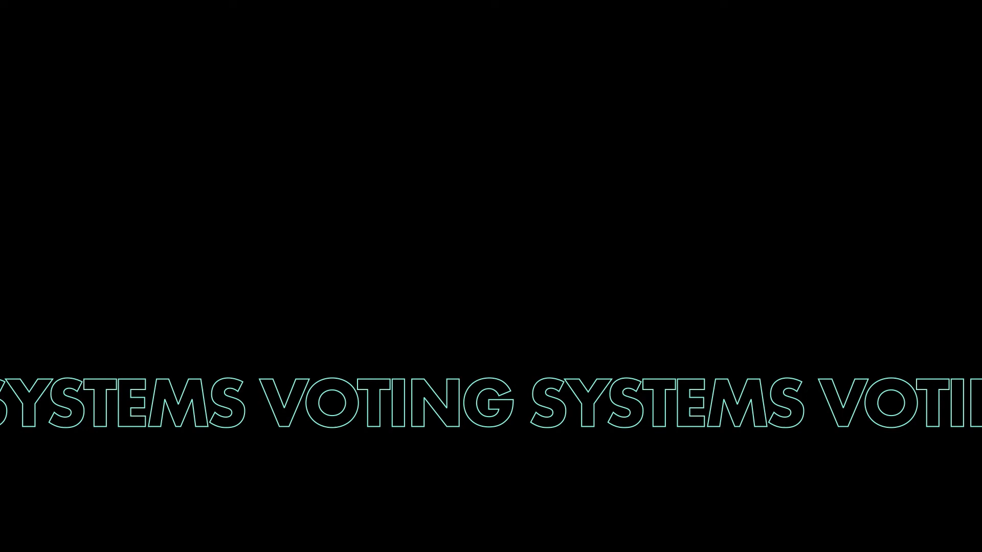
How we vote
Notes:
If the video does not work, you can access it here – please pause at 3 minutes and 20 seconds: https://www.youtube.com/watch?v=kKhgSMzGcbs&list=PLm0G6YKL5VxImoHfRFJugHUicYdX_dAoF&

Slide 30
How we vote
People standing for election are called ____________.
We use a system called the additional members system to elect members of the _________________.
Everyone in Scotland is represented by _______ members of the Scottish Parliament (MSPs).
When voting in an election which uses the additional member system, you get two __________ and two ___________.
To vote for your _____________ MSP, mark an X in the box next to their name on the ballot paper.
To vote for your ____________ MSPs, mark an X in the box next to the political party or independent candidate that you support.
Missing words
Votes
Regional
Scottish Parliament
Ballot papers
Constituency
Candidates
Eight

Slide 31
How we vote
People standing for election are called candidates.
We use a system called the additional members system to elect members of the Scottish Parliament.
Everyone in Scotland is represented by eight members of the Scottish Parliament (MSPs).
When voting in an election which uses the additional member system, you get two ballot papers and two votes.
To vote for your constituency MSP, mark an X in the box next to their name on the ballot paper.
To vote for your regional MSPs, mark an X in the box next to the political party or independent candidate that you support.
Notes:
Candidates
Scottish Parliament
Eight
Ballot papers
Votes
Constituency
Regional
Don’t worry if you can’t remember this information – there will always be instructions on your ballot paper, and people in the polling place who you can ask for help.

