Slide 1
Register of electors -canvasser briefing session
Notes:
This presentation has been designed to support the briefing of staff employed to carry out personal canvassing. It contains content suitable for briefing staff employed to carry out canvassing during the canvass and for briefing canvassers employed to conduct house-to-house enquiries throughout the year. The presentation will need to be edited locally to reflect your audience and how you are deploying canvassers. Some of the slides will need to be adapted if you are providing canvassers with electronic equipment or are encouraging alternative methods for responding to the canvass.
While the Section 9A duty to take all necessary steps to ensure your registers are accurate and complete still applies, the requirement to carry out house-to-house enquiries as part of the annual canvass has not been extended to 14 and 15 year olds. A personal visit to 14 or 15 year olds who have not responded to an ITR is not required at any time during the year. Therefore these training slides assume that no visits will be made with the purpose of speaking to 14 or15 year-olds but reflect the need to capture the details of any 14 or 15 year olds residing at an address.

Slide 2
Introduction
Add names of trainers
Notes:
Introduce yourself and colleagues taking part in the briefing
Thank canvassers for attending the session
Ask all present to switch off mobile phones before the start of the presentation
Detail fire evacuation procedures and tell those present where toilet facilities are.

Slide 3
Objectives of the training session
To outline your duties as a canvasser
To ensure that you are confident about all aspects of your role
Notes:
Provide an indication of the proposed length of the briefing session
Discuss format of the session (e.g. when you prefer to deal with questions).

Slide 4
Overview of the canvass

Slide 5
Eligibility to register
Resident in [add registration area]
Aged 14 or over
Electors of any nationality are eligible to register to vote
British, Irish, EU citizen, Commonwealth citizen or qualifying foreign national who has permission to remain in the UK or who does not require permission to remain
Notes:
Summarise who is eligible to register to vote, i.e. those who are:
Resident (usually live) in the registration area
Aged 14 or over but can’t vote until they are 16 in local elections or Senedd elections. Still have to be 18 to vote in UK Parliamentary elections
and are either:
A British, Irish, a Commonwealth citizen who has permission to remain in the UK or who does not require permission to remain - can vote in UKPGE, Senedd, local council elections and PCC elections
A qualifying EU citizen or EU citizen with retained rights - can vote in Senedd, local council and PCC elections only
A foreign national who has permission to enter or remain in the UK or who does not require such permission - can vote in Senedd and local council elections only.

Slide 6
Electoral registration
Applicants can apply to register online
  By phone [if offered] / in person [if offered]
All applicants must be ‘verified’ – their National Insurance number and date of birth are checked against official records
  14 and 15 year-olds will not be asked to provide a National Insurance number. They will be verified using education records or other local data
Notes:
Can register online at www.gov.uk/register-to-vote or by completing a paper application form. Add telephone/in person registration if offered.
All applicants must have their identity verified before they can appear on the electoral register, they do this by providing their personal identifiers: their date of birth and National Insurance number. These are then checked against official records. The requirement to provide a National Insurance number does not apply if a person is aged 14 or 15 years old. Instead, their identity will be verified using education records or other local data.

Slide 7
The annual canvass (1)
Legal requirement to conduct the canvass and for certain households to respond
A canvass communication must be sent to every address where the ERO thinks there is a change(s)
  No response = follow up, choice of method
  Still no response = visit by canvasser
  New potential electors cannot register via a canvass communication
  Households must respond to the canvass, even if residents have made a successful application to register online
Notes:
The ERO has a legal duty to undertake a canvass (between 1 July and 30 November) of all households and produce a revised Register of Electors by 1 December.
Properties where the ERO believes there is no change in household composition, will be sent a Canvass Communication A which does not require a response.
Where the ERO believes there may have been a change to household composition, they will be sent a Canvass Communication B or a Canvass Form. In these cases a response is required. The process is for the personal canvass is very much similar to the way we previously canvassed.
By law, households must provide the information asked for on the canvass communication.
The purpose is to gather information on who lives in each household.
Outline the requirements to make at least 3 contact attempts (and set out your timetable for using these).
Where a response is still not received, a personal visit must be made to try and obtain the information required on the form (mention telephone canvassing if you are using this).
Any new residents at the address who are eligible to vote must have their names added to the canvass communication. However, it is not possible to register via this. Once the completed form is received, the potential elector will be invited to register and they will be sent an ITR.

Slide 8
The annual canvass (2)
An Invitation to Register (ITR) must be sent to any potential electors (including those whose names are added to a canvass communication) with a registration form
Prescribed reminder process - except that personal visits are not required if the person is 14 or 15 years old
Notes:
ITRs have a prescribed reminder process, and require a personal visit where no response is received to encourage an application to be made.
Therefore personal visits are required to individuals who have not responded to an ITR or a reminder ITR. The only exception to this is that a personal visit is not required to a person aged 14 or 15 years old.
(Depending on your strategy, make clear that that this is a non-linear process)
We will look at the information required on the canvass form and the ITR in more detail later.

Slide 9
Your role as canvasser

Slide 10
Key canvasser activities
Your role is important.
[Delivery of forms and reminders]
Visit households/individuals that have not responded to a canvass communication or ITR to encourage a response:
  obtain a correctly completed form
  if no answer - return at a later time/date
  if still no answer - leave form and envelope at the property and mark your canvass list accordingly
  record date and time of all visits
Notes:
Adapt this slide depending on how you are using canvassers.
Emphasise the importance of their role: a personal visit from you can make sure that eligible residents do not lose their right to vote.
Delivery of forms and reminders – remove this bullet point if not applicable – remind those delivering of the timescales etc. and that they could be delivering a combination of forms such as the canvass communication B(CCB) / canvass form (CF)/ Invitations to register (ITR) and reminders.
Visiting non-responding properties/individuals – highlight the importance of obtaining a response.
You could also mention payment details where payment is by response, how many visits are expected, the required frequency you require forms to be returned to the office etc…
Also outline any paperwork you will be giving to canvassers to complete and emphasise the importance of recording the date and time of each visit. It will provide the necessary audit trail for proving whether or not an individual has received an invitation to register, a pre-condition for initiating the requirement to register process. If a person has not applied to register after a reasonable time after the third invitation to register has been given, and they have been visited at least once to encourage an application, they can be required to register by a specified date. If they don’t, then an £80 fine can be issued. This fine does not apply to 14 or 15 year-olds.

Slide 11
The Canvass Form (CF)
Notes:
This section of the briefing provides a step by step guide to delivering and completing the canvass form. This information should help canvassers in the event that they are asked questions by householders, or if they assist a householder with the completion of the form.

Slide 12
The canvass form
Purpose: in order to know who is eligible to register to vote, we need to know who lives at an address. The CF is used to collect this information.
Two versions:
  Pre-Printed with the details of all electors registered at the household
  Blank for properties with no electors currently registered, and any new properties you identify
Notes:
Remember always to be courteous and professional in your approach
Confirm that canvassers will be supplied with pre-printed forms for all households in their allocated area along with a list of the properties they need to call at. Ask them to check that they have a form for every property on the list; if there are any missing, contact ward supervisor / electoral office. If a new property (or conversion) is identified and it is not on the canvasser’s list, they should leave a blank form at that address. Outside the canvass period, blank CFs may also be sent to an address if the ERO considers that, in doing so, they may identify any potential electors at that address.
Canvassers may also be given a list of properties that have returned their forms since the canvass forms were printed. Tell canvassers to pull these forms out before starting their canvass. They won’t appear on the canvasser working list as there is no need to canvass households that have already returned their forms.
For presentation purposes, these slides have separate sections on CFs and ITRs, but it might be that you issue canvassers delivering CFs with blank individual registration forms as well, in which case you should amend this presentation accordingly

Slide 13
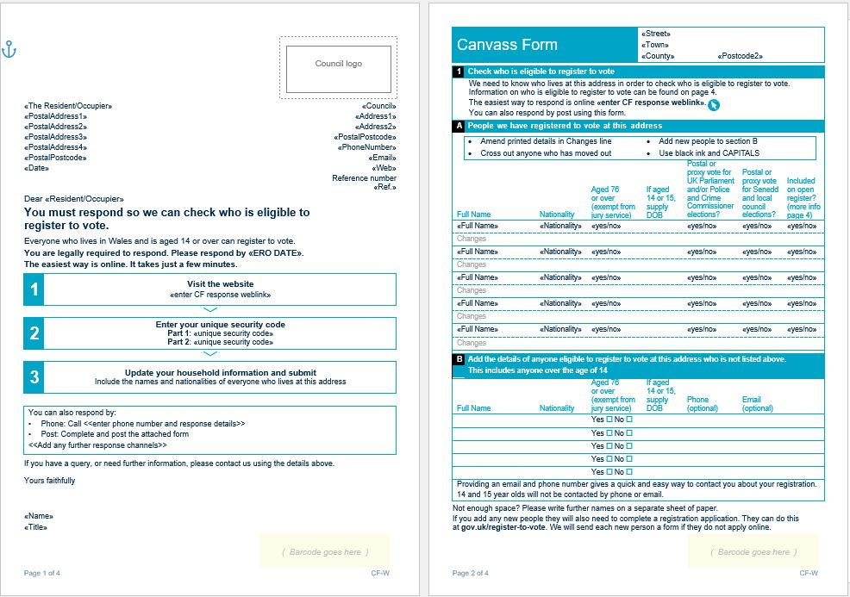
Example Canvass Form – pre-printed
Notes:
Provide a copy of the Canvass Form (pre-printed and blank) as a visual example. The CFs included on this and the following slide are placeholders only – replace with an image of the CFs you will be using locally.
The example shows the covering page and first page of the Canvass Form

Slide 14
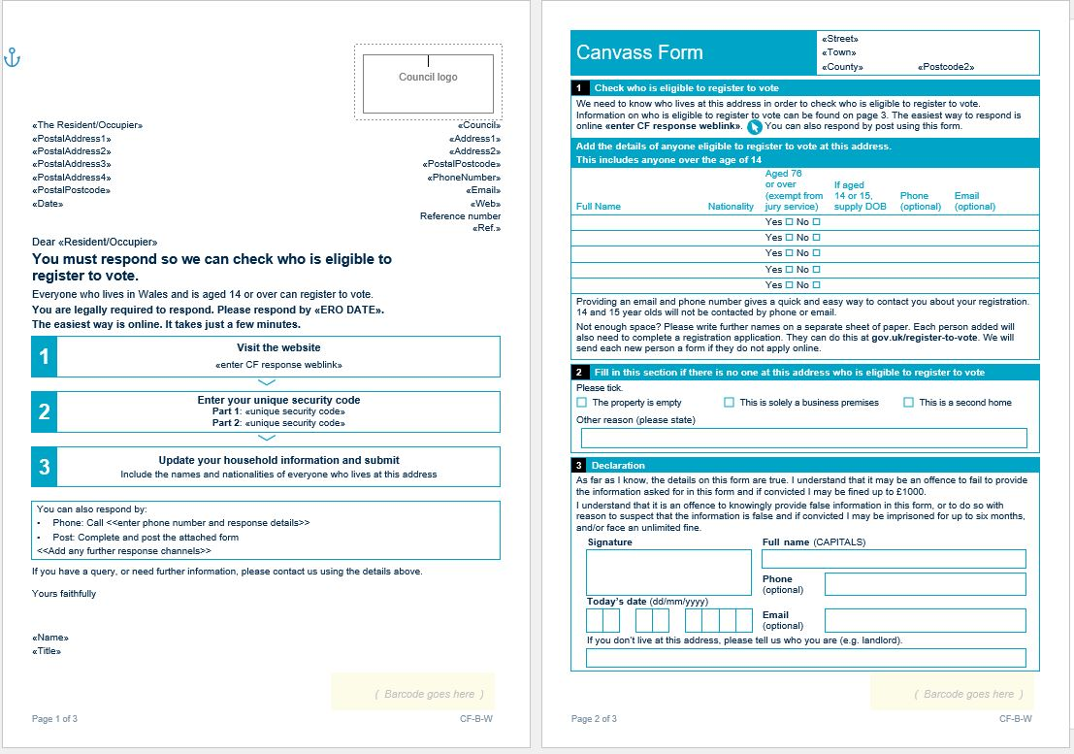
Example Canvass Form - blank
Notes:
The blank form is similar to the pre-printed one – slightly different format allowing for residents’ details to be added. Pre-printed form also contains additional information – for example, an elector’s preferred voting method (e.g. by post), which is not included on the blank form.
Example shows covering page and first page

Slide 15
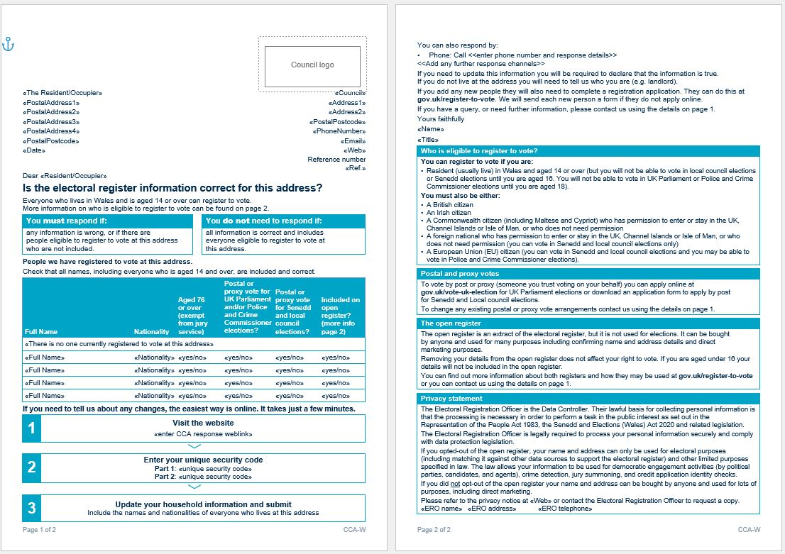
Example CCA
Notes:
There is only one version of the CCA.

Slide 16
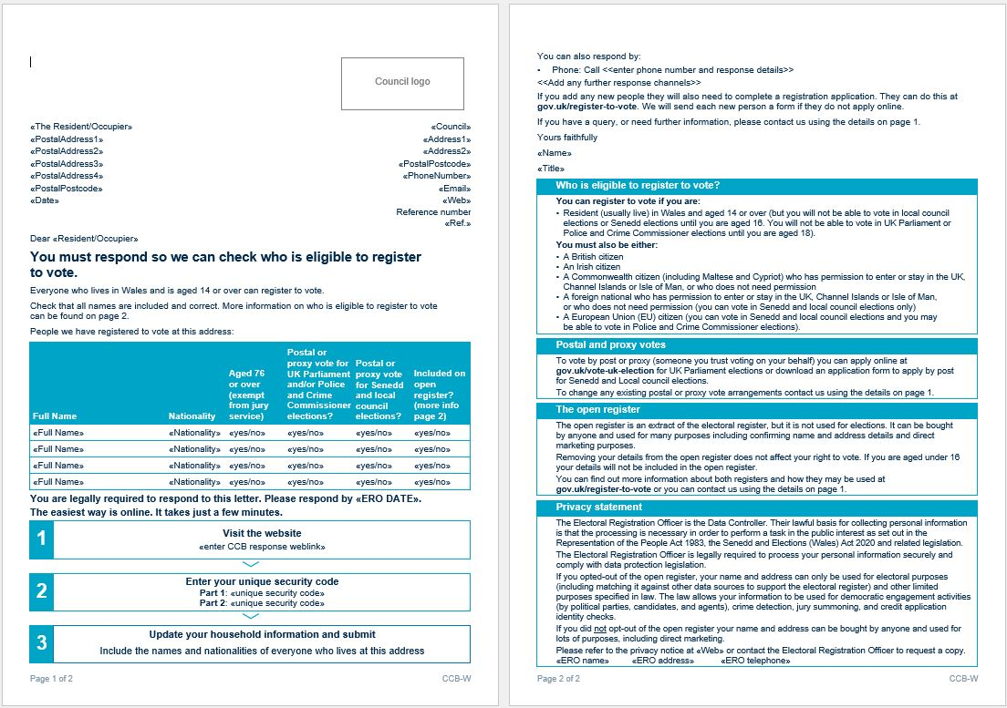
Example CCB – pre -printed
Notes:
The pre-printed form also contains additional information – for example, an elector’s preferred voting method (e.g. by post), which is not included on the blank form.
Example shows covering page and first page

Slide 17
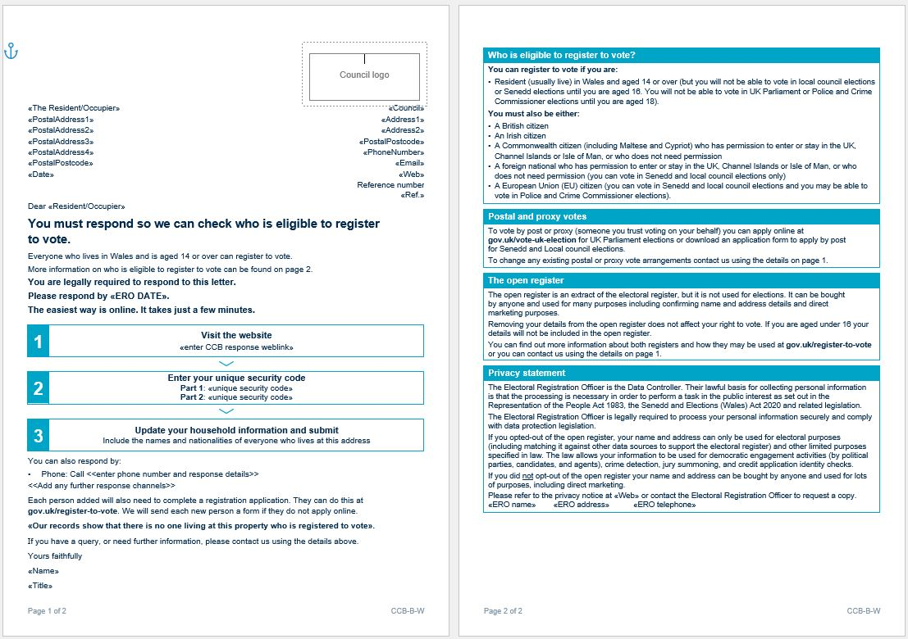
Example CCB - blank
Notes:
The blank form is similar to the pre-printed one – slightly different format allowing for residents’ details to be added. Pre-printed form also contains additional information – for example, an elector’s preferred voting method (e.g. by post), which is not included on the blank form.

Slide 18
Online return of the CF
[Insert screenshot if offered]
Notes:
Insert details of online system for returning CFs.

Slide 19
Using tablets / smartphones to collect information and submit a canvass return
[To be included if you are providing canvassers with electronic equipment to complete and submit canvass returns directly – to cover, for example: How should the equipment be operated? How to log in and keep passwords secure? What are your policies on canvassers using the equipment for other purposes?]
Notes:
Consider a practical demonstration to ensure canvassers are confident in operating any electronic equipment you have provided.

Slide 20
Key messages when following up with canvass non-responders
It is important that this form is completed and returned. In order to know who is eligible to register to vote, we need to know who lives at your address. This form is to collect this information.
Returning the information requested is straightforward. I have a form which I can help you complete now, or I can come back later to pick it up. [add any online response options]
Notes:
Penalty for a non-response to a canvass communication is a £1,000 fine. For a full set of key messages and FAQs, direct canvassers to the Doorstep script for canvasser visits.

Slide 21
Information required (1)
Address
Pre-printed with address details in most cases
Make any corrections to the address if advised to you by a member of the household
If you have to use a completely blank form (e.g. if you have identified a new property) please fill in address, including the code for that particular polling district
Notes:
Go through an example of a pre-printed and blank Canvass Form in detail, ensuring that all staff have a copy of the form to refer to as you go through each section.

Slide 22
Information required (2)
Names
Make sure any pre-printed names are correct, and cross out or amend any that are incorrect
Add any names as appropriate
Nationality
If pre-printed, check the nationality is correct
If the nationality field is blank, ask ‘what is your nationality’?
Notes:
Names: canvassers to check the details printed on the form with the householder, clearly cross out any people no longer at the address, amend any names as necessary and add any new residents. Write clearly in capital letters and get full names, not initials. Canvassers to check that the new people they are adding are old enough to register.
Nationality: even if you think you know their nationality, you must ask. Phrase the question carefully (for example, “what is your nationality?”) - don’t ask “where do you come from?” as the person may answer “The Philippines” but also have British Citizenship.
British, Irish, European, Commonwealth and qualifying foreign citizens resident have the right to register. Qualifying foreign citizens are those who do not require permission to enter or remain in or have any type of permission to enter or remain (whether temporary or permanent).
A list of eligible nationalities will be provided to you and you should keep this to hand at all times. If you are in any doubt, add the person’s name to the form, along with their nationality and we will confirm whether they are entitled to register.

Slide 23
Information required (3)
Other information
    postal / proxy vote
    open register – see instructions on changing opt-out preference
Contact details (e-mail / telephone)
Collect these if possible – they will help us contact electors quickly in case of further queries.
Notes:
Open register: There are two registers: an electoral register and an open register. The open register is an extract of the electoral register, but is not used for elections. It can be bought by any person, company or organisation. For example, it is used by businesses and charities to confirm name and address details. If a person has opted out of the open register, that information will be pre-printed next to their other details on the CF.
A person aged 14 or 15 years old will not be included in the open register.
Postal /proxy voting: Anyone who would prefer to vote by post or by proxy may request an application form by putting a tick in the relevant box on the form. If an elector already has a postal or proxy vote there will be a tick pre-printed on the form. If they have a postal or proxy vote but no longer want it you should cross out the pre printed details. We will follow up with the elector so they can formally make a cancellation request.

Slide 24
Information required (4)
14 - 17 year olds
Always ask if there are any 14 to 17 year-olds, and ensure they are included on the form
Notes:
Young people aged 14/15 must be included on the form with their dates of birth. As they cannot yet vote, they may be accidentally omitted by householders.
They are entitled to vote as soon as they turn 16 at local government and Senedd elections - and when they turn 18 at UK Parliamentary elections.
Make sure you ask each householder if there are 14-17 year olds living in the household. Even if you think they look too old or too young to have a young person living in the house, they may be living with a grandparent or older brother / sister - don’t assume anything.
14/15 year olds will be included on the electoral register, but only Electoral Registration Officers and their staff can usually see the details provided. 14/15 year olds will not be included in any register that is published. About six weeks before an election certain people need details of everyone who can vote in that election. If a person will be 16 on the date of Senedd election or local government election, their name and address will be given to people who run the elections, and to candidates who want to provide information to voters.

Slide 25
Information required (5)
Nobody eligible to vote?
Section for recording the reason
Examples:
  property obviously empty
  business premises
  second home
Notes:
If a property is clearly empty/no longer exists, canvassers should note this on the form, sign it and feed this information back to the registration office. Registration staff will then take steps to verify the status of these properties by using other records.

Slide 26
Information required (6)
Declaration and signature
The form must be signed by the person supplying the information
DO NOT sign on behalf of the occupier; you can only sign a form where the property is clearly empty or does not exist
Notes:
Ask the householder to sign the form to say that all the information provided is true.
It is very important that the form is signed in this section by the person supplying the information, or we will have to send it back to them for signature. Canvassers are not able to sign the form on behalf of the occupier. You should not take information from anyone other than from a member of the household or a person responsible for the property (e.g. landlord).

Slide 27
New properties
You can play an important role in identifying ‘new’ properties
If a new property (or conversion) is identified and it is not on your list, obtain a completed Canvass Form from that property and update your list with the ‘new’ property information
Notes:
When new properties are canvassed using a blank CF, canvassers should write as much of the address as possible on the form.

Slide 28
Invitations to register and the registration form
Notes:
Provide a copy of the Registration Form (pre-printed and blank) as a visual example.
Confirm that canvassers will be supplied with pre-printed forms and a list for all potential electors they are expected to make contact with in their allocated area. Ask them to check that they have a form for every individual on the list; if there are any missing, contact ward supervisor / registration office [amend as appropriate to reflect your local arrangements].
Canvassers will also be provided with a list of people who have already responded to an invitation since the original forms and letters were printed. Tell canvassers to pull the forms for these out before delivering the invitation/following up with a non-responder– there is no point in visiting an elector who has already responded to an invitation to register.

Slide 29
Who will receive an invitation to register?
Potential new electors – identified through, for example, the Canvass Form, your personal visit or local data.
Notes:
Canvassers to include on log sheet whenever invitations have been left with electors and personal visits have been made.

Slide 30
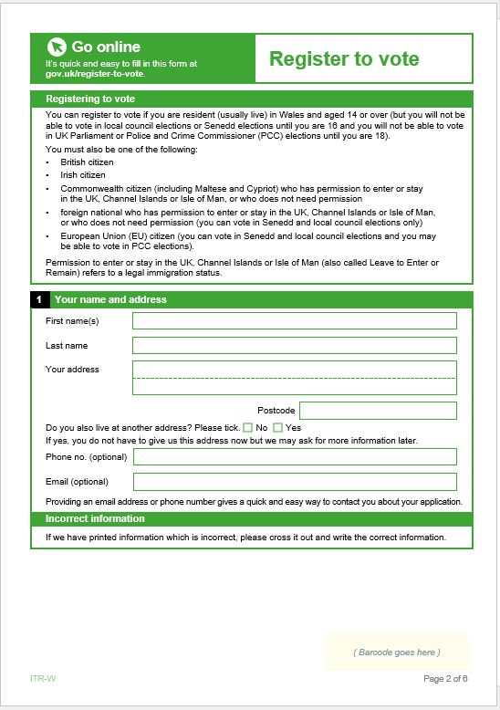
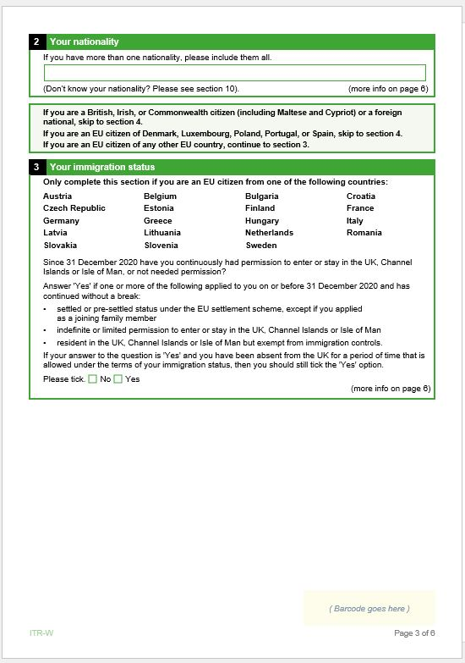
Example application form
Notes:
The form included is a placeholder. Make sure you replace the image with a copy of the form used locally.

Slide 31
Key messages when delivering the first ITR
Your vote matters. It is important that you complete the application to register so you don’t lose out.
Registering to vote is straightforward - you can register online, though, if you prefer, you can still complete and post back the completed application [add registration by phone/in person if offered].
Notes:
For a full set of key messages and FAQs, direct canvassers to the Doorstep script for canvasser visits.

Slide 32
Key messages when delivering ITRs during the reminder stage, speaking to non-responders
Registering to vote is straightforward – it only takes a few minutes, but you will need your National Insurance Number.
(the requirement does not apply to 14/15 year-olds.)
I have a form with me which I can help you complete now, or I can come back later to pick it up.
Notes:
If the canvasser is speaking to a parent or guardian of a 14-15 year-old, they should note that the requirement to provide a National Insurance Number does not apply to those aged 14 or 15, although 16 and 17 year-olds will be asked to provide it.
The message in the second box will need to be adapted if you have provided canvassers with electronic equipment to collect data on the doorstep.
For a full set of key messages and FAQs, direct canvassers to the Doorstep script for canvasser visits.
If they insist that they don’t want assistance/ a canvasser to collect the form, direct them to the www.gov.uk/register-to-vote website (and telephone number, if offered).

Slide 33
ITR - Information required (1)
Name
Make sure that you are speaking to the individual named on the form and that any pre-printed name is correct; applicant to make any changes where necessary
Address
Applicant to check pre-printed address is accurate and make corrections if necessary
The applicant should also indicate whether they live at another address
Notes:
Go through the application form in detail, ensuring that all staff have a copy of the form to refer to as you go through each section. This slide will need to be adapted if you are issuing canvassers with electronic equipment to collect information on the doorstep.
If completing the form on behalf of the applicant, write clearly in capital letters and get full names, not initials.

Slide 34
ITR - Information required (2)
Change of name / recently moved
Their previous name if it has changed
Their previous address if they have moved in the last 12 months
Other personal information
Date of birth
Nationality
National Insurance number
  Or reasons these cannot be provided
Notes:
Date of birth: not all potential electors will know their exact date of birth. If not known, they should use the date they use on official forms, etc. or explain on the form why they are unable to provide it.
Nationality: British, Irish, European, Commonwealth and qualifying foreign citizens resident have the right to register. Qualifying foreign citizens are those who do not require permission to enter or remain or have any type of permission to enter or remain (whether temporary or permanent). A list of eligible nationalities will be provided to you and you should keep this to hand at all times.
National Insurance Number: not all potential electors will know their National Insurance number, but most people will have one. Not knowing their NINo is not a good enough reason for a person not to provide it. There are a number of ways to find it: on official paperwork, such as National Insurance card, payslips or letters from the DWP or HMRC. There is also an HMRC enquiry service. Full details on how to find it are included in the Doorstep script for canvasser visits. If they don’t have a National Insurance Number, they need to explain on the form why they are unable to provide it. Note that 14 and 15 year-olds are not asked to provide a National Insurance number.

Slide 35
ITR - Information required (3)
Contact details
Not required, but very useful if we need to make contact about their registration
Other information
Whether they want to be included in the open register
Whether they wish to apply for a postal or proxy vote
Declaration
The form must include a declaration of truth made by the applicant
Notes:
Open register: there are two versions of the register – the full version, which is used for elections and the open version. The open register is an extract of the electoral register, but is not used for elections. It can be bought by any person, company or organisation. For example, it is used by businesses and charities to confirm name and address details. If people do not want their names to appear on the open register, they should indicate this on the form. They will appear on the full register, which is used for voting, credit and other crime prevention purposes.
Those aged 14 or 15 years old will not be included on the open register. They will be included on the electoral register, but only Electoral Registration Officers and their staff can usually see their details. The details of 14 and 15 year olds will not be included in any register that is published. About six weeks before an election certain people need details of everyone who can vote in that election. If a person will be 16 on the date of a Senedd election or local government election, their name and address will be given to people who run the elections, and to candidates who want to provide information to voters.
Postal /proxy voting: Anyone who would prefer to vote by post or proxy may request an application form by indicating this on the form.
Declaration: On a paper form, ask the applicant to sign to say that all the information provided is true. It is essential that the form is signed in this section by the applicant, or we will have to send it back to them for signature. Canvassers are not able to sign the form on behalf of the applicant. On the online form, the applicant will be asked to assent to a declaration of truth.

Slide 36
Using tablets / smartphones to collect identifiers and submit an application
[To be included if you are providing canvassers with electronic equipment to complete and submit applications directly via the https://www.gov.uk/register-to-vote website - to cover, for example: How should the equipment be operated? How to log in and keep passwords secure? What are your policies on canvassers using the equipment for other purposes?]
Notes:
Consider a practical demonstration to ensure canvassers are confident in operating any electronic equipment you have provided.

Slide 37
If you identify a new potential elector not on your list
Give a blank form and encourage the person to apply, explaining the various methods for registering available.
If not collecting the completed application on the doorstep, make a note of:
  their name
  email address (if they have one)
  the date the potential new elector has been identified
Notes:
Explain how potential new electors that have been identified by the canvasser should be logged and the information passed on to the office [this will trigger the formal issuing of an ITR if no application is received within 28 days]. Invitations to register can be sent via email. It is therefore helpful if canvassers are able to collect this information from potential electors on the doorstep.
Include information on your approach in the event that the new potential elector is aged 14 or 15 years old.

Slide 38
Health and safety
Notes:
Consider speaking to your H&S advisers when developing the contents of this section
Hand out copies of relevant local procedures

Slide 39
Lone working
We have a responsibility for your safety
Assess risks when visiting locations
Let someone know where you are going and what time you expect to be home
Take a mobile phone
Notes:
Canvassers also have a responsibility to maintain their safety – do not put yourself into positions where you feel this is threatened.
Provide information to canvassers on your Lone Worker Monitoring Scheme if applicable. Also advise canvassers to let people know where they are going and how long they expect to be out, and keep in contact with someone at home / work to let them know they are OK if they are running late.
Always carry and show identification to make it clear who you are representing and the purpose of your visit

Slide 40
Minimising risk
NEVER go into anyone’s house
Take care when carrying and lifting large quantities of forms
Walk away from verbal abuse or aggression
Beware of dogs and other animals
Keep any electronic equipment and other valuables secure
Report any incidents to your Ward Supervisor / the office
Notes:
As with any job, be aware of the possible risks, which can be significantly reduced by following some common sense rules:
Never go into anyone’s house. If a person needs assistance which you cannot give at the door, explain that you will pass this information on to the registration office to arrange a formal home visit.
Be careful lifting large quantities of forms – give a demonstration of the correct way to lift.
If you are subjected to verbal abuse or aggression, walk away. Never argue back or antagonise the situation in any way. Take a note of where the incident took place and report any incidents to your ward supervisor immediately.
Take extreme care entering a garden if there is a dog there, (even if it looks harmless). Be careful posting forms, in case there is a dog in the house. Use the flat of your hand to push an envelope through the letterbox, as dogs like to grab the forms and may take your fingers with them!
Make sure you close garden gates to prevent dogs escaping and to reduce the risk of complaints from householders.
Try not to canvass in the dark. It will be difficult to canvass during daylight at all times, but be aware that not everyone will answer their doors once it starts to get too dark. Also, don’t canvass too early in the morning – especially at the weekend.
If you have a mobile phone, take it with you so you can contact someone or be contacted at all times.
Take care to keep all valuable portable items from view when not in use e.g. iPads etc.

Slide 41
Data protection
Notes:
Consider liaising with your Data Protection advisers when developing the contents of this section
Current data protection legislation applies to the processing of ALL personal data.
The ERO is the data controller.
Forms used will contain appropriate data protection messaging.
The canvasser is the data collector.
Hand out copies of any relevant local procedures

Slide 42
Security of personal information (1)
  Responsible for forms and personal information in your care
  Personal data must be kept safe from unauthorised access, accidental loss or destruction.
  Instances of unauthorised access, loss or destruction must be immediately communicated to your supervisor.
Notes:
Personal information is defined as:
Information relating to a living individual or identifiable individual
It can be held in electronic or paper filing systems (i.e. structured paper records)
Emphasise the importance of keeping all the personal data secure in light of current data protection legislation.
Strongly emphasise the importance of ensure data relating to 14/15 year olds is secure.

Slide 43
Security of personal information (2)
[Cover local security measures, e.g. use of lockable cases / satchels for carrying forms – don’t carry more forms than you can fit into the secure case/satchel, etc.].
[Completed forms must be delivered to the office by X, within X hours/days].
[If providing canvassers with a smartphone or tablet to access https://www.gov.uk/register-to-vote: the application must be submitted directly and not stored on the device]
Notes:
Customise this form with specific local processes.
Emphasise that the canvasser is responsible for any personal information collected and that it must be kept safe – for example forms need to be stored securely and must never be left in vehicles overnight.

Slide 44
Collecting personal data on the doorstep (1)
Always wear and show your official identification to the elector
Be aware of other people around you and take precautions so that nobody else can overhear any personal information you are collecting
Notes:
Emphasise again the importance of keeping any personal information collected from electors safe.
If completing an application on the doorstep, when they collect the personal details required for an application they must be sure that any passers-by cannot overhear any personal information.

Slide 45
Collecting personal data on the doorstep (2)
When collecting information on a CF, make sure you are speaking to a member of the household (or landlord)
When collecting information on an ITR, make sure you are speaking to the relevant individual
  Not there? Do not share personal information, even with spouses or family members

Slide 46
Putting it into practice
Notes:
Checking that the training given is effective
Consider using a short quiz on canvass forms, ITRs, health and safety, and data protection
Consider using role play, for example:
Asking canvassers to practice completing a canvass form and an ITR
If you are using electronic devices, practice using these to complete the canvass form/ITR
Splitting the canvassers into pairs and asking one of them to play the role of a canvasser and the other someone from a household who has not responded to the canvass
Ask those pairs to play out a scenario where someone does not want to complete the canvass or does not understand why they need to complete an ITR

Slide 47
Contacts

Slide 48
Out of hours contacts
Between xpm and xpm on weekdays and xam and xpm Saturday/Sunday there will be a contact number available for queries. [01234 567890]
This number will be staffed by office staff; we advise that you restrict your working hours to match these
Members of the public can also call this number to check that you are working on behalf of the ERO
Notes:
Mention the types of queries you will be able to deal with outside of office hours e.g.
register checks (if office is going to be staffed)
queries about registration
verification of canvasser details

Slide 49
Area supervisors
Please note your area supervisor
  Canvass area 1-4
    Contact John Smith 01234 567891
  Canvass area 5-8
    Contact Jack Brown 01234 567892
  Canvass area 9-13
    Contact Jane Black 01234 567893
These people are your first contact in case of query and they be will contacting you during the canvass period to check your progress
Notes:
Highlight the people supervising each area – have them attend the briefing if possible so that people can meet them.

Slide 50
Questions?
Notes:
Provide opportunity for canvassers to ask questions to clarify any of the information provided.

